Slide 1
Visualizing Dispossession Envisioning Land Back

Slide 2
“Indigenous Lands Dispossession In Wisconsin and Beyond Education” Modules
“The University of Wisconsin, established in 1848 and designated a land grant university through the Morrill Act of 1862” continues to benefit from Indigenous lands
These educational materials allow readers to learn about “the Morrill Act of 1862 in Wisconsin, the impact of the land grant system and dispossession on tribal nations across the state, and the ways the Morrill Act was part of a larger policy initiative aimed at shifting lands across the US from tribal hands to settler control.”
From “Indigenous Lands Dispossession In Wisconsin and Beyond Education Modules” introduction

Slide 3
Goals
Deconstruct archival mapping sources to understand how dispossession manifests through representations and erasures of Indigeneity and/or sovereignty.(Past)
Assemble/Reassemble archival material to visualize alternatives to colonial representations of the landscape. (Present)
Reflect upon how the processes of deconstruction and reassembly could contribute to dialogues about Indigenous land return. (Future)
Deliverable: Documentation of process using a provided slideshow template.

Slide 4
Grounding

Slide 5
Settler Colonialism
“Complex social processes in which at least one society seeks to move permanently onto the terrestrial, aquatic, and aerial places lived in by one or more other societies who derive economic vitality, cultural flourishing, and political self-determination from the relationships they have established with the plants, animals, physical entities, and ecosystems of those places.”
Kyle Powys Whyte (Citizen Potawatomi)
From “The Dakota Access Pipeline, Environmental Injustice, and U.S. Colonialism” (2017)
Notes:
Kasey

Slide 6
Indigenous Dispossession
Settler colonialism functions through the dispossession of Indigenous people from their homelands.
In a settler-colonial society, dispossession is not a one-time event. Rather it is a structure that continually reproduces dispossession.
Notes:
Caroline

Slide 7
Dispossession in the Upper Midwest
Treaties and Removal
  Ceded lands and established reservations
  1832 Treaty with the Ho-Chunk
Land Transfer Legislation
  Morrill Act, Homestead Act, Pacific Railways Act, Swamp Lands Act.
    Provided “public” lands to settlers and institutions.
  Dawes Act (1887)
    Allotted (subdivided) reservations into individual parcels. Enabled outside interests to more easily acquire land on reservations.
The vast majority of transferred lands are still held by settlers
Notes:
Joe

Slide 8
Tribal Sovereignty
The ability for Tribal Nations to govern themselves without outside interference.
Notes:
Caroline

Slide 9
Archival Investigations and Group Formation

Slide 10
Archives
There are 7 archival sources located throughout the room.
Each includes:
  Description
  Physical copies of archival materials
  Digital repositories
Each archive centers a particular time period with a particular thematic focus.
For the next 50 minutes, we’re going to spend time with each archive (about 7 minutes each).
At the end, we’ll form groups based on which archive you found most interesting.

Slide 11
Archive Questions
As you investigate the archival material, consider the following questions:
What is the focus of the archive?
What strikes you about the way the archive represents the landscape?
What questions could you ask of the archive?
Note: if you are interested in a place not included in the physical copies, you can use the digital repositories to find it after group formation.

Slide 12
Group Formation
Which archive were you drawn to the most?

Slide 13
Unit 1: Past
Deconstructing Dispossession in the Archives
Notes:
Structure our thinking through time
Begin by critically reading and deconstructing what is present in your chosen archives
This could be discussion, reflection, but also manipulating some of the visual materials
Give brief background on some conceptual foundations that are common throughout these archives

Slide 14
Surveying & Dispossession
The selected archives are largely built upon the same foundation: the survey.
Surveying is the practice of precisely measuring points across the Earth’s surface.
Surveying also represents an ideological transformation, from land into property.
As Indigenous lands were violently acquired by the U.S., they were surveyed before formal settlement occurred.
In Wisconsin, and much of the western U.S., the Public Land Survey System (PLSS) was the formal surveying system used to define property.
Designed to facilitate fast and efficient distribution of land.
Notes:
Archives are generally built upon the same foundation: the survey
Surveying is the practice of precisely measuring points across the Earth’s surface
Long history, but particularly important for the settler colonization of the U.S.
Surveying represents a particular relationship to the land, and in particular the transformation of land as something held in common to something privately owned
Property regimes require precise measurements to define what property is so it can be appropriately valued
As land in the U.S. was violently acquired from Tribal Nations throughout the 1800s, it had to be surveyed before it could officially become property
Messy, nonlinear process! Including “illegal” squatting
For the most of the Western U.S., the Public Land Survey System was the method of defining land
You’re going to evidence of the PLSS throughout these archives—want to provide some conceptual foundation

Slide 15
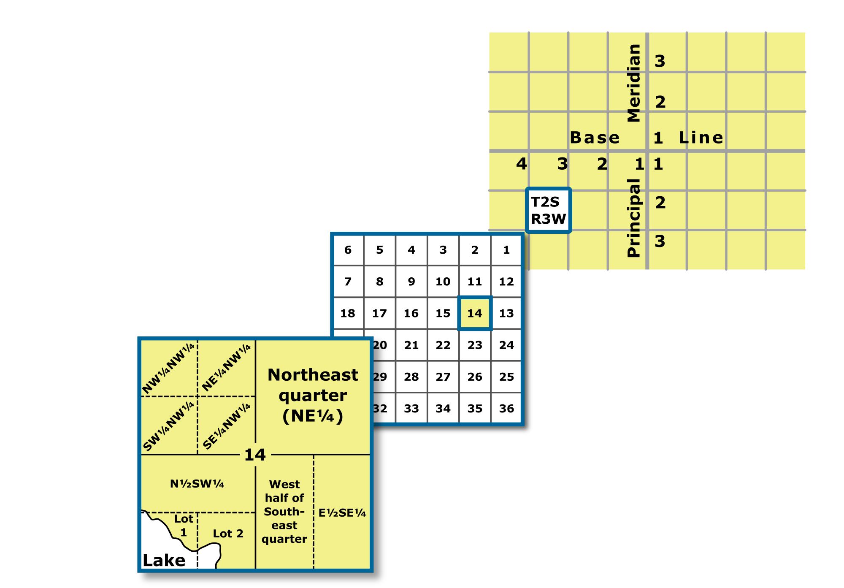
PLSS
Created by the Land Ordinance of 1785 to create standard surveying practices in the expanding territory of the U.S.
Systematic way of describing land based on defined “meridians” and “baselines”
Divided land in 6x6 mile townships, further divided into 1x1 mile sections
¼ Section = 160 acres
Graphic from Wikimedia
Notes:
PLSS was created through the Land Ordinance of 1785
Designed to standardize the practices of surveying and measurement in the expanding U.S.
Systematic way of describing land related to “meridians” which go north and south, and “baselines” which go east and west
Specifics not too important—a number of these lines criss-cross the U.S.
From the intersections of these lines, there were 6x6 mile squares called townships, which were further divided into 1 square mile sections
Section divisions form the basis of a lot of land transfer legislation. The Homestead Act, for example, offered 160 acres of land to settlers

Slide 16
The PLSS facilitated the transfer of land to settlers and transformed land into property.

Slide 17
Module 1: Deconstruct Dispossession in the Archives
What does this archive emphasize about the landscape?
What aspects of the landscape relevant to this archive are not represented?
What processes of dispossession are present in this archive?
How are (or are not) Indigenous people present in this archive?
How is your interpretation of these archival materials informed by your positionality?

Slide 18
Unit 2: Present
Reassembling Alternative Visualizations of the Landscape
Notes:
Now, we’re going to focus more explicitly on constructing new geographic imaginaries, with particular attention on the present landscape

Slide 19
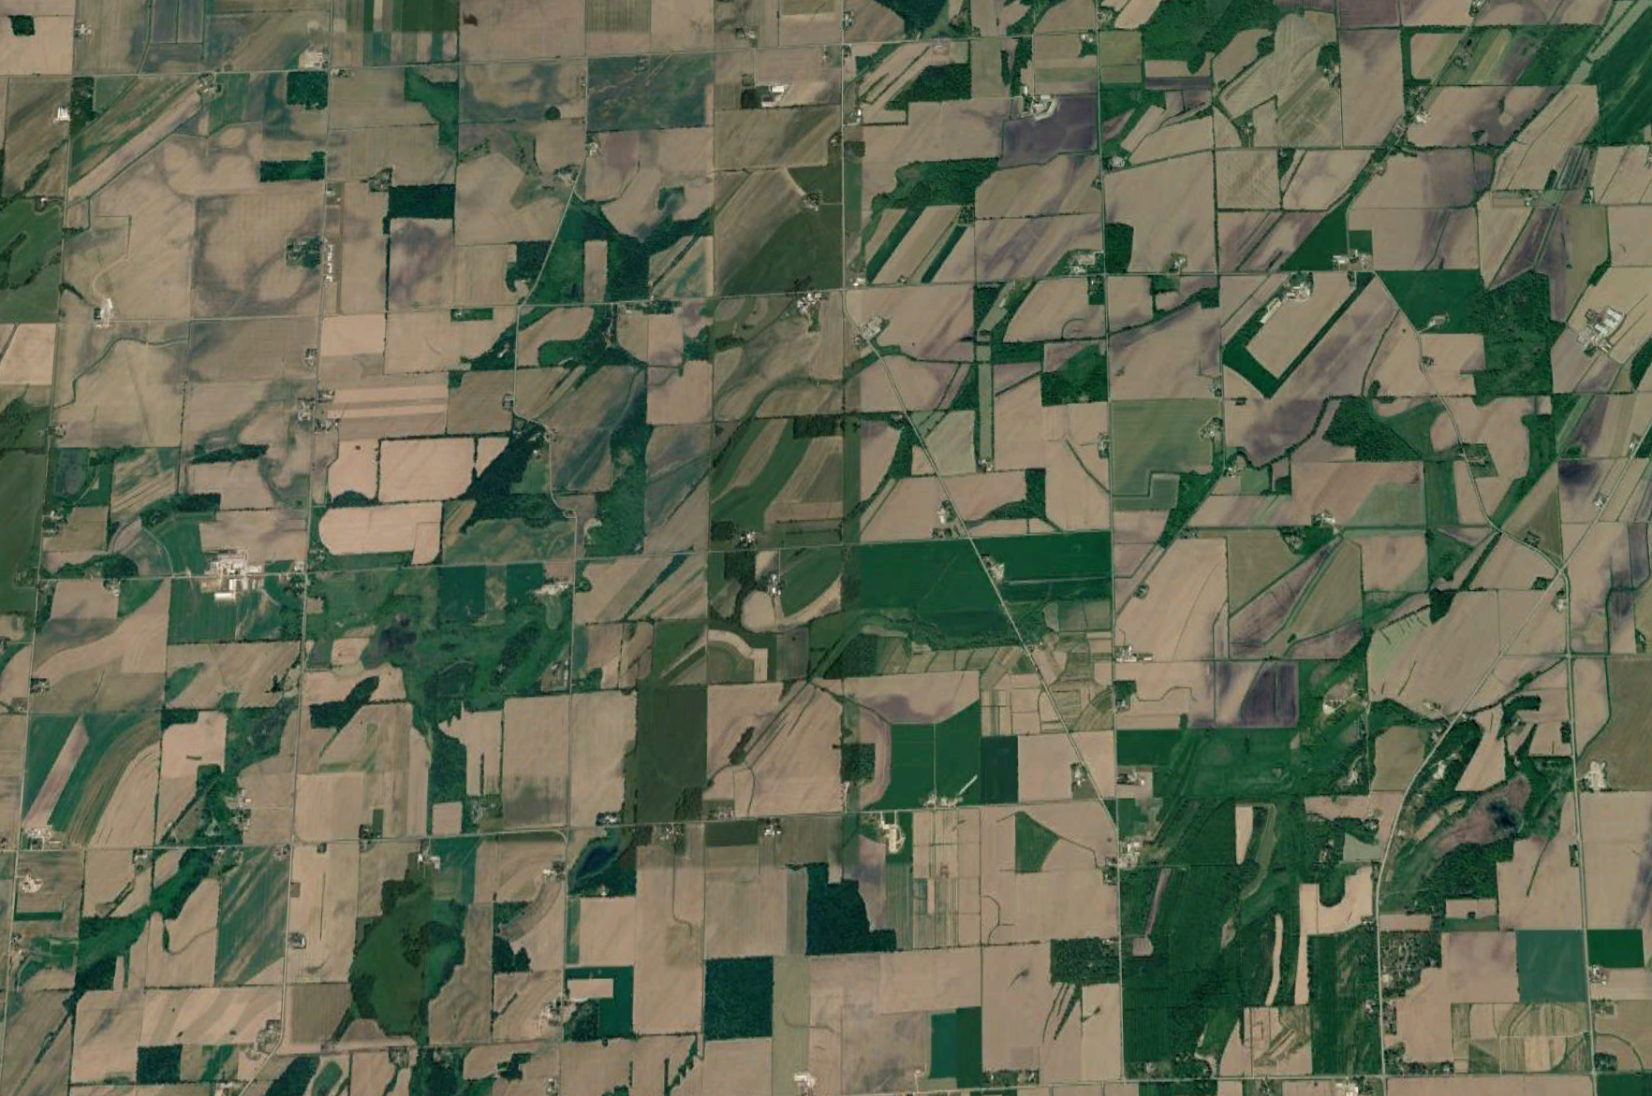
Maps & Modern Property
Today, the PLSS is still used to describe property.
  Property data are typically managed by city or county governments.
  These data are used for the purposes of management and governance.
Property has transformed landscapes.
How could we envision alternatives?
Notes:
The PLSS is still used to describe property
Most property data today are managed by city and county governments
Property regimes have transformed our landscapes and shaped space across the country in particular ways.
How can we assemble these archives to envision alternatives conceptions of the landscape

Slide 20
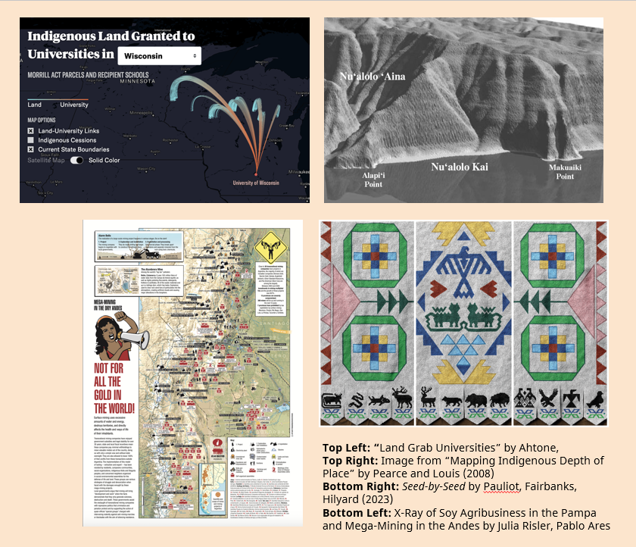
Counter-Mapping
The use of mapping to challenge power structures and open possibilities to new ways of thinking.
Methods… limitless!
  Layering, storying, collaging, reimagining, and many, many more.
Notes:
Counter-mapping is the use of mapping to challenge dominant power structures to and open possibilities to new ways of thinking
A few examples to illustrate the breadth of counter-maps
Including more traditional cartographic representation centered around a critical theme (land grab universities and not for all the gold in the world) designed to hold power to account. Whether its how universities have profited from Indigenous land, or how major agribusiness and mining projects have proliferated in Argentina/Paraguay, these projects use mapping creatively and strategically to challenge power.
Two examples on the right are examples of mapping from Indigenous perspectives (Kanaka Maoli/Native Hawaiian on the top, Ho-Chunk on the bottom). The top map disrupts the top-down orthographic perspective common to Western Cartography to capture the perspective of someone on a boat, approaching this particular bit of shoreline. The bottom example is a project called Seed-by-Seed, which sometimes hangs outside Bascom Hall, and portrays Teejop, or Madison, from a Ho-Chunk perspective. Including the four lakes, which are shown in green, containing colors that represent various colors throughout the season

Slide 21
Module 2: Reassemble Alternative Visualizations
What additional context could be provided to help explain how these archival materials relate to dispossession?
How could you deemphasize the grid, both visually and conceptually?
What additional layers could be added to these archival materials to disrupt conceptions of ownership and property?
How could this archive could be reimagined/recreated to center Indigenous people?
What are the limitations of mapping regarding dispossession and what alternative conceptions of the landscape are possible to disrupt or reimagine these limitations?

Slide 22
Unit 3: Future
Reflecting on Visualizations for Land Back
Notes:
In this last section, we move our focus to the future, and how we might use visualization to envision alternative futures that involve returning land to Indigenous communities

Slide 23
Land Back
The return of ancestral lands to their rightful Indigenous owners/stewards.
  The ability to manage land as Sovereign Nations.
In part, a form of legally holding the U.S. Government accountable to their treaty obligations, as well as the beneficiaries of dispossession.
  Such as universities, railways, logging companies, etc.
Notes:
Land Back, put simply, is the return of ancestral lands to their rightful Indigenous owners/stewards, as well as the enforcement of their ability to manage land as sovereign nations
In part, this can involve holding the U.S. government accountable to their treaty obligations, which were often violated, as well as potential beneficiaries to dispossession
But land back is also broader than just honoring treaty obligations

Slide 24
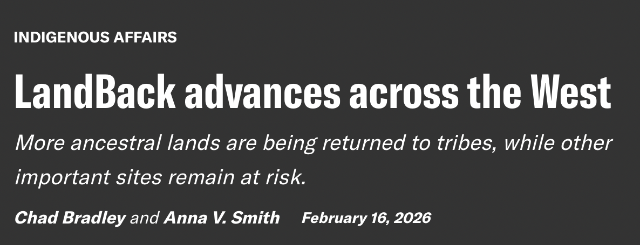
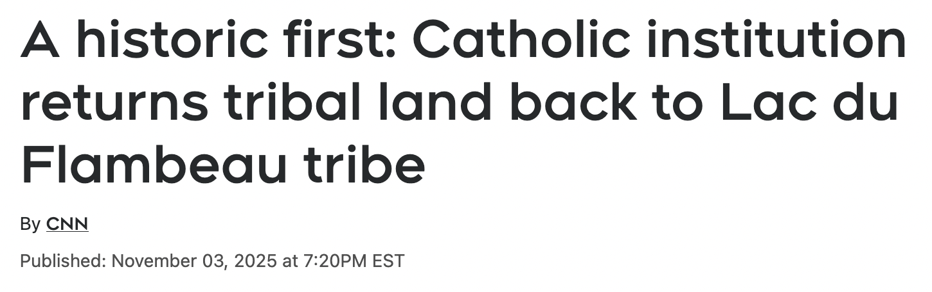
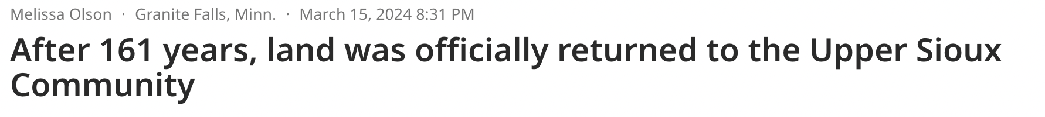
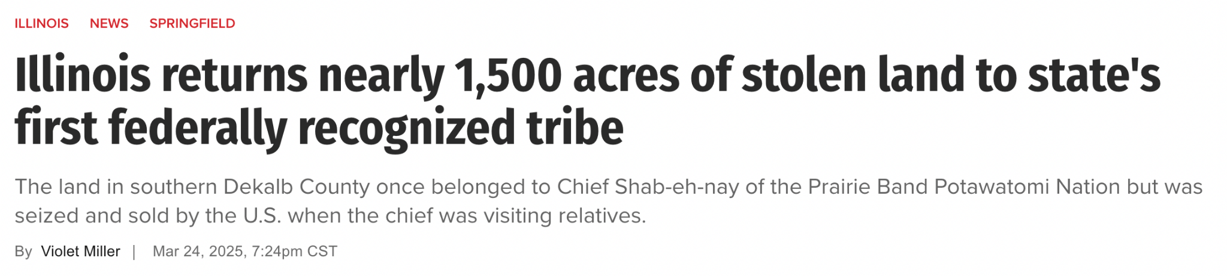

Slide 25
Module 3: Reflecting on Visualizations for Land Return
How does your reassembled map reimagine the landscape and how does this new understanding of space support Land Back?
How could you use your reassembled map to create productive dialogue towards Land Back?
How could the reassembled map be used to hold beneficiaries of dispossession accountable?
What are the continued limitations of mapping to support Indigenous Land Back, and how could your reassembled map acknowledge these limitations?
How can you more fully consider Indigenous people and thinking in all of your work going forward?

