Slide 1
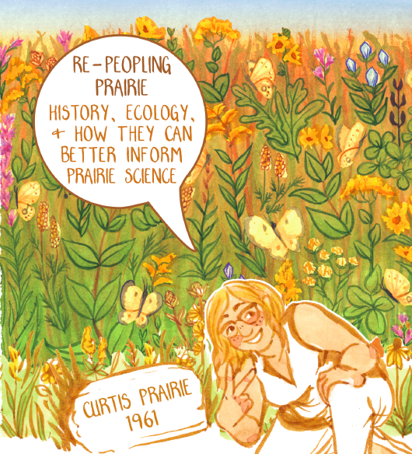
Prairies, Ecologies, and Indigenous Land Dispossession: Site Histories and How To Do Them
“Whose Land Was Granted?”
An educational module funded by the National Endowment for the Humanities

Slide 2
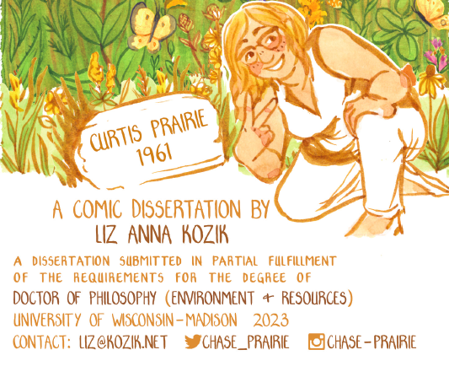
What this Site History Research Module Does
This module is designed to guide the process of conducting a site history. The module draws from the brilliant work of Liz Kozik and her dissertation. Ruth Goldstein (ruth.goldstein@wisc.edu) prepared text and the slides.

Slide 3
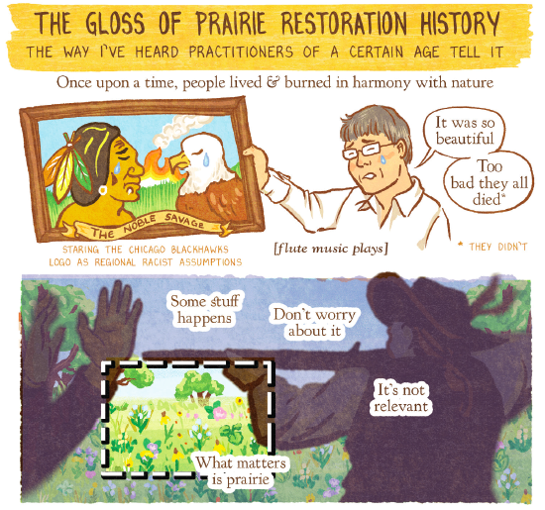
Some Background
What is site history and how does it relate to Indigenous Land Expropriation?
Well, it has to do with perceptions of “nature” and a particular framing (so to speak) of history.
Prairie in the Midwest is part of this story, much of which has gone untold.

Slide 4
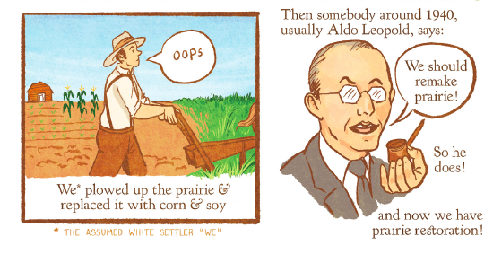

Slide 5
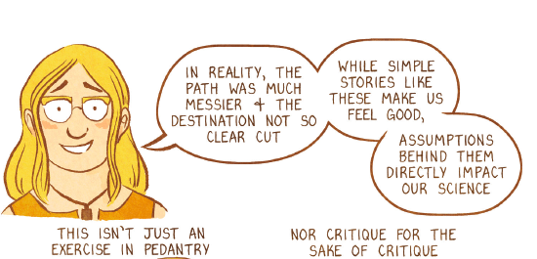
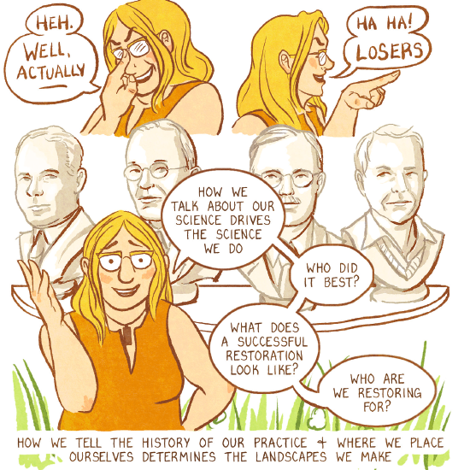

- Words matter for the science that people do. After all, what is scientific objectivity but a human conception?
- Prairie restoration participates in Indigenous Land Expropriation because it fails (most often) to acknowledge who inhabited the land before settler colonialism.

Slide 6
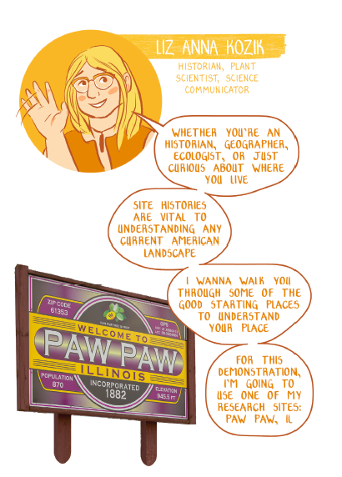
Site Histories
Why they matter and how to do them!
Follow along with this case study in Illinois

Slide 7
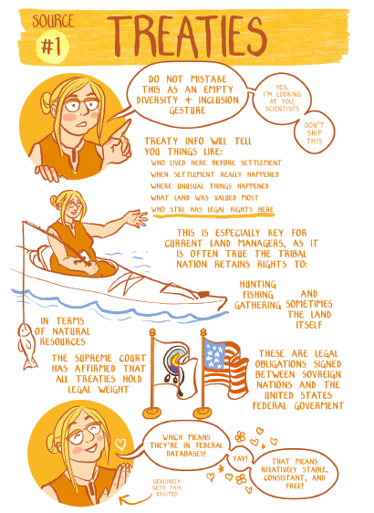
Treaties
- The history of treaties (and how the United States broke them) is a troubling one.
- While there are many Native American tribes in the United States, they are not recognized unless they signed a treaty with the United States government.
- It’s important to think about why some people didn’t want to do sign anything with a government that had designs on genocide and land expropriation.

Slide 8
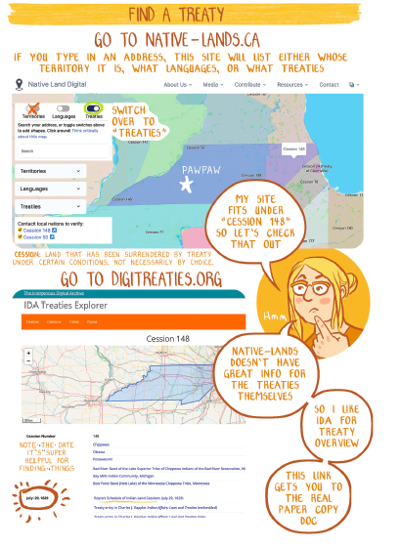
Find a Treaty!
Once you know where you want to do your site history, then you can find a treaty.

Slide 9
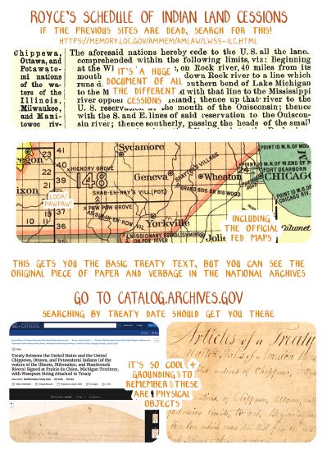
The Archives
This can take some time, but it’s worth the time digging.

Slide 10
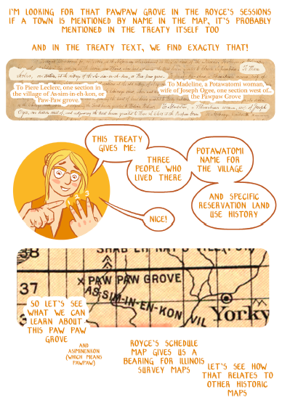

Slide 11
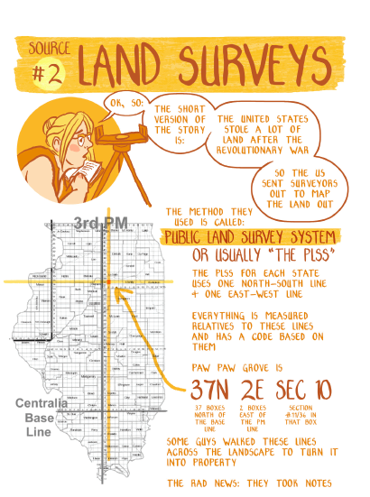
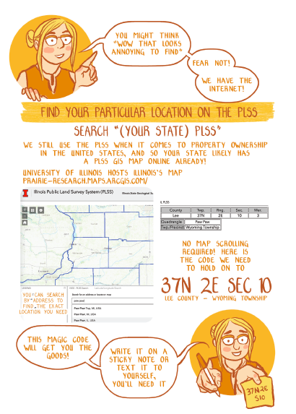
Your next step is to check out Land Surveys

Slide 12
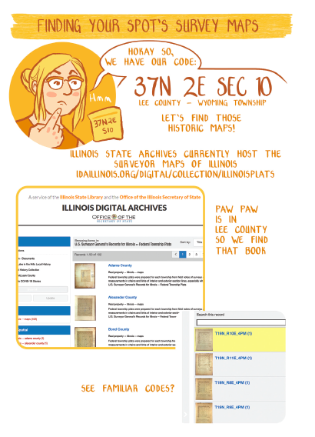
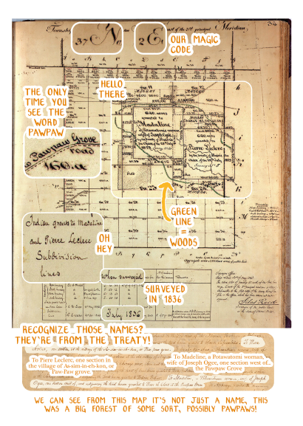

Slide 13
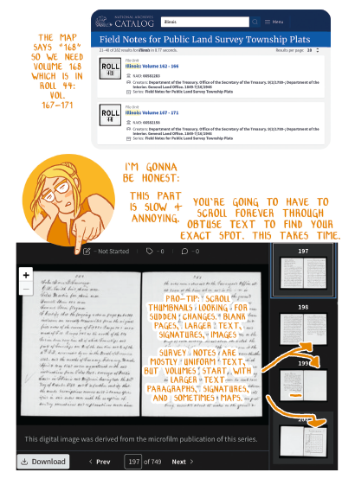
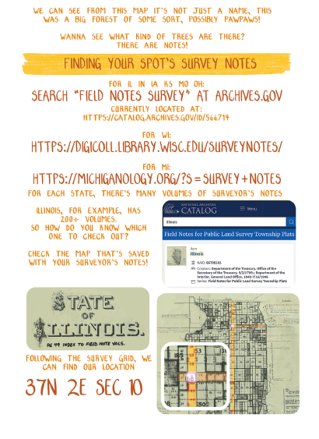

Slide 14
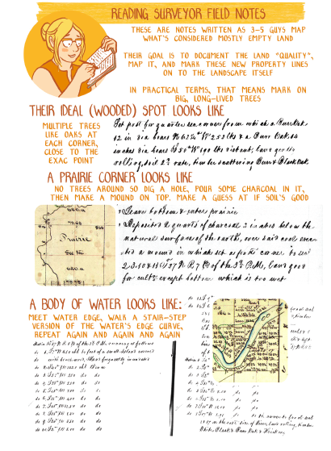
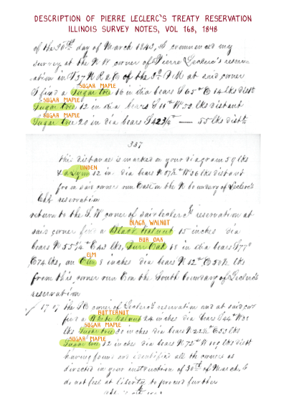

Slide 15
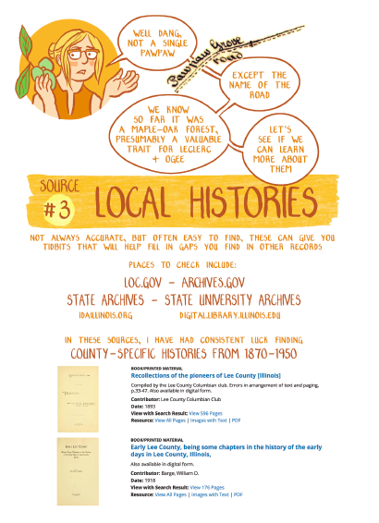
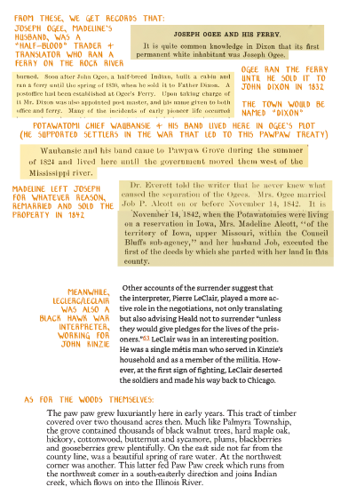

Slide 16
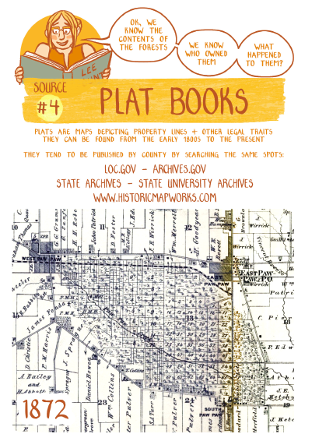
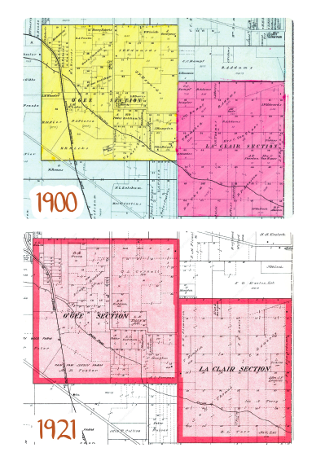

Slide 17
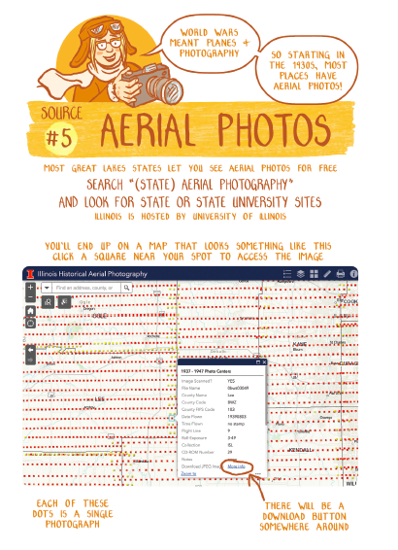
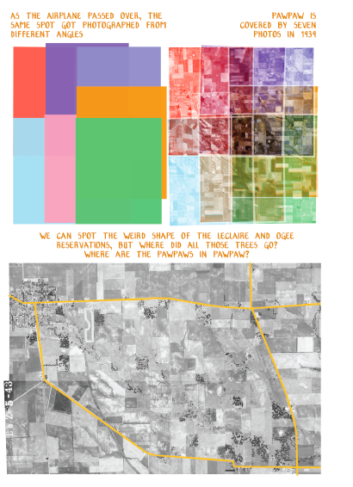

Slide 18
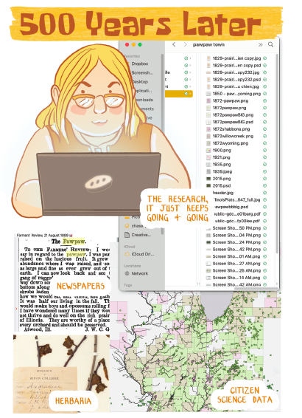
What did you find?
- Are there histories to a particular site, maybe even a place you call home, that has a treaty history attached to it?
- What surprised you about this process of conducting a site history?
- Whether prairie or not, what does ecological restoration mean to you and has it changed since conducting this site history?

Slide 19
