Slide 1

Dams as Dispossession
Cover image: Dammed: The Politics of Loss and Survival in Anishinaabe Territory
by Brittany Luby, University of Manitoba Press (2020)
Whose Land was "Granted to the Land Grant?"
Funded by the National Endowment for the Humanities
prepared by Caroline Gottschalk
Vilas Distinguished Achievement Professor of English
University of Wisconsin-Madison

Slide 2
Dams as Dispossession
As the Morrill Act and related 1860s legislation worked to "open" the Midwest to resource extraction, the pine tree trade depended on harnessing water power to transport and process lumber. This module examines the historic and contemporary impacts of dam building on white settlement, Treaty rights, and Native sovereignty, and introduces forms of Native resistance to dams and dispossession.

Slide 3
Learning Outcomes
By the end of this module, students will:
Understand the role of dam building in white settlement and Indigenous dispossession in Wisconsin and the Great Lakes
Evaluate the impacts of dam building on Treaty rights and Native sovereignty in Wisconsin and the Great Lakes
Recognize various forms of Native resistance to dams and dispossession in Wisconsin and the Great Lakes
Produce original syntheses that highlight the roles of dams and Indigenous resistance in Wisconsin and the Great Lakes

Slide 4
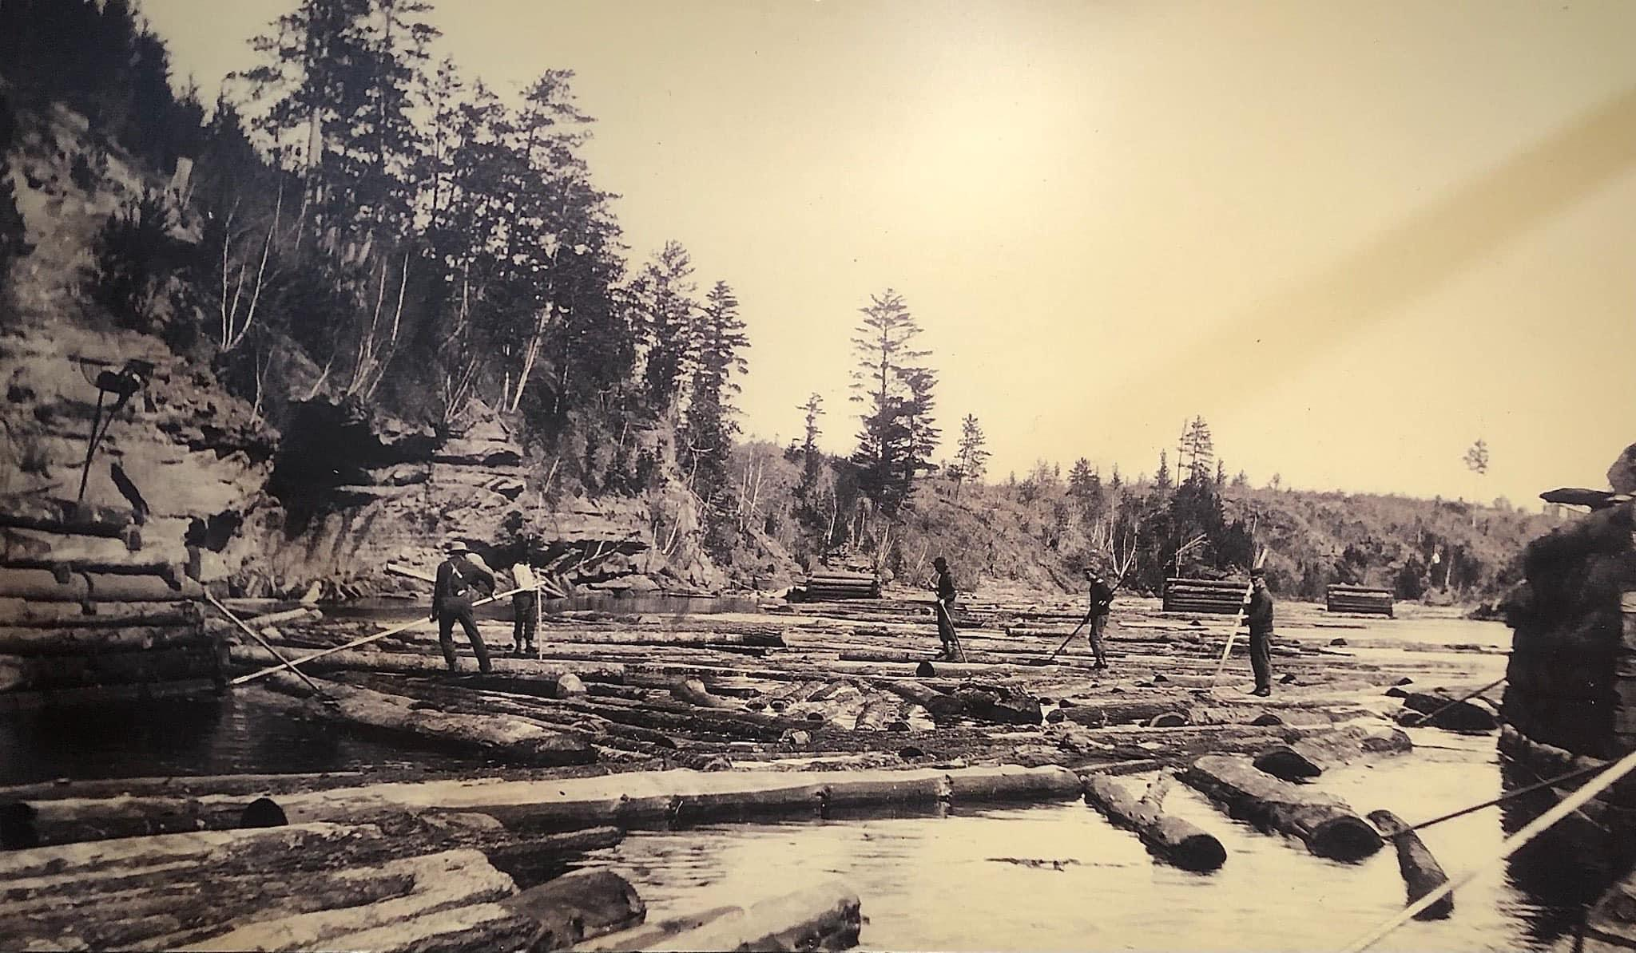
Week One, Day One:
Pines, Rivers, and Dams
Credit: Chippewa Area History Center

Slide 5
Prep for class today:
Watch:
  "When the White Pine was King: A History of Lumberjacks, Log Drives, and Sawdust Cities in Wisconsin" with Jerry Apps (first 38 mins.)
Read:
  Fries, R. F. (1942). "The Founding of the Lumber Industry in Wisconsin." The Wisconsin Magazine of History, p. 23-35.
  "Logging and Lumbering on the Wisconsin River." (2022). The Historical Marker Database.
Write:
  Major points from each text and video
  Some discussion questions to bring to class

Slide 6
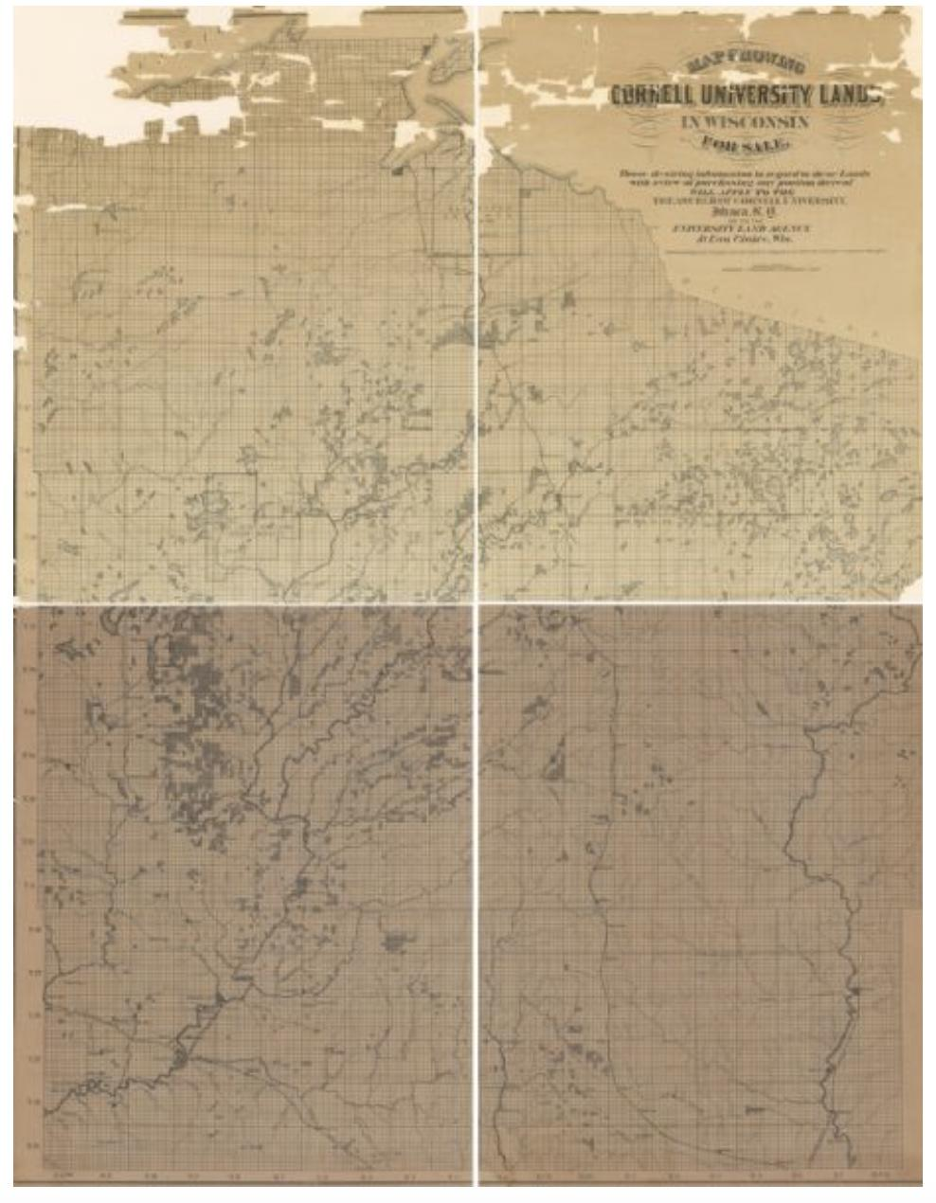
Connection to the
Morrill Act:
Much of this land was sold for logging, then re-sold or defaulted to the County, State, or Federal government through non-payment of taxes
Silas Chapman, “Map Showing Cornell University Lands in Wisconsin for Sale” (1877), Wisconsin Historical Society
Credit: landgrabu.org

Slide 7

Getting Started (20 m.)
Take a few minutes to look back at homework notes (3 min.)

Slide 8
Getting Started (20 m.)
Take a few minutes to look back at homework notes (3 min.)
Get into small groups of three (7 min.)
  compare notes and questions about the Apps video ("When White Pine was King", the Fries reading ("The Founding of the Lumber Industry in Wisconsin"), and the web page ("Logging and Lumbering on the Wisconsin River")
  prepare some big ideas to share with the group

Slide 9
Getting Started (20 m.)
Take a few minutes to look back at homework notes (3 min.)
Get into small groups of three (7 min.)
  compare notes and questions about the Apps video ("When White Pine was King", the Fries reading ("The Founding of the Lumber Industry in Wisconsin"), and the web page ("Logging and Lumbering on the Wisconsin River")
  prepare some big ideas to share with the group
Large group discussion (7 min.)
  First impressions?
  What seems important to cover today?

Slide 10
What Stories Get Told about Wisconsin Logging? (15 m.)
Large group discussion (take notes on board):
  What stories have you heard about the history of lumbering in Wisconsin? (3 min.)

Slide 11
What Stories Get Told about Wisconsin Logging? (15 m.)
Large group discussion (take notes on board):
  What stories have you heard about the history of lumbering in Wisconsin? (3 min.)
  What are the stories that circulate in the texts from homework? (7 min.)

Slide 12
What Stories Get Told about Wisconsin Logging? (15 m.)
Large group discussion (take notes on board):
  What stories have you heard about the history of lumbering in Wisconsin? (3 min.)
  What are the stories that circulate in the texts from homework? (7 min.)
  Point to quotes and examples from the homework that support your understanding of these stories (7 min.)

Slide 13
Group Activity: Life in a Lumbercamp (20 m.)
Use Wisconsin Historical Society "Life in a Lumber Camp" activity to integrate primary sources about Wisconsin lumber camps
Play "The Lumbercamp Song" to support the lesson

Slide 14
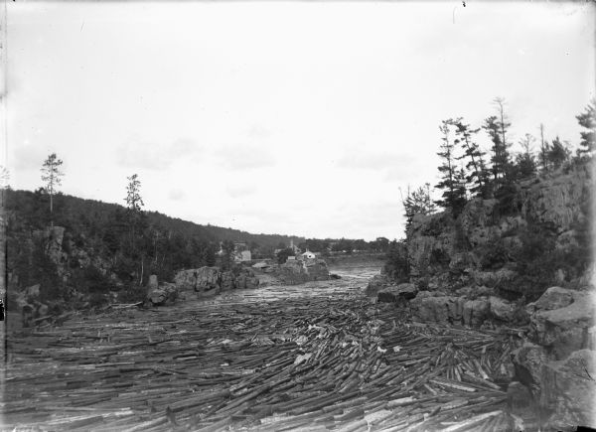
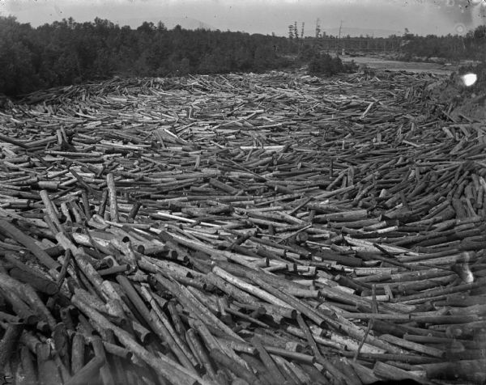
What Role did Dams & Rivers Play in Logging? (10 m.)
Rivers served as superhighways for cut pines, carrying lumber downstream to mills
Wisconsin River at Lone Rock, 1907
Credit: Wisconsin Historical Society
Wisconsin Log Jam, 1895
Credit: Wisconsin Historical Society

Slide 15
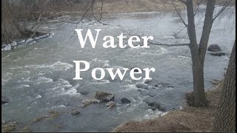
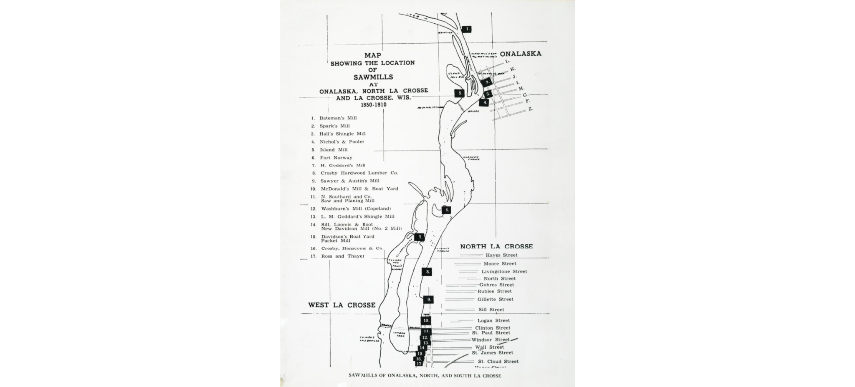
What Role did Dams & Rivers Play in Logging? (10 m.)
Downstream lumber mills relied on water power from dammed rivers
"Water Power" by Sauk County Historical Society (6 m.)
Credit: UW-Madison Libraries

Slide 16
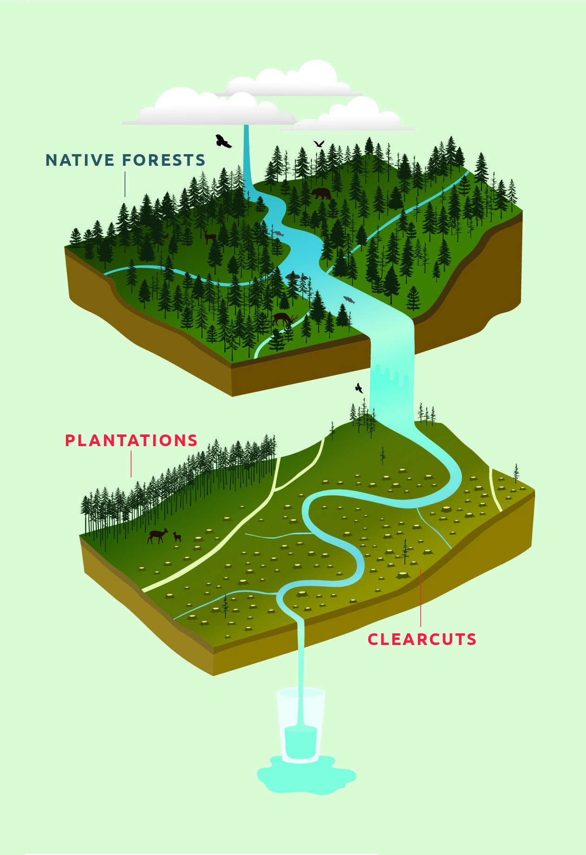
What Role did Dams & Rivers Play in Logging? (10 m.)
These log drives and dams had major effects on Wisconsin's rivers:
  eroding river banks
  transporting sediment into streams
  blanketing rocky aquatic habitat with sediment
  increasing water temperatures
  blocking fish species from migrating upstream
  extirpating some species entirely (e.g. Arctic grayling)
  eliminating wetland habitat
  slowing river flow and impounding water
Credit: GreenOregon.org

Slide 17
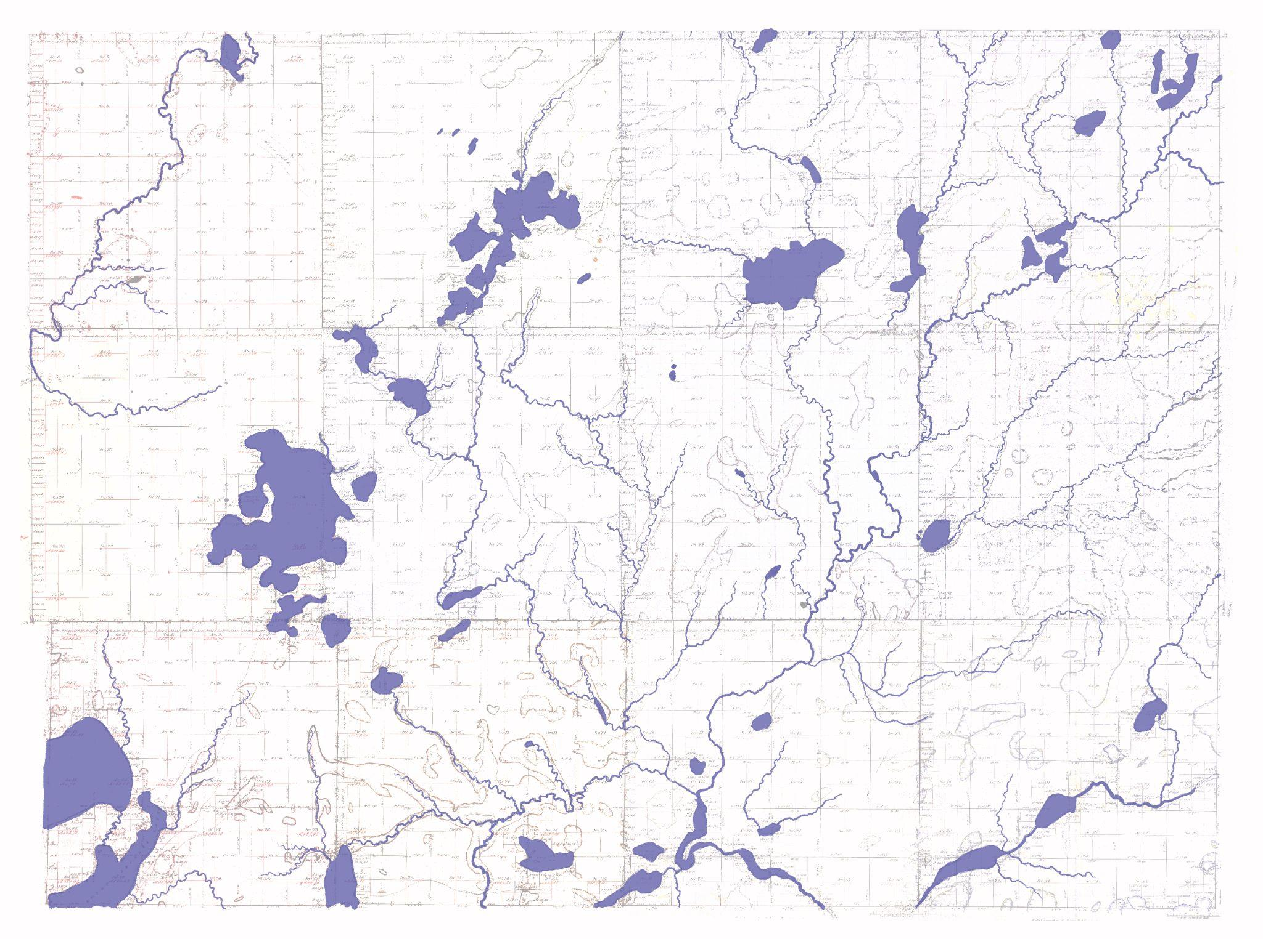
Sawyer County,
Wisconsin
waterways
1857
Credit:
Liz Anna Kozik

Slide 18
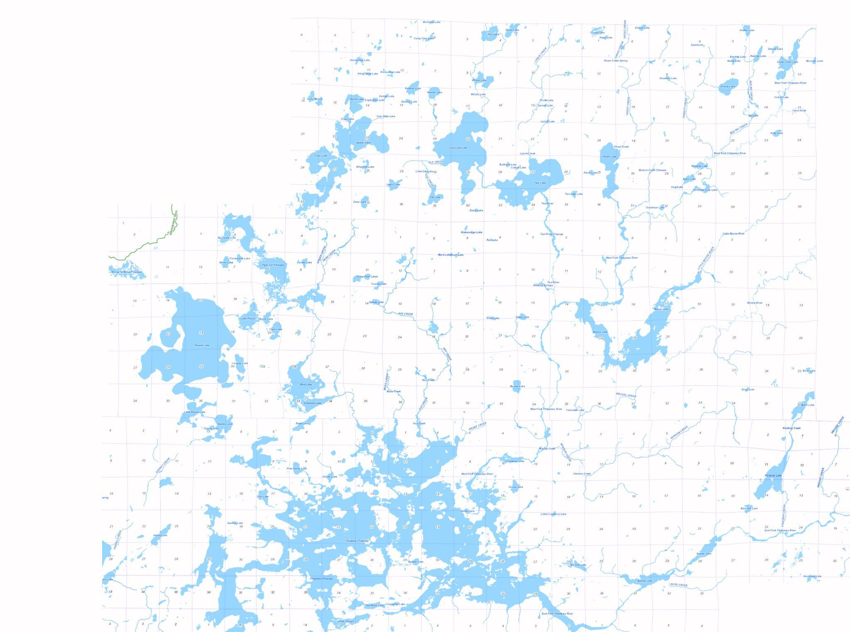
Sawyer County,
Wisconsin
waterways
2022
Credit:
Liz Anna Kozik

Slide 19
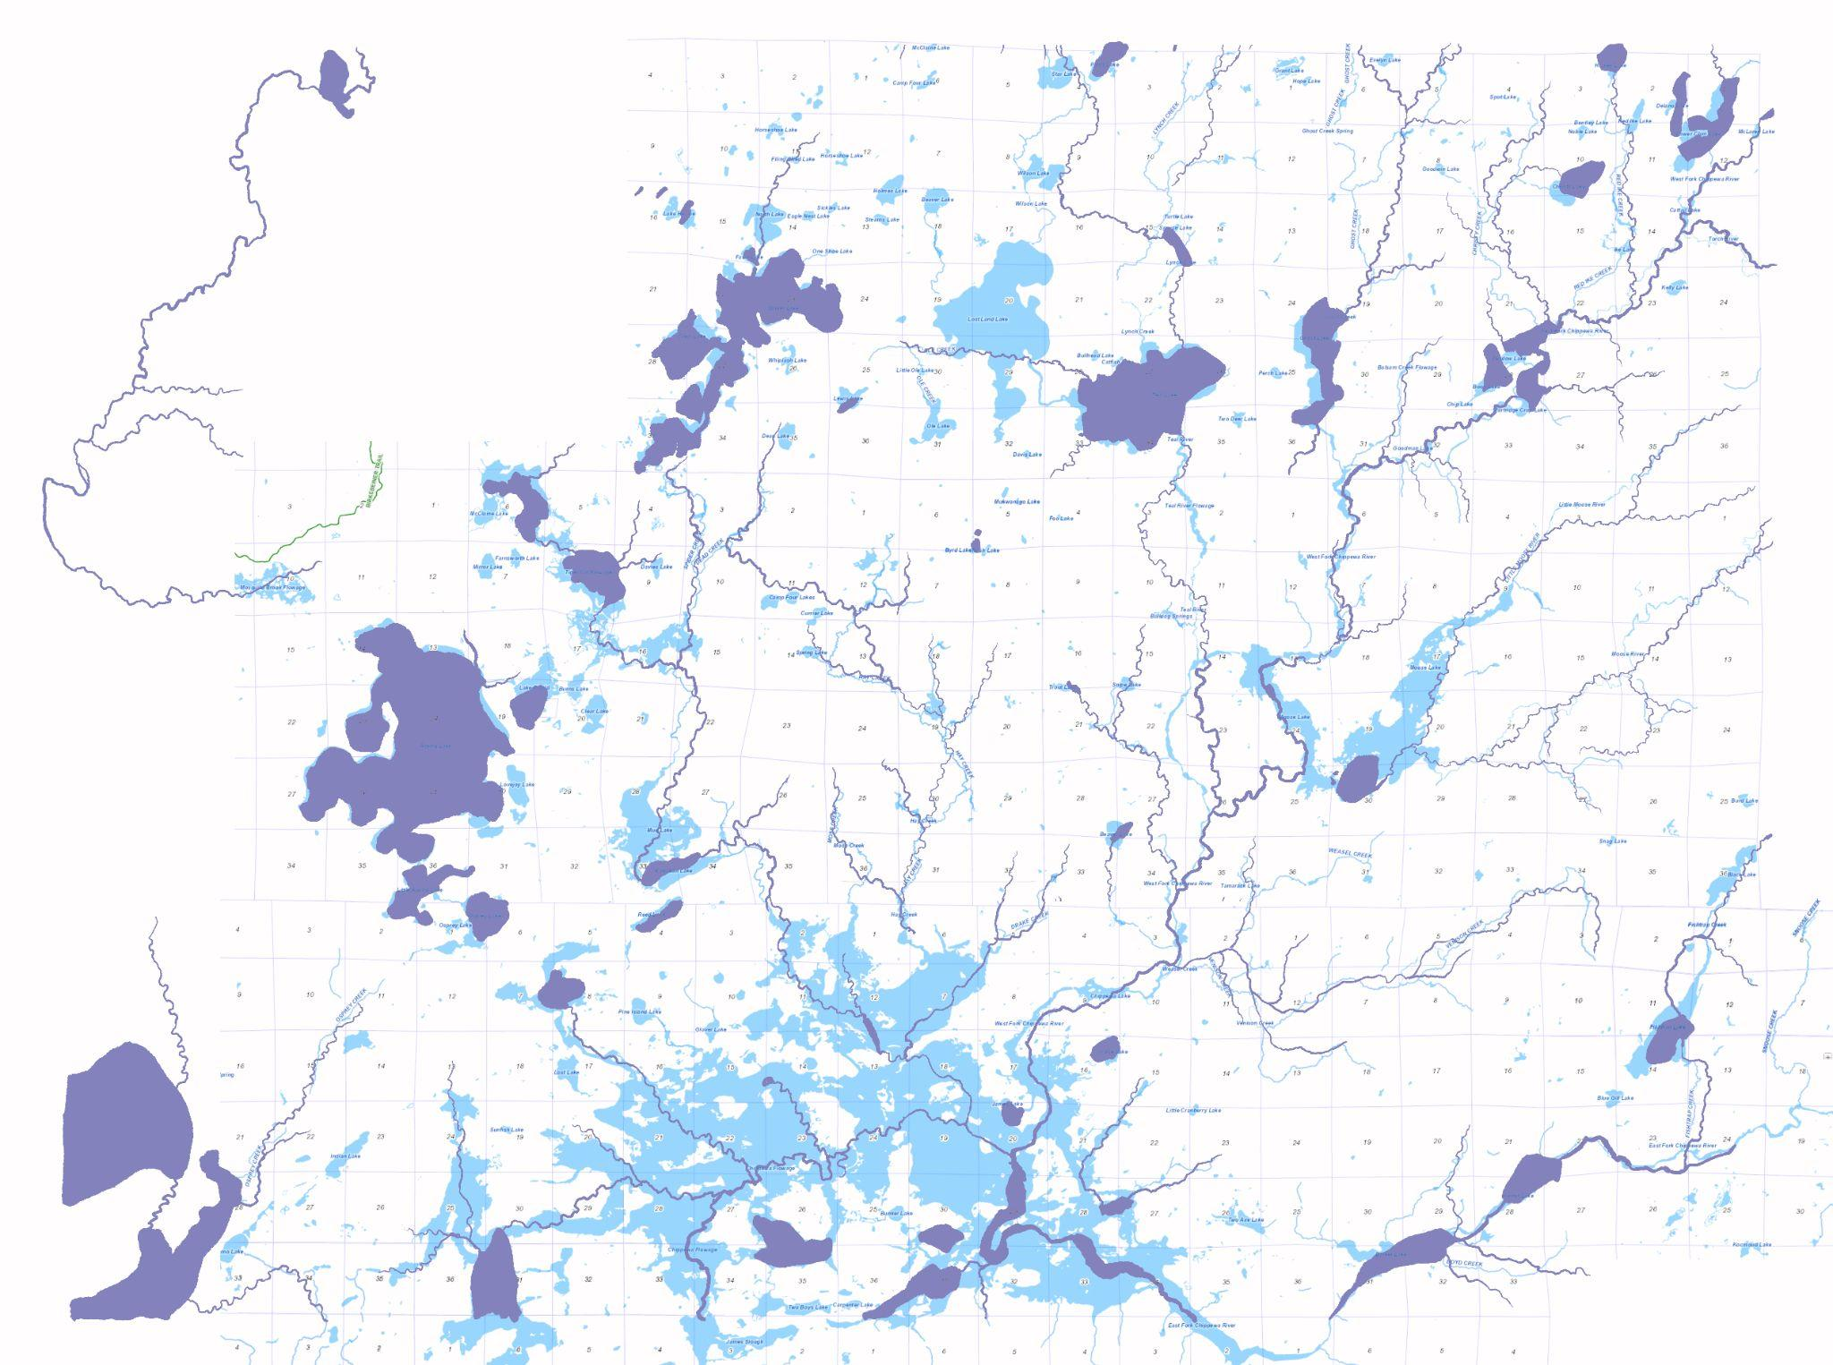
Sawyer County,
Wisconsin
waterways
1857 (purple)
2022 (blue)
The impacts of these logging dams on rivers last even today
Credit:
Liz Anna Kozik

Slide 20
Pulling the Threads Together (8 m.)
Large group wrap-up
  What stories get told about Wisconsin logging?
  What do pines, rivers, and dams have to do with one another?
  What role does the Morrill Act play in all that?
Bonus question: What might we be missing?

Slide 21
Homework for next time (2 m.)
Read:
  "Paul Bunyan and Settler Nostalgia in the Northwoods" by K. Keeler and R. Hellenbrand, Edge Effects, 2023.
  “The 1837 Pine Tree Treaty,” from Chippewa Treaty Rights: The Reserved Rights of Wisconsin's Chippewa Indians in Historical Perspective by R. Satz, 1991.
  Selections from Where the River is Wide: Pahquahwong and the Chippewa Flowage by C. O. Rasmussen, 1998.
Write:
  Major points from the readings
  Some discussion questions to bring to class

Slide 22
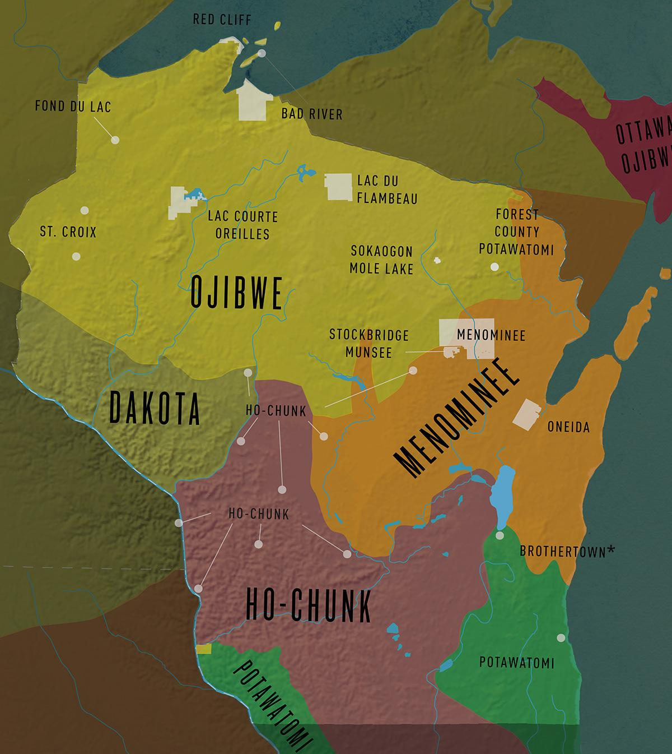
Week One, Day Two:
Who's Missing from Stories of Wisconsin logging?
Credit: Great Lakes Indian Fish and Wildlife Commission

Slide 23
Prep for class today:
Read:
  "Paul Bunyan and Settler Nostalgia in the Northwoods" by K. Keeler and R. Hellenbrand, Edge Effects, 2023.
  “The 1837 Pine Tree Treaty,” from Chippewa Treaty Rights: The Reserved Rights of Wisconsin's Chippewa Indians in Historical Perspective by R. Satz, 1991.
  Selections from Where the River is Wide: Pahquahwong and the Chippewa Flowage by C. O. Rasmussen, 1998.
Write:
  Major points from the readings
  Some discussion questions to bring to class

Slide 24
Remember?
Much of this land was sold for logging, then re-sold or defaulted to the County, State, or Federal government through non-payment of taxes
Silas Chapman, “Map Showing Cornell University Lands in Wisconsin for Sale” (1877), Wisconsin Historical Society
Credit: landgrabu.org

Slide 25
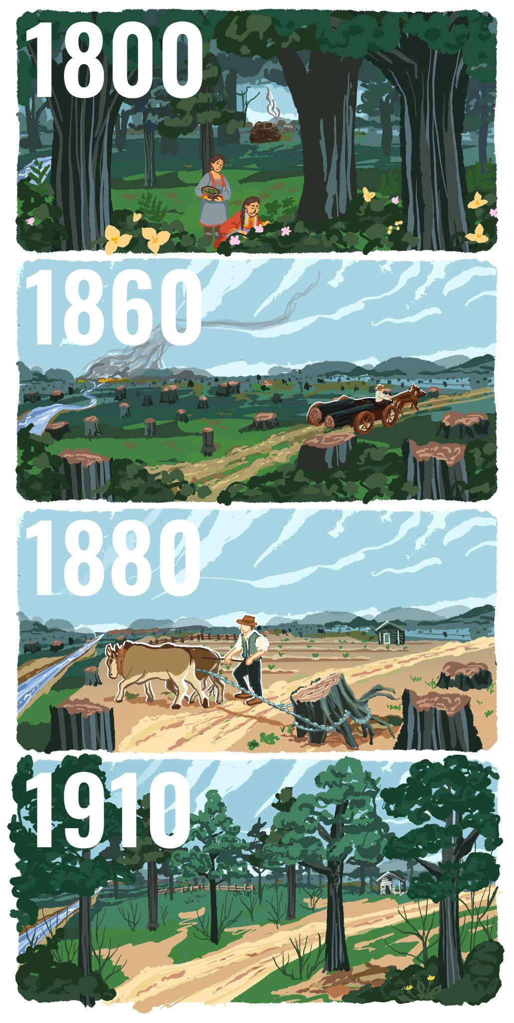
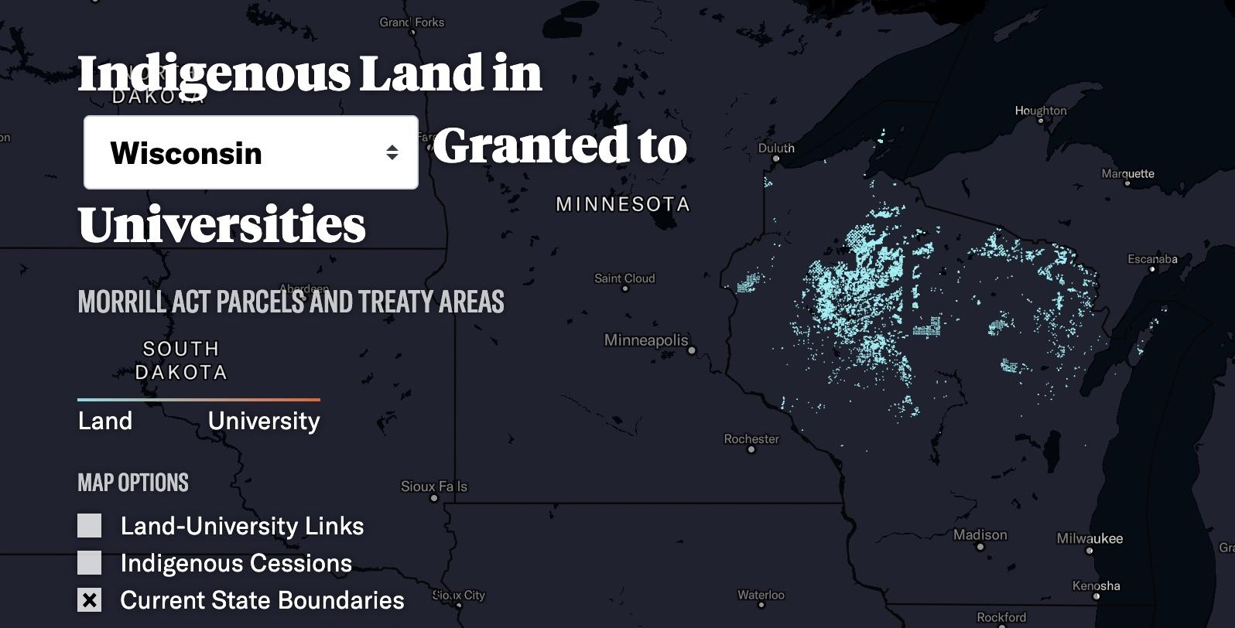
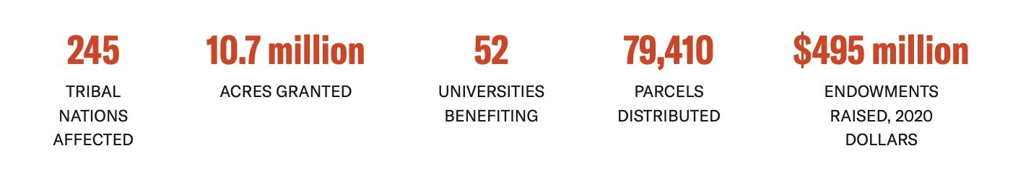
Credit:
Liz Anna Kozik
Credit: landgrabu.org

Slide 26
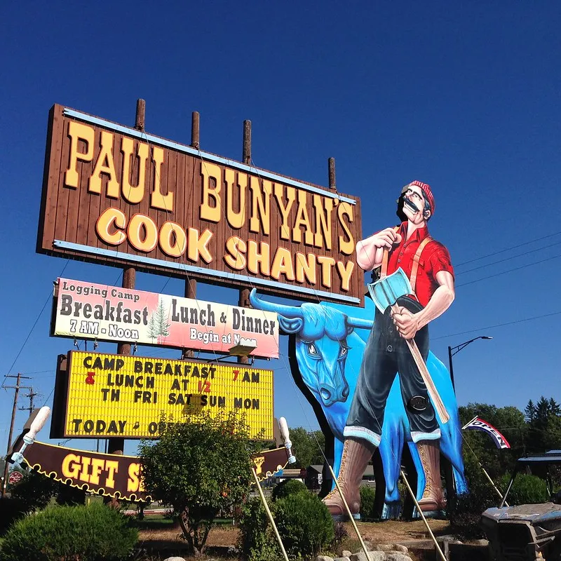
Getting Started (20 m.)
Take a few minutes to look back at homework notes (3 min.)

Slide 27
Getting Started (20 m.)
Take a few minutes to look back at homework notes (3 min.)
Get into small groups of three (7 min.)
  compare notes and questions about the Keeler and Hellenbrand article ("Paul Bunyan and Settler Nostalgia in the Northwoods") and the Satz chapter ("The 1837 Pine Tree Treaty") (save Rasmussen for later)
  prepare some big ideas to share with the group

Slide 28
Getting Started (20 m.)
Take a few minutes to look back at homework notes (3 min.)
Get into small groups of three (7 min.)
  compare notes and questions about the Keeler and Hellenbrand article ("Paul Bunyan and Settler Nostalgia in the Northwoods") and the Satz chapter ("The 1837 Pine Tree Treaty") (save Rasmussen for later)
  prepare some big ideas to share with the group
Large group discussion (7 min.)
  First impressions?
  What seems important to cover today?

Slide 29
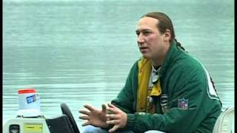
The Chippewa Flowage (15m.)

Slide 30
The Chippewa Flowage
Sawyer County,
Wisconsin
waterways
1857 (purple)
2022 (blue)
Credit:
Liz Anna Kozik

Slide 31
What's Missing from WI Logging Stories? (30 m.)
Large group discussion (take notes on board):
  Map major points from previous class period on the board about dominant narratives of logging in Wisconsin (5 min.)

Slide 32
What's Missing from WI Logging Stories? (30 m.)
Large group discussion (take notes on board):
  Map major points from previous class period on the board about dominant narratives of logging in Wisconsin (5 min.)
  Ask students from each group to come to the board and add stories, ideas, and points that are missing in that narrative (7 min.)

Slide 33
What's Missing from WI Logging Stories? (30 m.)
Large group discussion (take notes on board):
  Map major points from previous class period on the board about dominant narratives of logging in Wisconsin (5 min.)
  Ask students from each group to come to the board and add stories, ideas, and points that are missing in that narrative (7 min.)
  Discuss Keeler & Hellenbrand, Satz, Rasmussen readings (18 min.)
    what are the major points? (6 min.)
    what evidence do they use to support those points? (6 min.)
    how do these readings complicate dominant white settler narratives about Wisconsin lumbering? (6 min.)

Slide 34
Pulling the Threads Together (8 min.)
Come back together as a large group to process
  What are the links between pines, rivers, dams, and Native peoples in Wisconsin?
  What's sticking with them from week one?
  Create concept map on the board to synthesize the links

Slide 35
Homework for next time (2 m.)
Review:
  Treaty with the Chippewa, 1837
  Treaty with the Chippewa, 1842
  Treaty Rights Guide (for Tribal Citizens, for Non-Native Allies)
Read:
  Randell H, Curley A. (2023). "Dams and tribal land loss in the United States." Environmental Research Letters
Listen:
  "Eroding Sovereignty: The Devastating Impacts of Dams on Tribal Communities." (2024). Podcast. National Congress of American Indians. (28 m.)
Write:
  Major points from the article and podcast
  Some discussion questions to bring to class

Slide 36
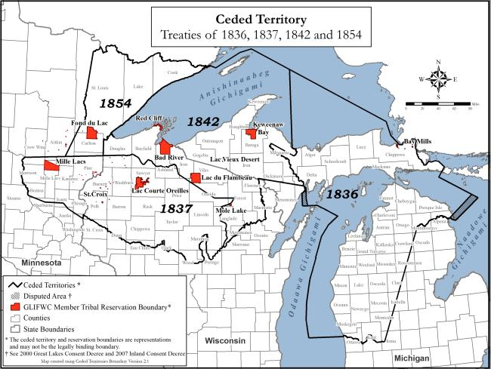
Week Two, Day One:
Treaties & Rights
Credit: Great Lakes Indian Fish and Wildlife Commission

Slide 37
Prep for class today:
Review:
  Treaty with the Chippewa, 1837
  Treaty with the Chippewa, 1842
  Treaty Rights Guide (for Tribal Citizens, for Non-Native Allies)
Read:
  Randell H, Curley A. (2023). "Dams and tribal land loss in the United States." Environmental Research Letters
Listen:
  "Eroding Sovereignty: The Devastating Impacts of Dams on Tribal Communities." (2024). Podcast. National Congress of American Indians. (28 m.)
Write:
  Major points from the article and podcast
  Some discussion questions to bring to class

Slide 38
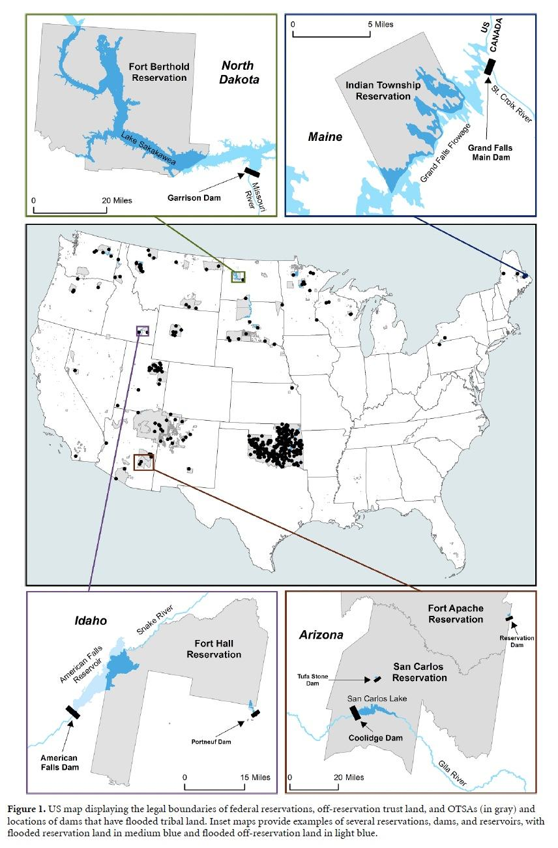
Getting Started (20 m.)
Take a few minutes to look back at homework notes (3 min.)
Credit: Randell and Curley (2023)

Slide 39
Getting Started (20 m.)
Take a few minutes to look back at homework notes (3 min.)
Get into small groups of three (7 min.)
  compare notes and questions about the readings
  prepare some big ideas to share with the group
Credit: Randell and Curley (2023)

Slide 40
Getting Started (20 m.)
Take a few minutes to look back at homework notes (3 min.)
Get into small groups of three (7 min.)
  compare notes and questions about the readings
Large group discussion (7 min.)
  First impressions?
  What seems important to cover today?
Credit: Randell and Curley (2023)

Slide 41
Why Do Treaties Matter?
Credit: Great Lakes Indian Fish and Wildlife Commission

Slide 42

What is Tribal Sovereignty? (3 min.)

Slide 43

Why Do Treaties Matter? (3 min.)

Slide 44
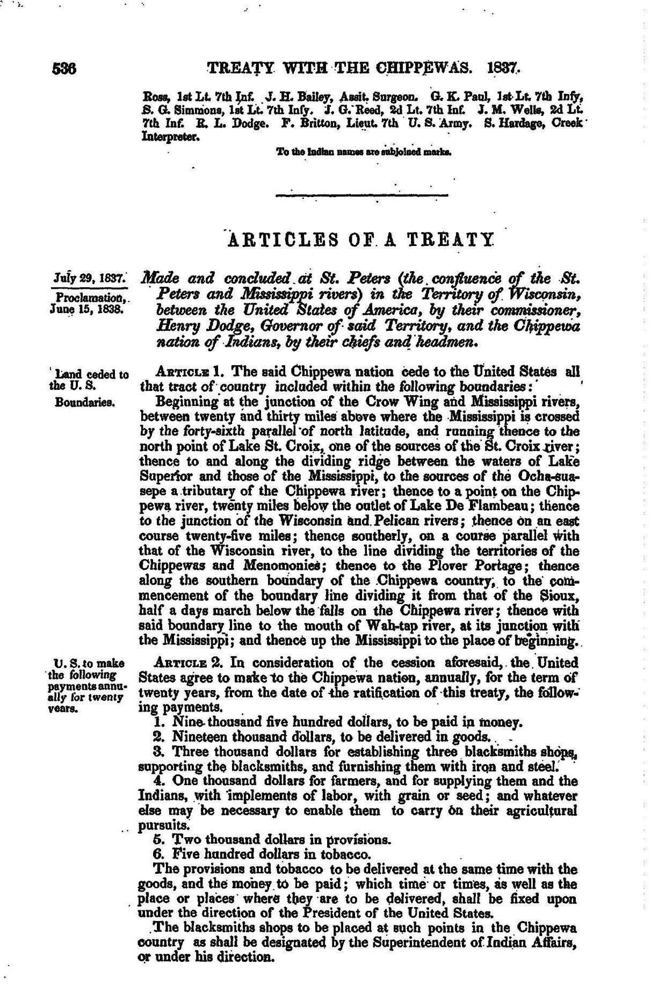
Treaties with the Chippewa (15 min.)
The Chippewa Treaties:
  Take a few minutes to look back at the text of the 1837 and 1842 Treaties. Highlight lines that seem important to you.

Slide 45
Treaties with the Chippewa (15 min.)
The Chippewa Treaties:
  Take a few minutes to look back at the text of the 1837 and 1842 Treaties. Highlight lines that seem important to you.
  As a large group at the board, try to gloss the texts

Slide 46
Treaties with the Chippewa (15 min.)
The Chippewa Treaties:
  Take a few minutes to look back at the text of the 1837 and 1842 Treaties. Highlight lines that seem important to you.
  As a large group at the board, try to gloss the texts
  Why do they matter for understanding logging, dams, land seizures, river access, fishing?

Slide 47
Treaties with the Chippewa (15 min.)
What were these treaties supposed to protect?
Where have they failed?

Slide 48
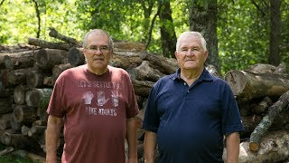
Fighting for Treaty Rights in the Great Lakes (5 min.)

Slide 49
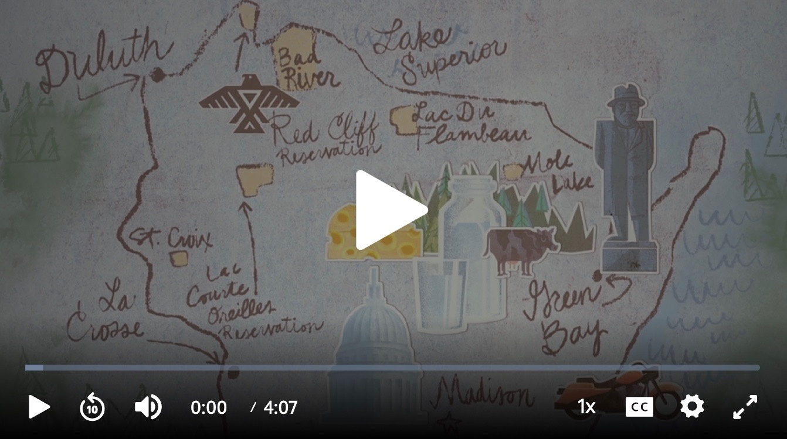
Fighting for Treaty Rights in the Great Lakes (4 min.)

Slide 50
Pulling the Threads Together (8 min.)
Students individually take some time to write some reflections on the question: what has it taken to fight for guaranteed Treaty rights in Wisconsin and across the Great Lakes?
Come back to the large group to offer final reflections

Slide 51
Homework for next time (2 m.)
Review:
  1836 Treaty of Washington
  2007 Inland Consent Decree (FAQ)
Read:
  Fox, C. A., Reo, N. J., Fessell, B., & Dituri, F. (2022). "Native American tribes and dam removal: restoring the Ottaway, Penobscot and Elwha Rivers." Water Alternatives, 15(1), 31-55.
  Gottschalk, C. and Holtgren, J. M. (forthcoming)."The Island that Isn't an Island" in Rivers on the Move, ed. Demuth, Healey, Parrinello, Smith, Duke University Press.
Write:
  Major points from each text
  Some discussion questions to bring to class

Slide 52
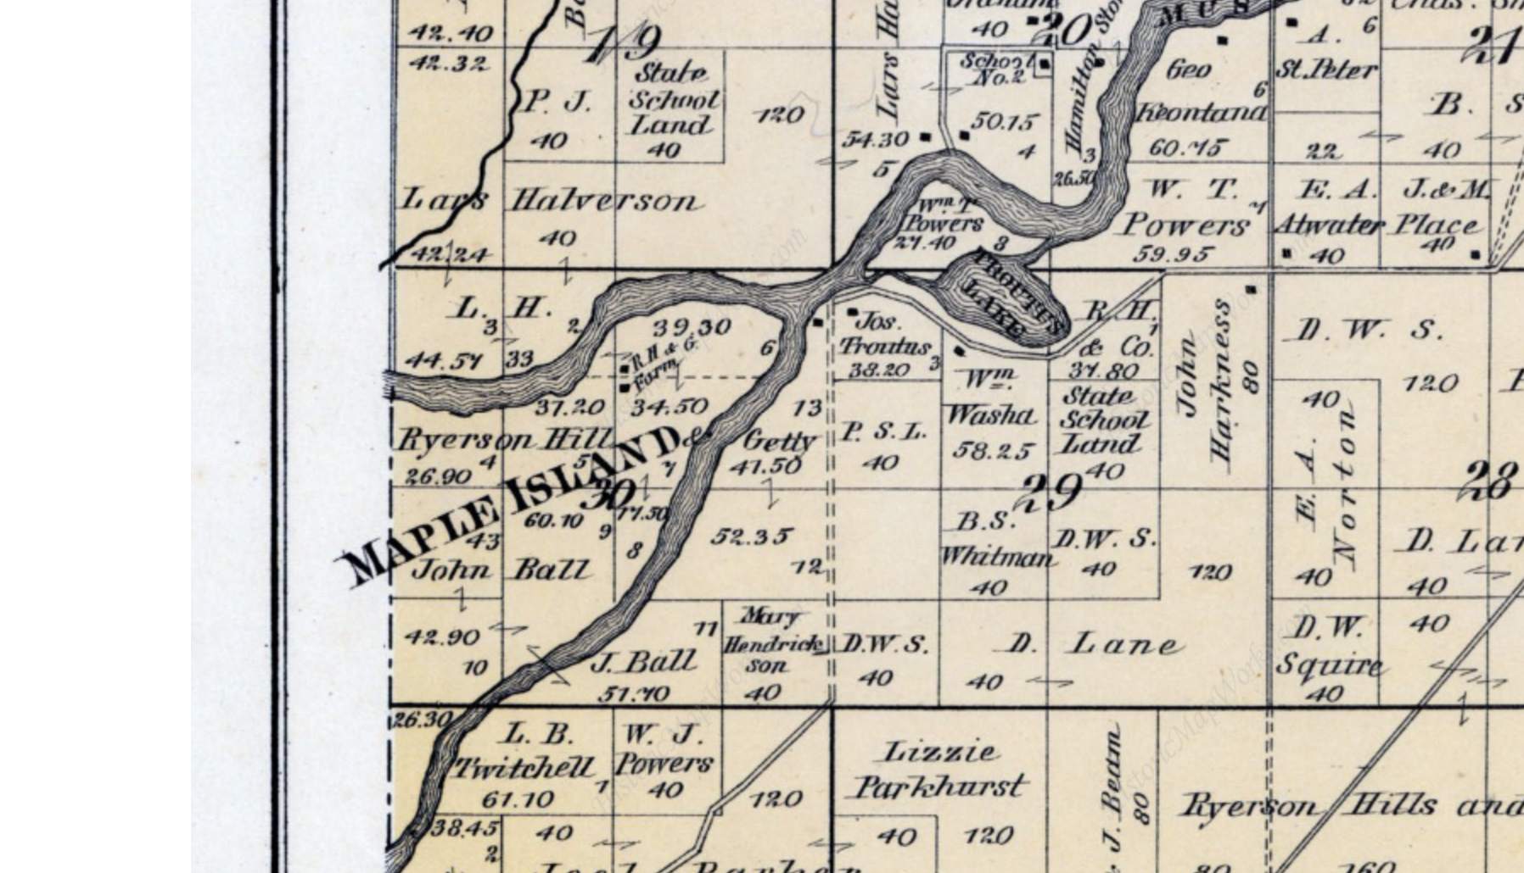
Week Two, Day Two:
Exercising Treaty Rights in Place

Slide 53
Prep for class today:
Review:
  1836 Treaty of Washington
  2007 Inland Consent Decree (FAQ)
Read:
  Fox, C. A., Reo, N. J., Fessell, B., & Dituri, F. (2022). Native American tribes and dam removal: restoring the Ottaway, Penobscot and Elwha Rivers. Water Alternatives, 15(1), 31-55.
  Gottschalk, C. and Holtgren, J. M. (forthcoming)."The Island that Isn't an Island" in Rivers on the Move, ed. Demuth, Healey, Parrinello, Smith, Duke University Press.
Write:
  Major points from each text
  Some discussion questions to bring to class

Slide 54
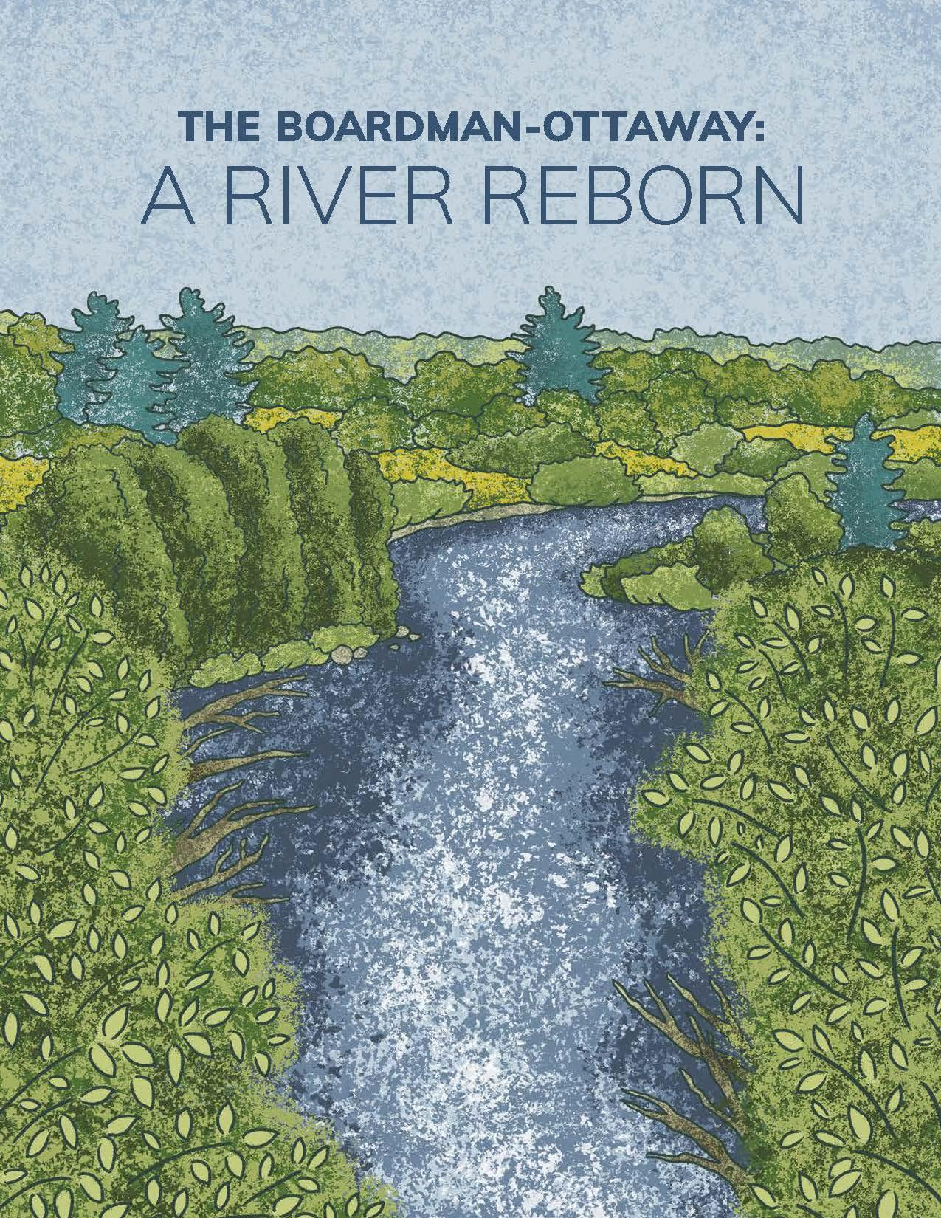
Getting Started (20 m.)
Take a few minutes to look back at homework notes (3 min.)

Slide 55
Getting Started (20 m.)
Take a few minutes to look back at homework notes (3 min.)
Get into small groups of three (7 min.)
  compare notes and questions about the readings

Slide 56
Getting Started (20 m.)
Take a few minutes to look back at homework notes (3 min.)
Get into small groups of three (7 min.)
  compare notes and questions about the readings
Large group discussion (7 min.)
  First impressions?
  What seems important to cover today?

Slide 57
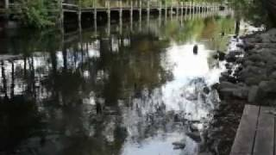
Lessons from the Boardman/Ottaway (MI) (5 min.)

Slide 58
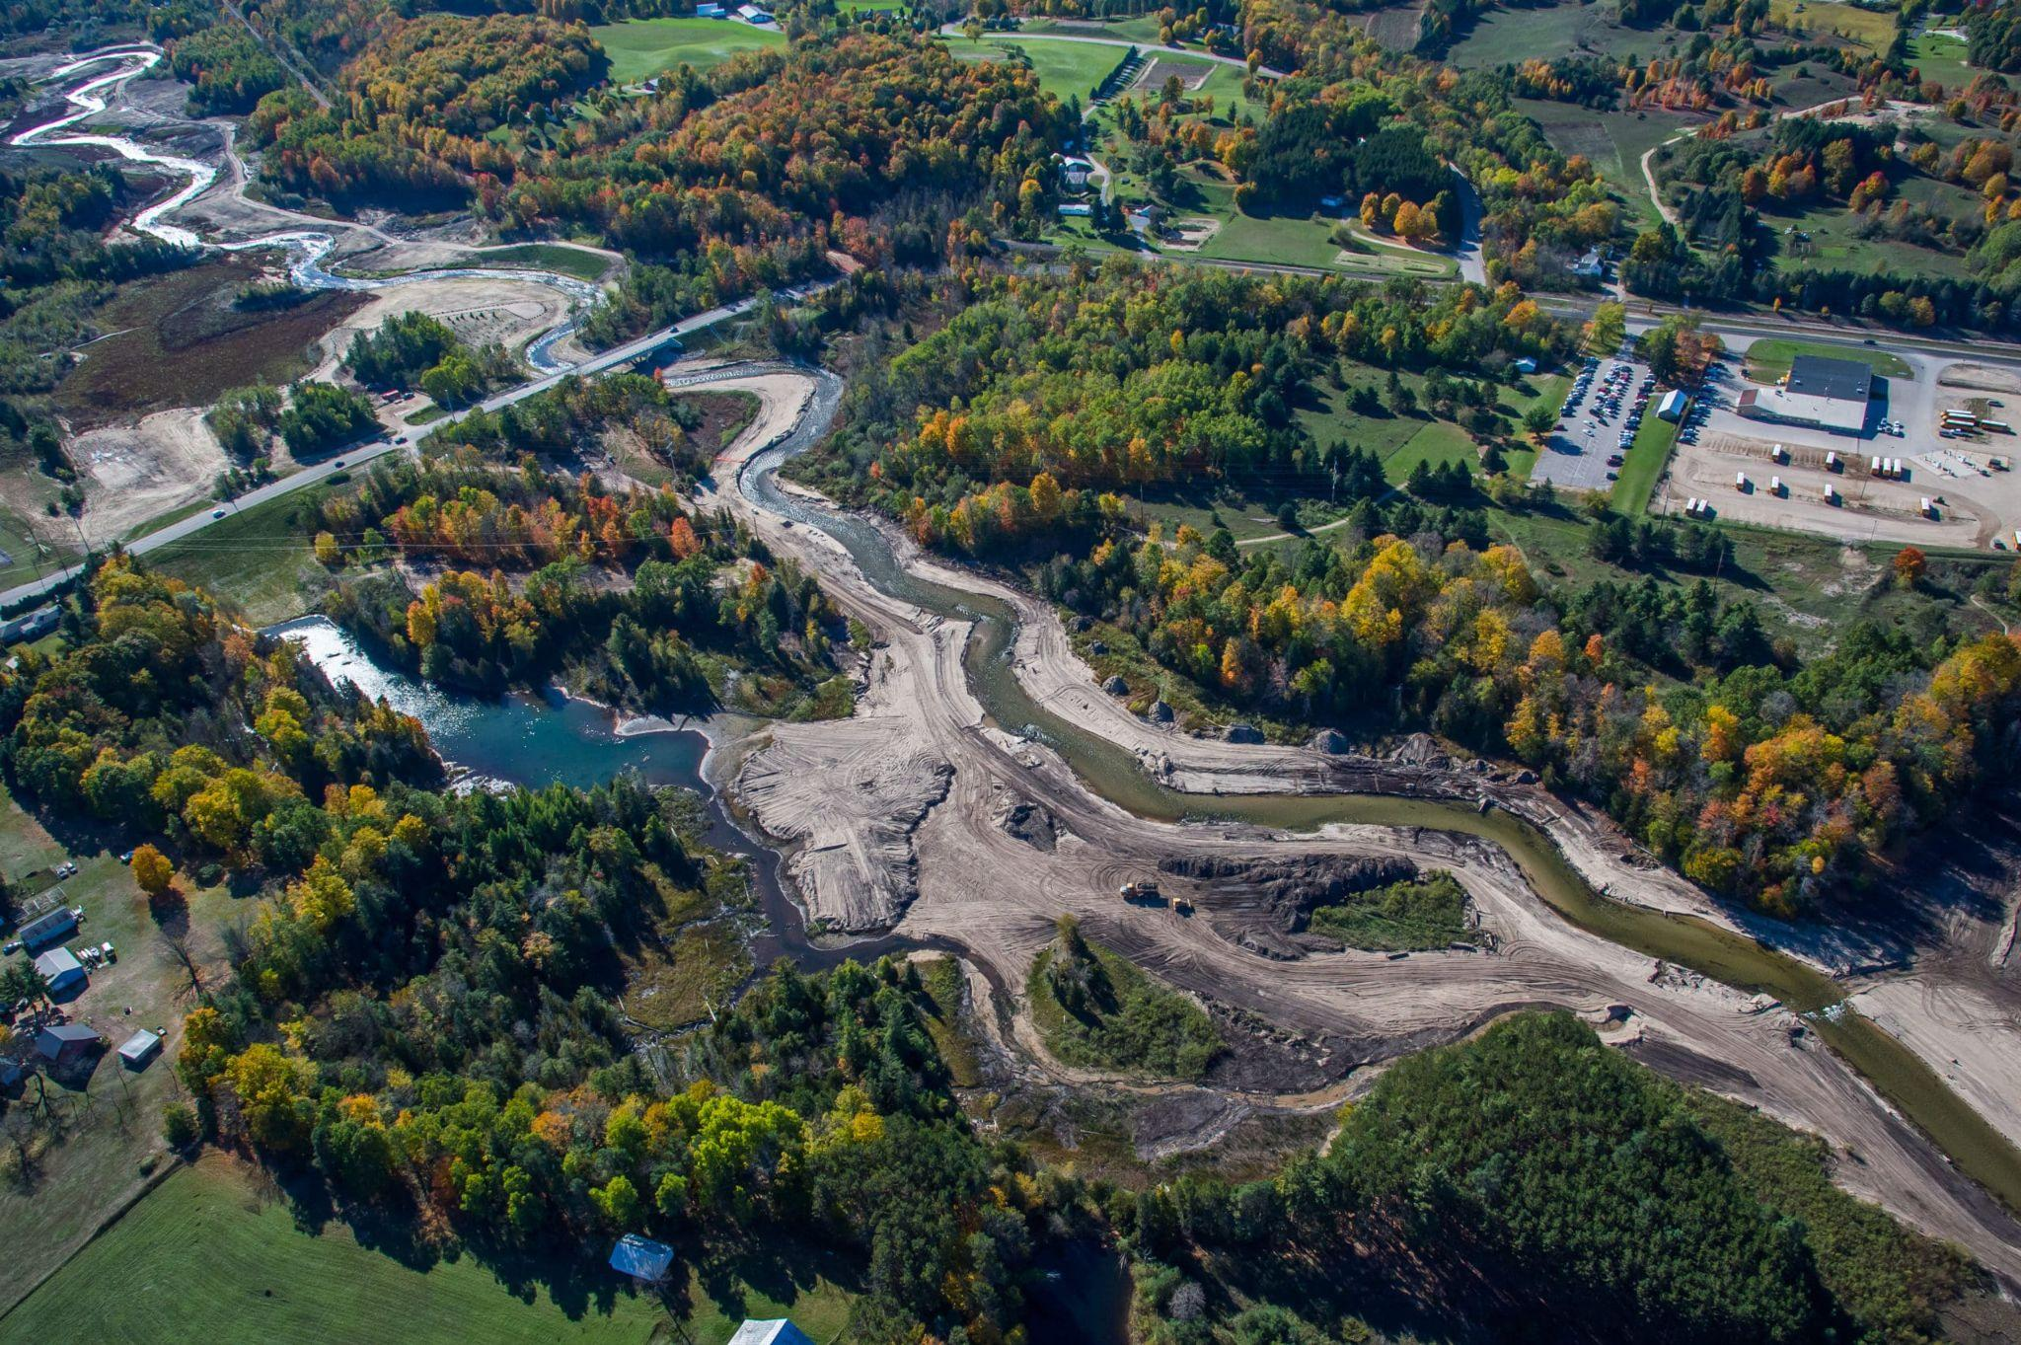
Lessons from the Boardman/Ottaway (MI) (15 min.)
Get into small groups and look back at the Fox et al. article. Identify some of the features of a Tribal dam removal (7 min.)
Come back to the large group to map responses on the board (3 min.)

Slide 59
Dam removal and Treaty rights? (5 min.)
Brainstorm as a class (think of previous readings!):
What might dam removal have to do with Treaty rights?

Slide 60
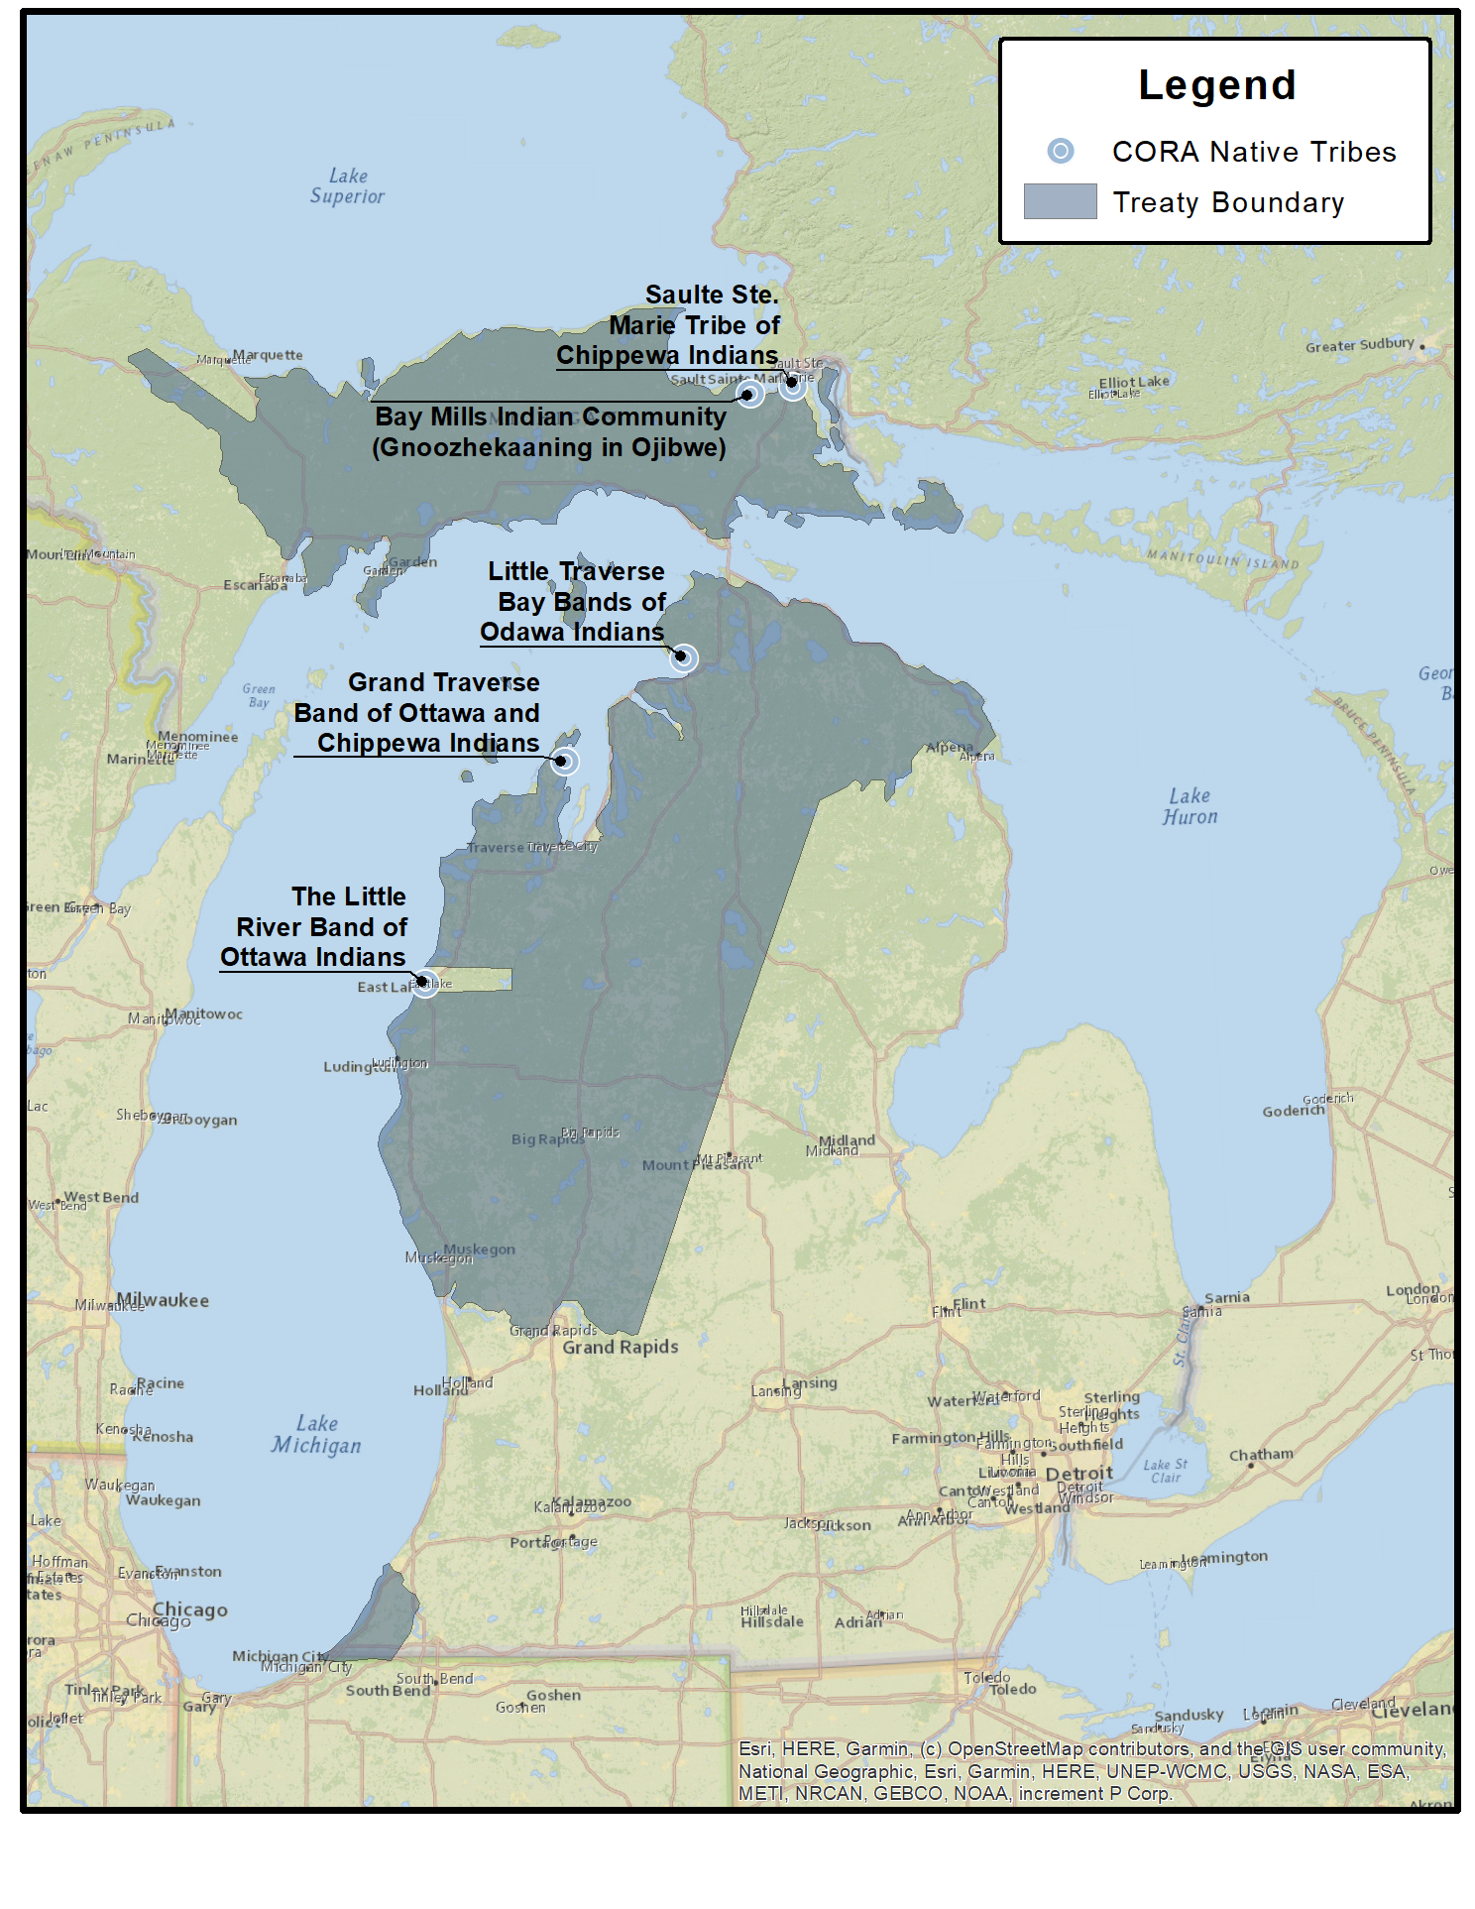
Rights Preserved in the 1836 Treaty of Washington (1 min.) U.S., Ottawa, and Chippewa Nations
Article Thirteenth. The Indians stipulate for the right of hunting on the lands ceded, with the other usual privileges of occupancy, until the land is required for settlement. In testimony whereof, the said Henry R. Schoolcraft, commissioner on the part of the United States, and the chiefs and delegates of the Ottawa and Chippewa nation of Indians, have hereunto set their hands, at Washington the seat of Government, this twenty-eight day of March, in the year one thousand eight hundred and thirty-six.
Credit: GreatLakesNow.org

Slide 61
Rights Re-affirmed in 2007 Inland Consent Decree (1 min.)
Bay Mills Indian Community, Sault Ste. Marie Tribe of Chippewa Indians, Grand Traverse Band of Ottawa and Chippewa Indians, Little River Band of Ottawa Indians, Little Traverse Bay Bands of Odawa Indians
Article Thirteenth. The Indians stipulate for the right of hunting on the lands ceded, with the other usual privileges of occupancy, until the land is required for settlement. In testimony whereof, the said Henry R. Schoolcraft, commissioner on the part of the United States, and the chiefs and delegates of the Ottawa and Chippewa nation of Indians, have hereunto set their hands, at Washington the seat of Government, this twenty-eight day of March, in the year one thousand eight hundred and thirty-six.
Credit: GreatLakesNow.org

Slide 62
Rights Confirmed in 2007 Inland Consent Decree (1 min.)
Bay Mills Indian Community, Sault Ste. Marie Tribe of Chippewa Indians, Grand Traverse Band of Ottawa and Chippewa Indians, Little River Band of Ottawa Indians, Little Traverse Bay Bands of Odawa Indians
“Each of the Tribes may regulate the foregoing treaty-right activities of its members and enforce regulations pertaining to such activities. The Tribes may also engage in natural resources assessment, enhancement, and restoration activities as provided in Section XXI (Assessment Activities) and Section XXII (Restoration, Reclamation, and Enhancement Projects).”
Credit: GreatLakesNow.org

Slide 63
What does that mean in practice?

Slide 64
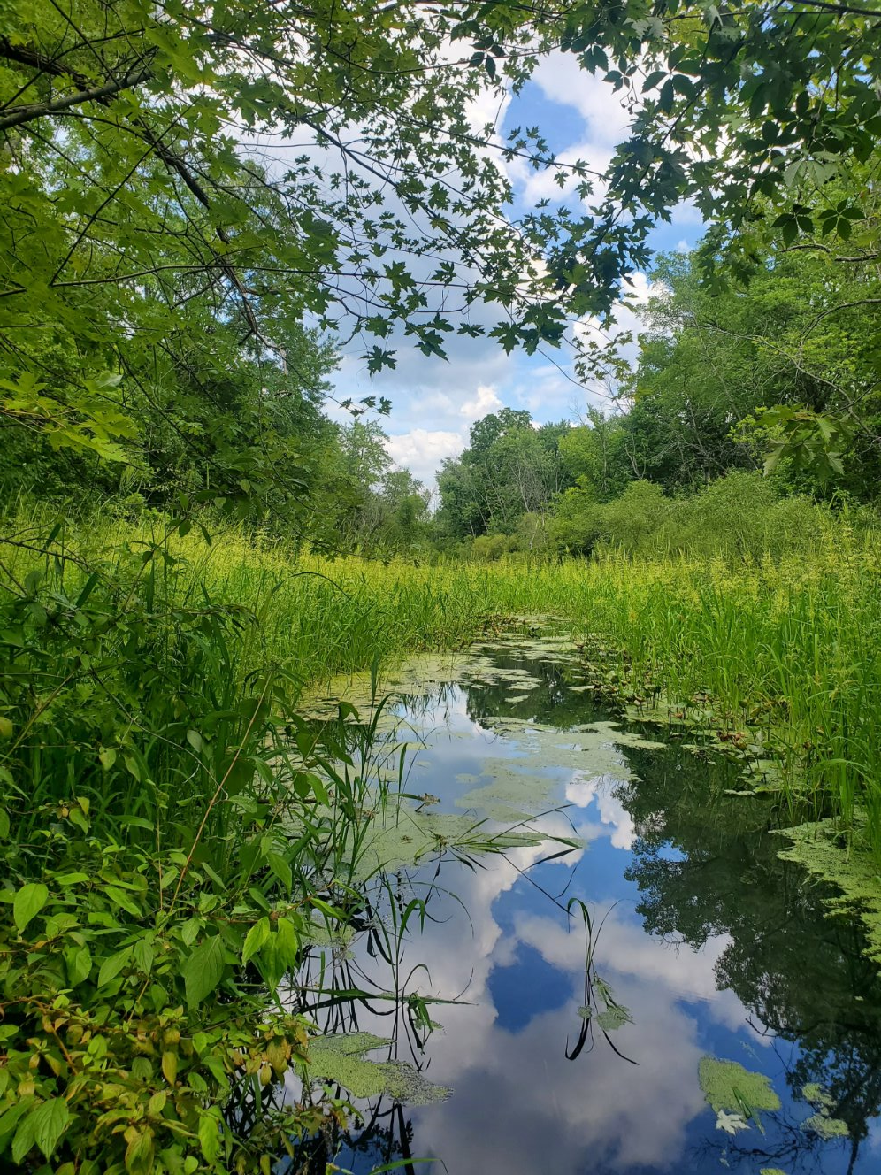
Learning from Practice:
Maple River, Michigan (20 min.)
Credit: Marty Holtgren

Slide 65
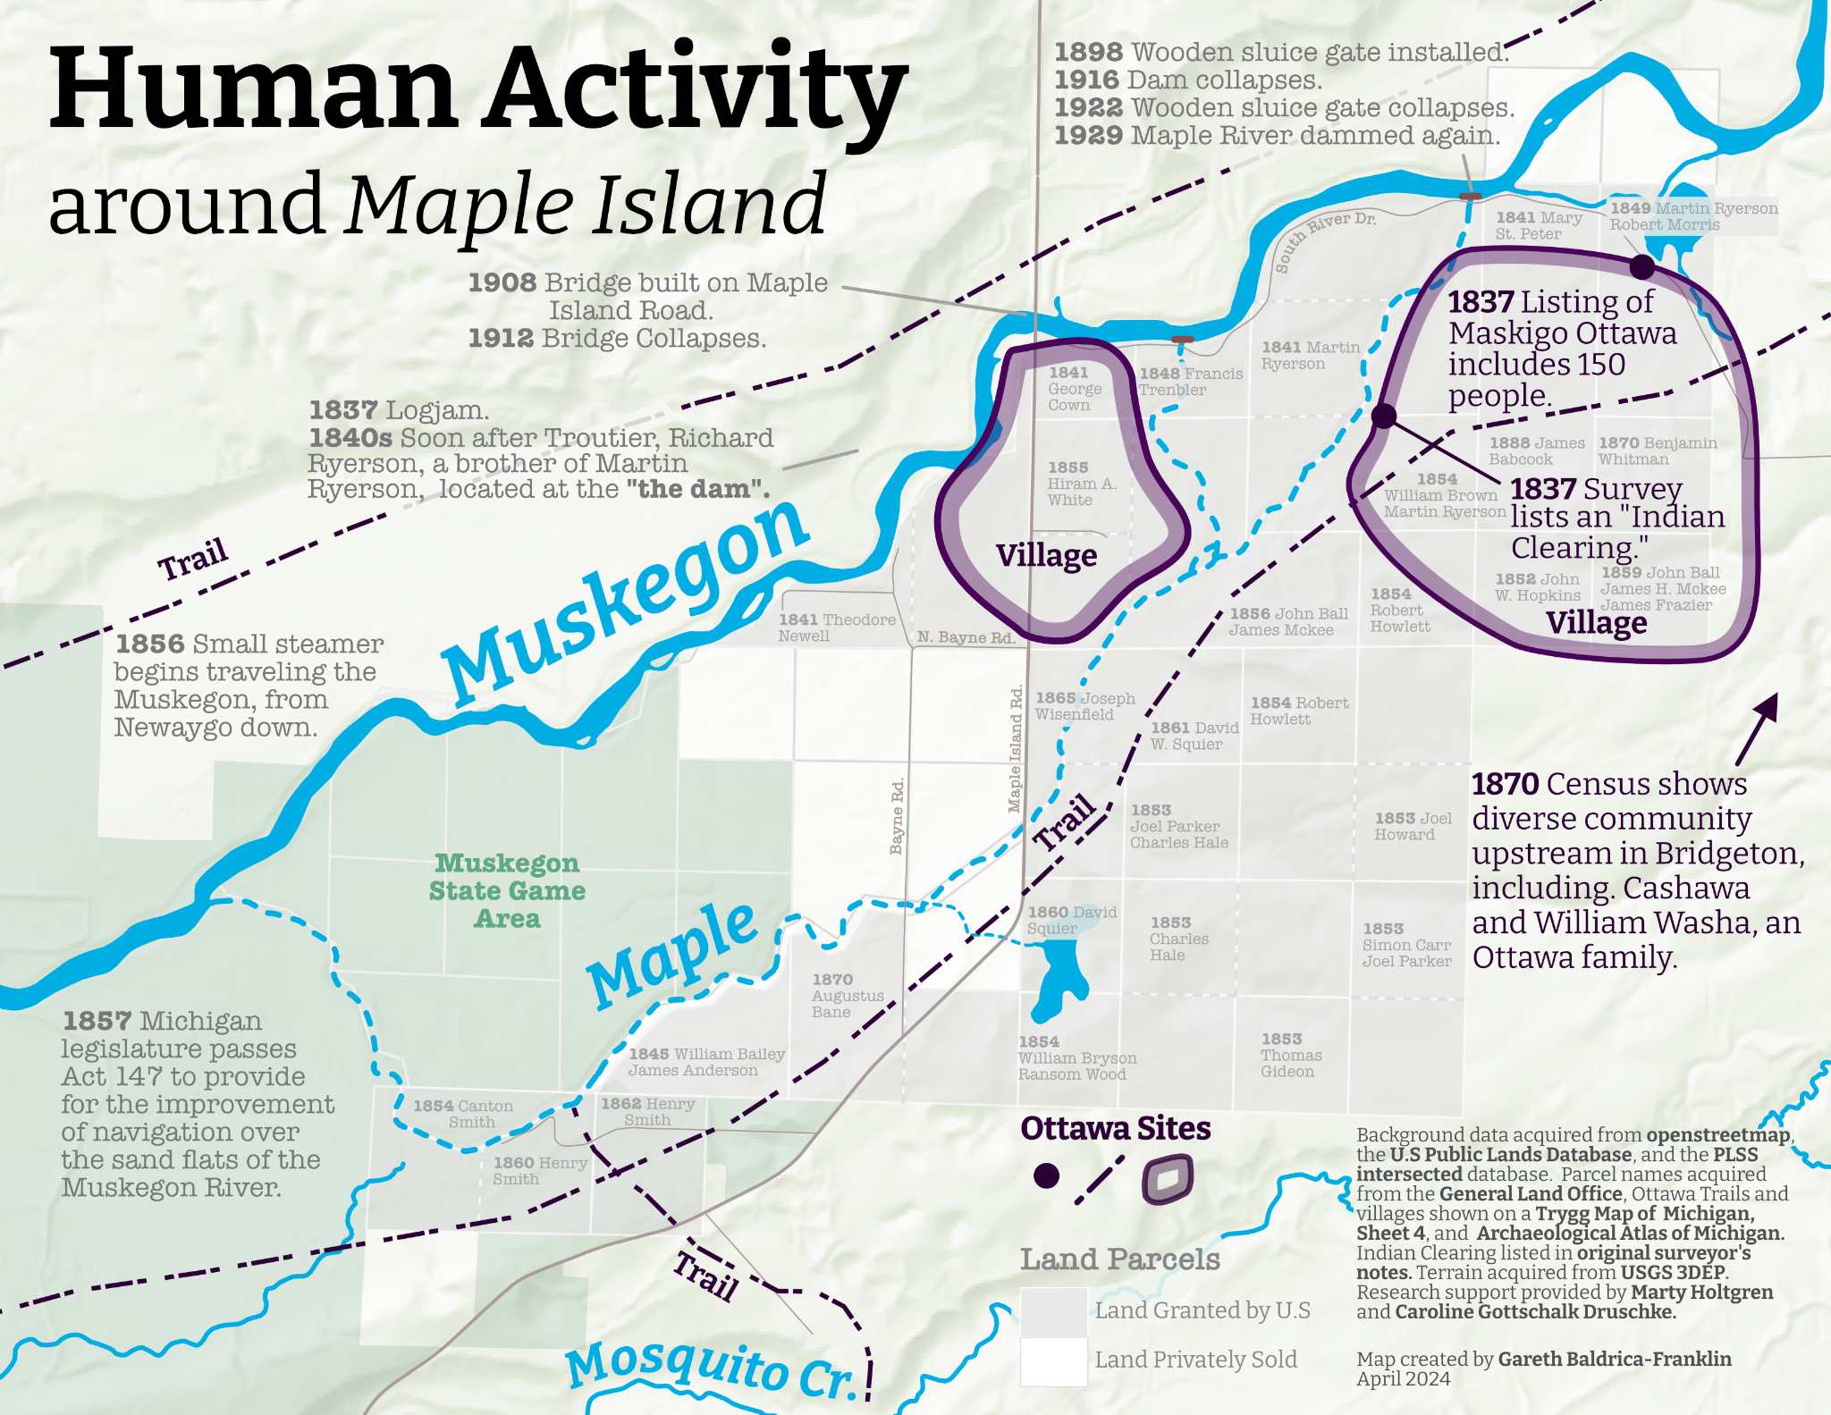
Maple Island, in the Lower Muskegon River Watershed (Michigan), was a long-time home for the Ottawa People

Slide 66
Pre-1830s
fur traders moved into the area, setting up a lucrative trade with the Ottawa people
1836
Treaty of Washington "opens" the area to white settlement
1837
Maple Island is surveyed by the U.S. Federal government for sale
1841
Martin Ryerson obtains land patents at the head of Maple Island to begin farming and logging

Slide 67
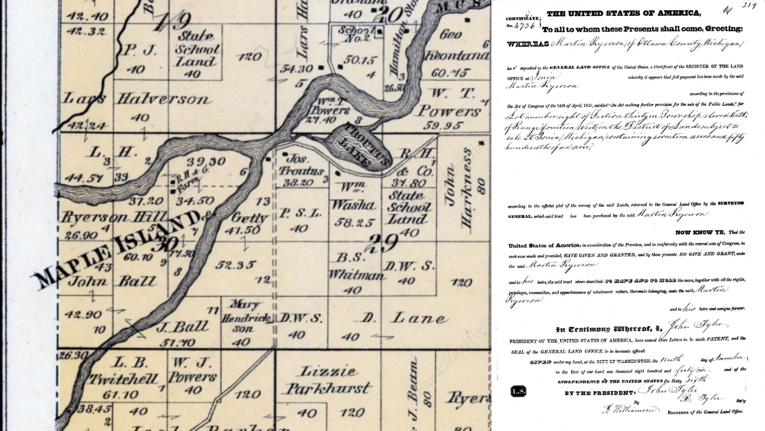
Martin Ryerson's property sat at the point where the Muskegon River split in two around Maple Island

Slide 68
This split was inconvenient for floating logs quickly downstream to the mills at Muskegon Lake on Lake Michigan

Slide 69
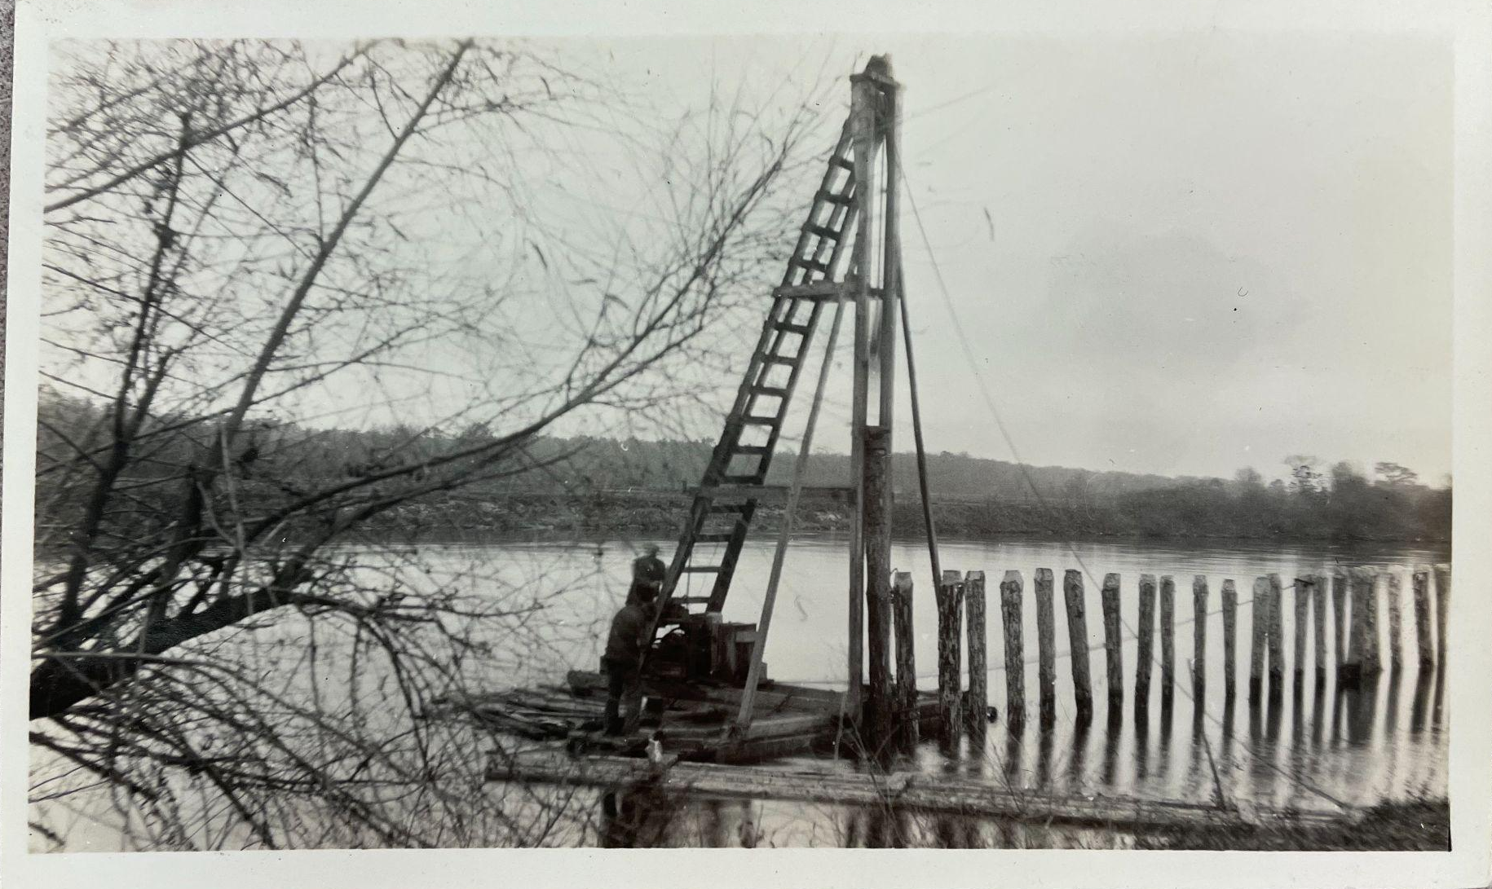
This split was inconvenient for floating logs quickly downstream to the mills at Muskegon Lake on Lake Michigan…so they blocked the inlets and stopped the flow into the Maple River
Credit: Harry Spooner Collection, Fremont Area District LIbrary, Fremont, Michigan

Slide 70

1880s
Both inlets to the Maple River are blocked by the Muskegon River Booming Company, owned by Martin Ryerson
Remnants of those original timber crib dams are still there today

Slide 71
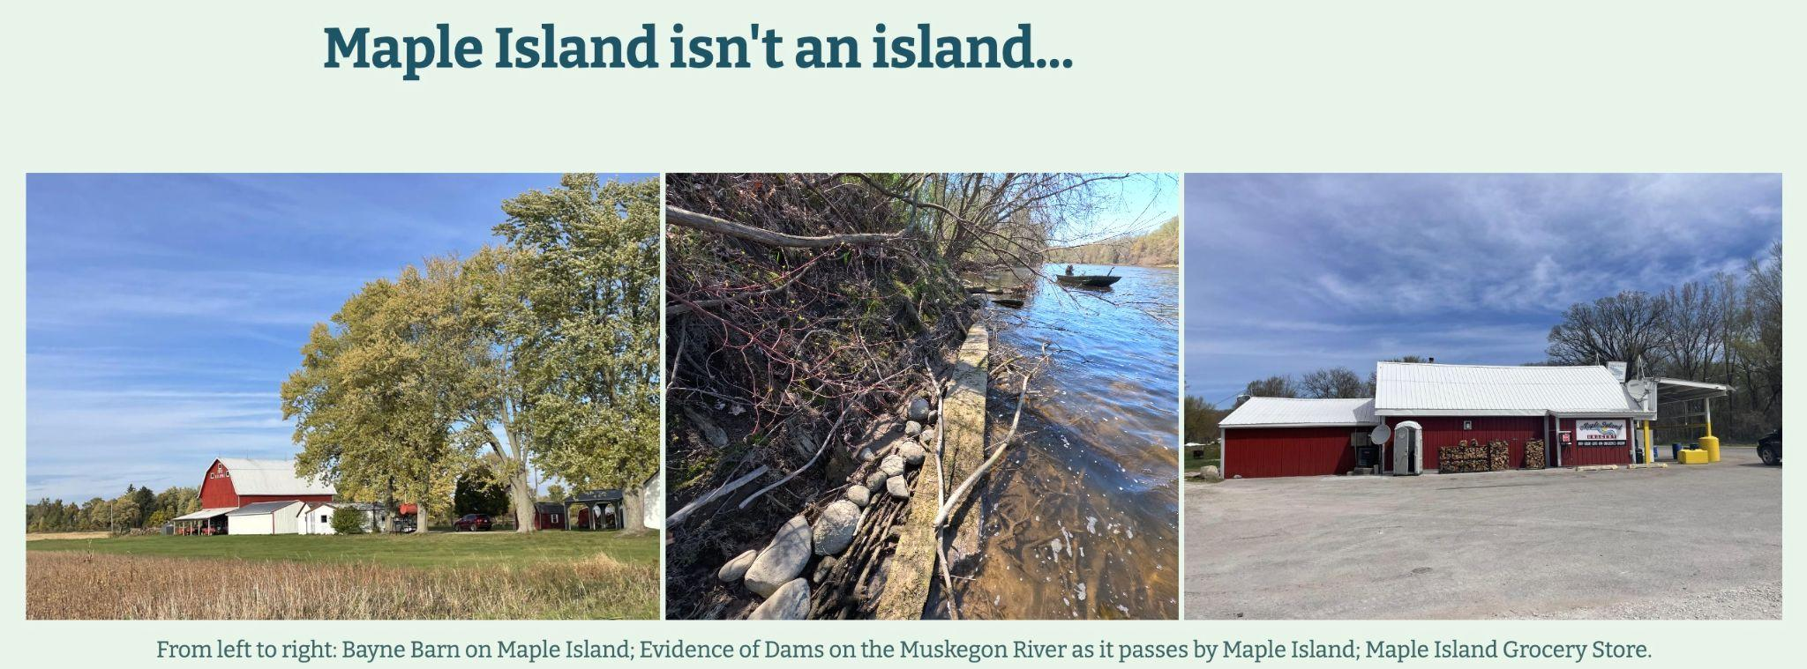
1880 to present
The 4.5-mile Maple River has been mostly dry ever since

Slide 72
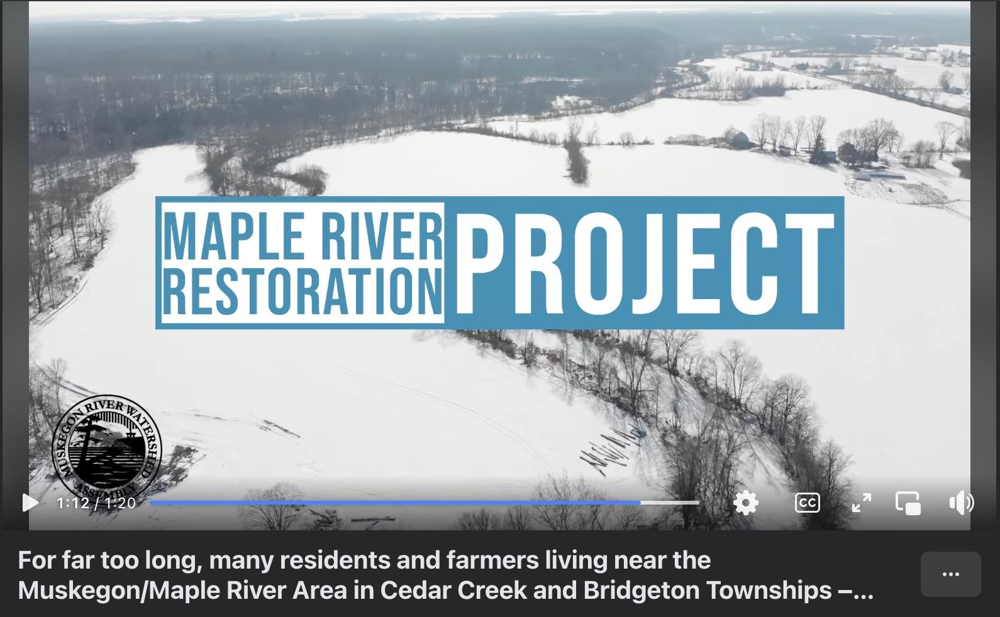
Closure has caused chronic flooding across Maple Island, as water overflows the Muskegon River banks and drains across the island (2 min.)

Slide 73
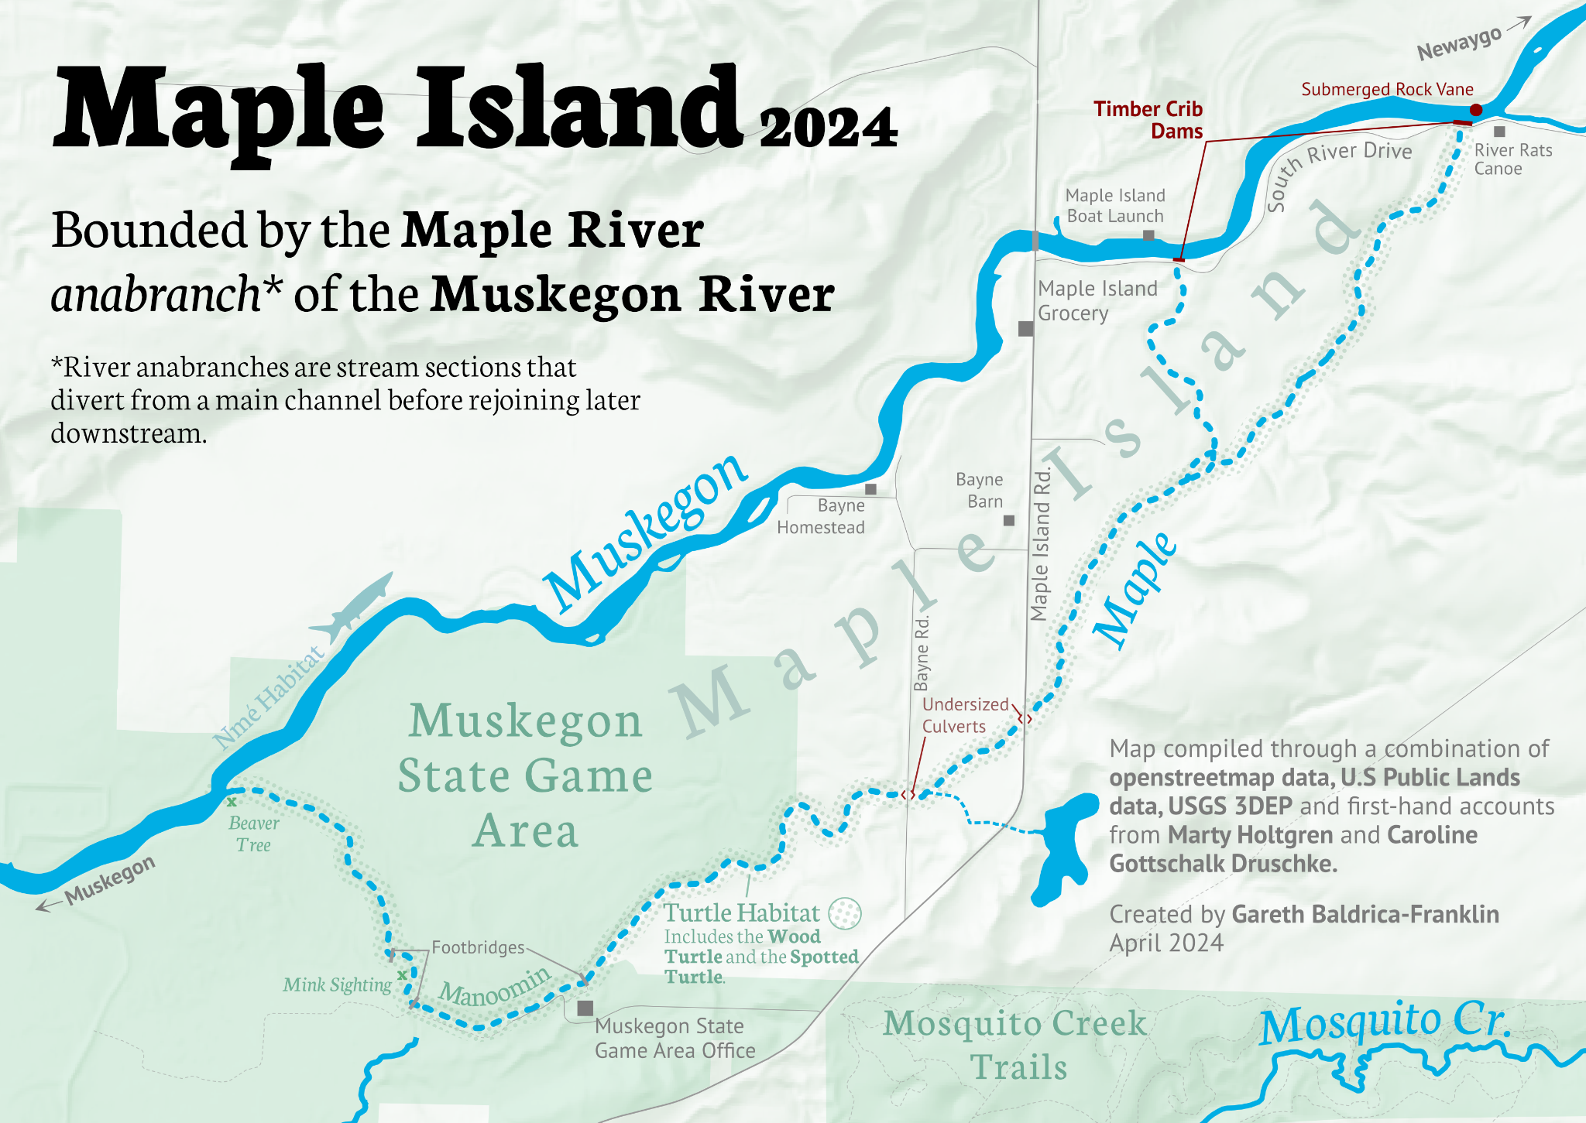
As well as a complete loss of habitat for manoomin (wild rice) and nmé (lake sturgeon)

Slide 74
As well as a complete loss of habitat for manoomin (wild rice) and nmé (lake sturgeon), and the severing of a way of life for Ottawa people

Slide 75
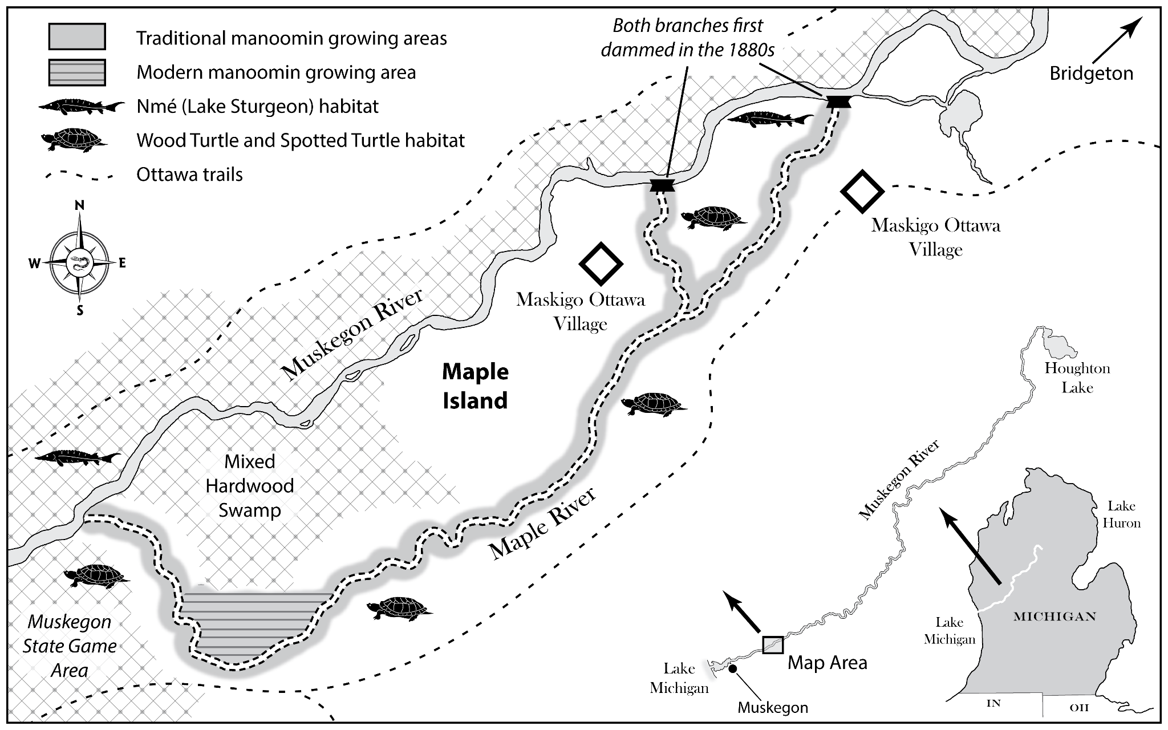
What do the Maple River dams have to do with Treaty Rights? (5 min.)
Students: what do you think?
Credit: Gottschalk and Holtgren (2026), Rivers on the Move

Slide 76
What do the Maple River dams have to do with Treaty Rights? (5 min.)
Maple River is part of the Little River Band of Ottawa Indians’ (LRBOI) Ceded Territory secured in the 1836 Treaty of Washington
LRBOI and the other 1836 tribal nations secured usufructuary rights (legal rights to use and derive benefit from property legally owned by another) to hunt, fish, and gather.
Purposeful closure of the Maple River destroyed habitat for many cultural important and subsistence fish species, including lake sturgeon, walleye, brook trout, and northern pike, resulting in a complete loss of a treaty protected fishery.
The impacts of closure on manoomin (wild rice) and aquatic mammals like beaver, muskrat, otter, and mink eliminated treaty protected hunting and gathering opportunities.

Slide 77
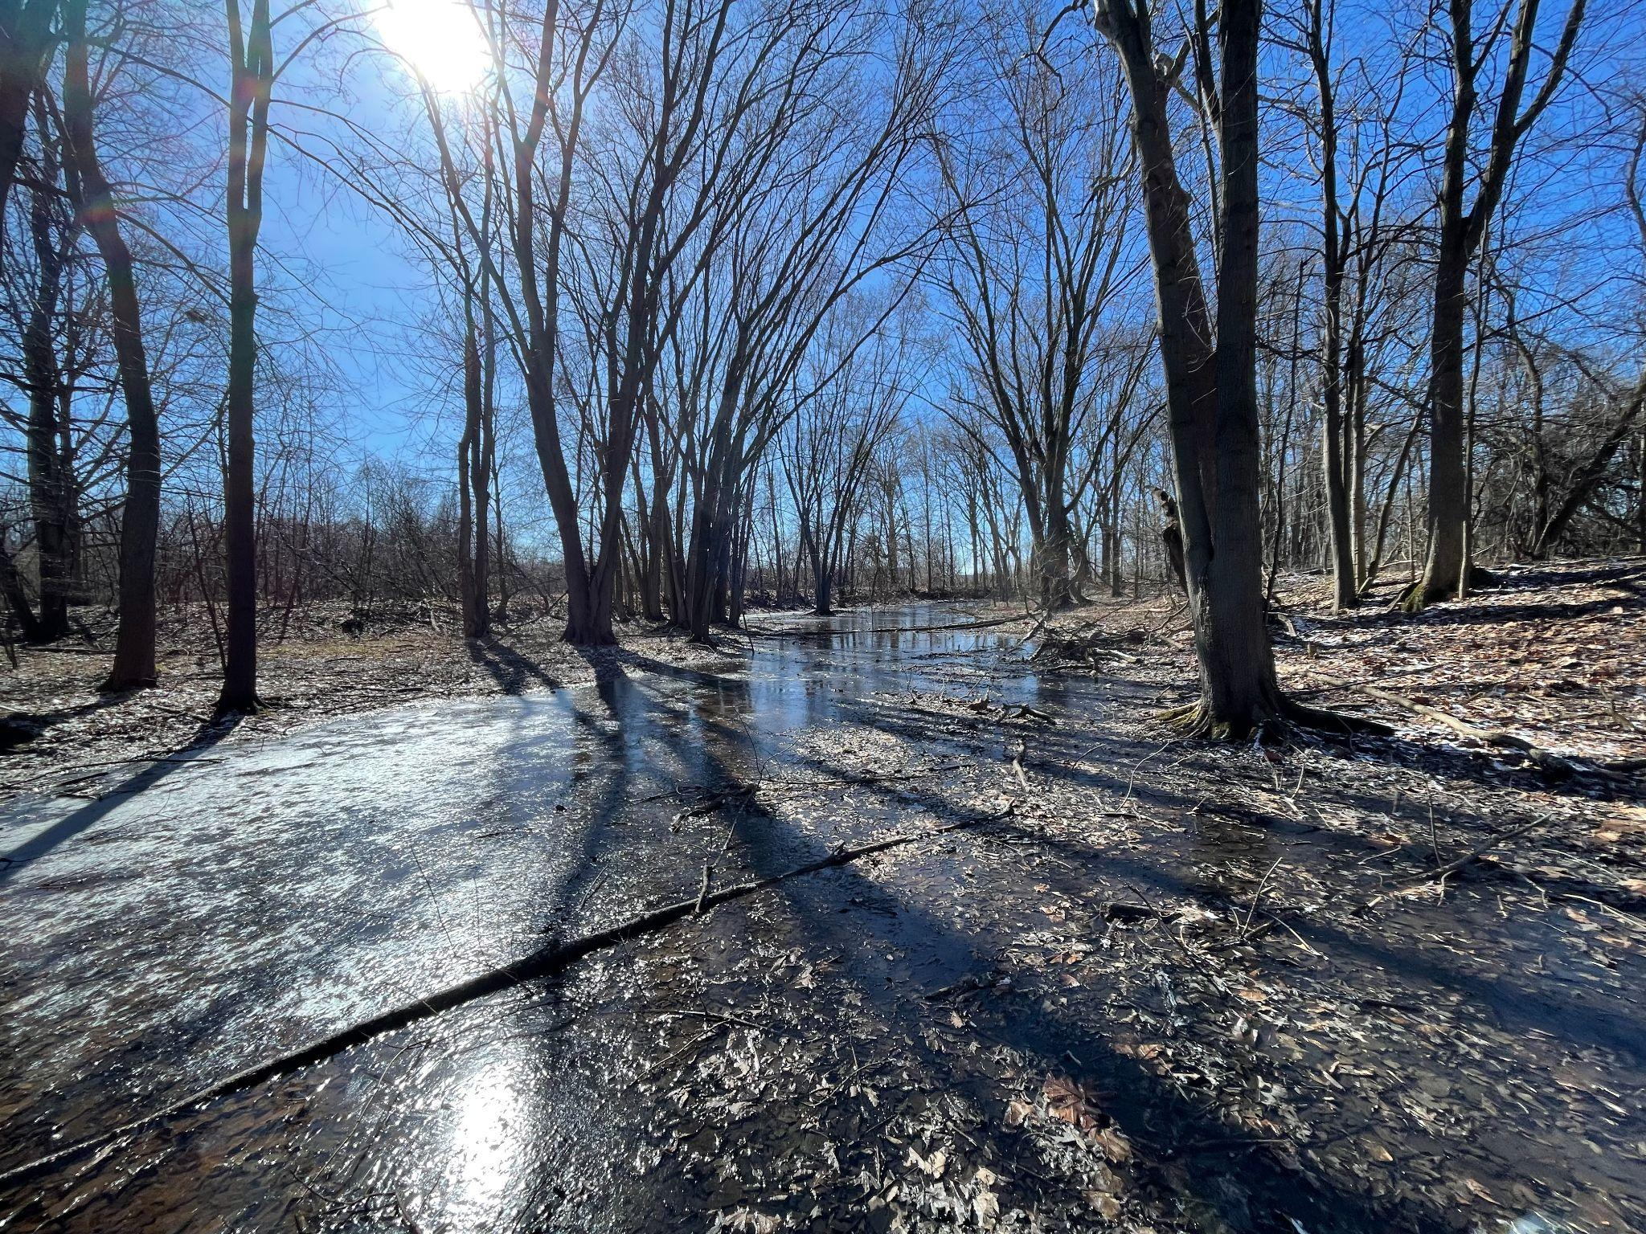
What can be done?
Students: what do you think?
The Maple River channel just below the lower inlet, filled with snowmelt, not running water. Credit: Caroline Gottschalk

Slide 78

What can be done?
MRWA (Muskegon River Watershed Assembly) started working on the Maple River Restoration Project in 2011, when agricultural owner Roger Peacock approached them after a large flood damaged Maple Island properties.

Slide 79


What can be done?
MRWA (Muskegon River Watershed Assembly) started working on the Maple River Restoration Project in 2011, when agricultural owner Roger Peacock approached them after a large flood damaged Maple Island properties.
In 2021, with the help of Encompass Socio-ecological Consulting, MRWA signed an agreement with the Little River Band of Ottawa Indians to work together on the project.

Slide 80
What can be done?
“The Tribe is very pleased to be partnering closely with MRWA. Our interests in Maple River center largely on our traditional cultural interests, including the revitalization of resources that could include expanded fish and wildlife habitat, and improved conditions for Manoomin (or wild rice).”
Frank Beaver, Director of Natural Resources, LRBOI

Slide 81
Remember the 2007 Inland Consent Decree?

Slide 82
Rights Re-affirmed in 2007 Inland Consent Decree (1 min.)
Bay Mills Indian Community, Sault Ste. Marie Tribe of Chippewa Indians, Grand Traverse Band of Ottawa and Chippewa Indians, Little River Band of Ottawa Indians, Little Traverse Bay Bands of Odawa Indians
Article Thirteenth. The Indians stipulate for the right of hunting on the lands ceded, with the other usual privileges of occupancy, until the land is required for settlement. In testimony whereof, the said Henry R. Schoolcraft, commissioner on the part of the United States, and the chiefs and delegates of the Ottawa and Chippewa nation of Indians, have hereunto set their hands, at Washington the seat of Government, this twenty-eight day of March, in the year one thousand eight hundred and thirty-six.
Credit: GreatLakesNow.org

Slide 83
Rights Confirmed in 2007 Inland Consent Decree (1 min.)
Bay Mills Indian Community, Sault Ste. Marie Tribe of Chippewa Indians, Grand Traverse Band of Ottawa and Chippewa Indians, Little River Band of Ottawa Indians, Little Traverse Bay Bands of Odawa Indians
“Each of the Tribes may regulate the foregoing treaty-right activities of its members and enforce regulations pertaining to such activities. The Tribes may also engage in natural resources assessment, enhancement, and restoration activities as provided in Section XXI (Assessment Activities) and Section XXII (Restoration, Reclamation, and Enhancement Projects).”
Credit: GreatLakesNow.org

Slide 84
Remember the 2007 Inland Consent Decree?
LRBOI is leading the proposed restoration of the Maple River, conducting wild rice assessments, partnering with the Army Corps of Engineers to model the hydraulic impacts of a reopened Maple River channel, and collaborating with Encompass Socio-ecological Consulting and UW-Madison faculty to secure grant funding for its reopening.

Slide 85
Remember the 2007 Inland Consent Decree?
This is work that will reconnect LRBOI to their Treaty-protected rights, and exercise the restoration provision of the 2007 Inland Consent Decree.

Slide 86
Remember the 2007 Inland Consent Decree?
This is work that will reconnect LRBOI to their Treaty-protected rights, and exercise the restoration provision of the 2007 Inland Consent Decree.
If this work is successful, it will result in one of the largest river restoration projects in Michigan (4.6 miles) and set a precedent for Tribally led restoration across the Great Lakes

Slide 87
Pulling the Threads Together from the Module (5 min.)
Large group wrap-up:
  What was the role of dam building in white settlement and Indigenous dispossession in the Great Lakes?
  How did dam building impact Treaty rights and Native sovereignty in the Great Lakes?
  What are some present day forms of Native resistance to dams and dispossession?

Slide 88
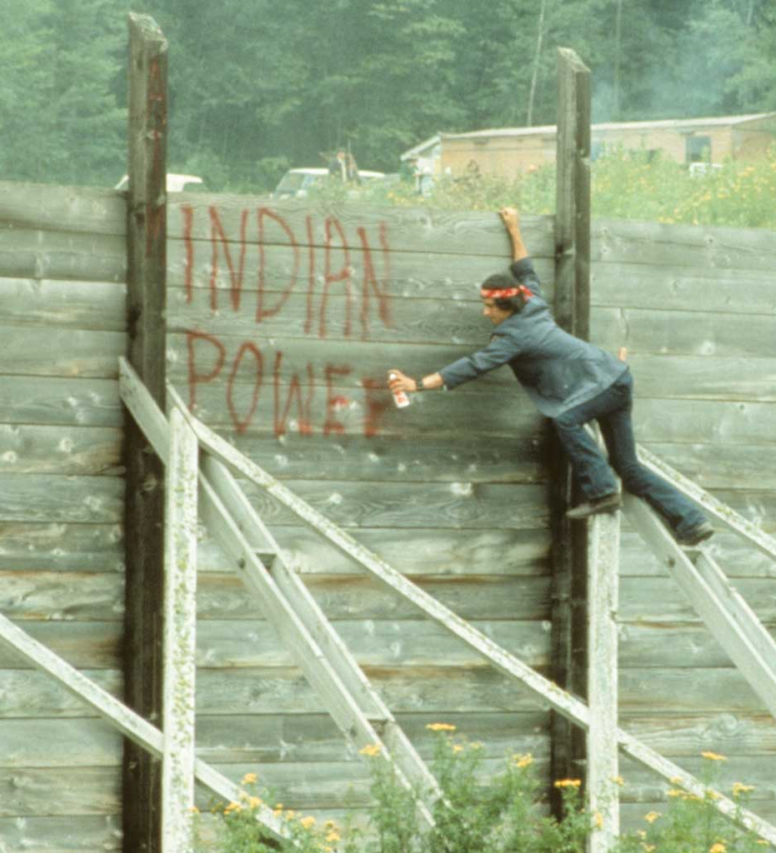
Post-module Student Projects:
Offer a postscript to Where the River is Wide about the Chippewa Flowage. What has happened since 1998 when this was written? Create a short essay or multimodal presentation (online StoryMap, web site, YouTube video, TikTok, etc.) that updates the story.
Select a Wisconsin or Great Lakes dam that wasn't discussed in class and create a short essay or multimodal presentation that offers the story of the dam in the context of Indigenous dispossession.
Highlight a contemporary example of Native resistance to a North American dam. Create a short essay, StoryMap, or multimodal presentation that highlights the story and points to important lessons for inspiration.
Winter Dam Takeover, 1971
Credit: facingfreedom.org

