Slide 1
The US-Dakota War
Module 1: The 1862 Moment
Whose Land was “Granted” to the Land Grant?

Slide 2
Lesson Objectives
Identify Dakota homelands
Recognize key individuals and events connected to US-Dakota War
Describe the ways treaty-making and land loss contributed to the war
Understand how US-Dakota war fits into national events of 1862 moment
Explain the historical legacy of the war

Slide 3
Key
Words
US-Dakota War
Treaties
Dakota homelands
Bdote
Fort Snelling
Exile
Dakota Expulsion Act

Slide 4
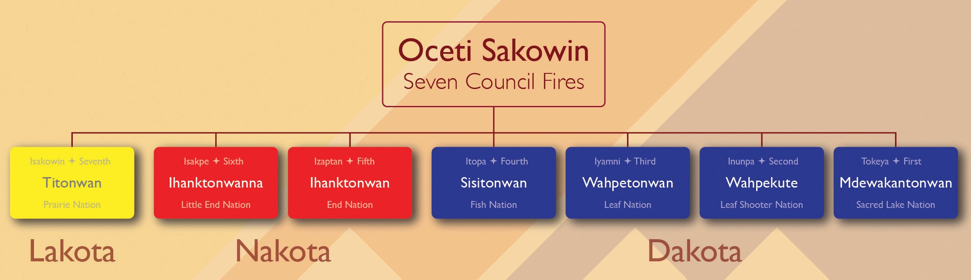
Dakota Peoples

Slide 5
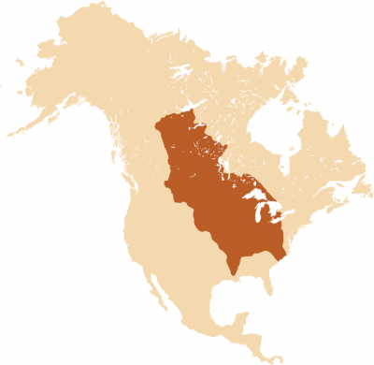
Dakota Homelands
“Aboriginal Map of North America denoting the Boundaries and Locations of various Indian Tribes,” 1857.
Notes:
View
US-Dakota War: Dakota People: https://www.youtube.com/watch?v=LAyP-nLrsuI

Slide 6
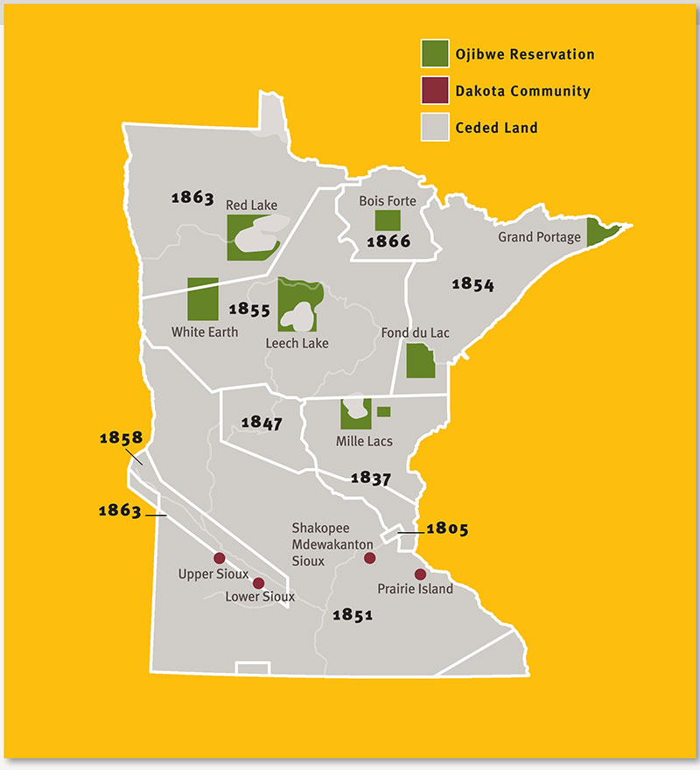
Treaties in Minnesota
Image from the Minnesota Historical Society Collections

Slide 7
Independent Treaties Activity
Explore Interactive Treaties Website
https://www.usdakotawar.org/history/treaties/minnesota-treaty-interactive
Explore Why Treaties Matter Website
https://treatiesmatter.org/exhibit/welcome/

Slide 8
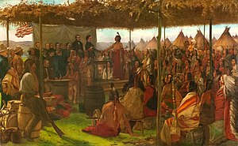
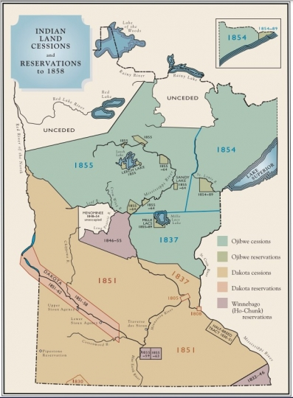
Treaties Discussion
Treaty of Traverse des Sioux
Francis Davis Millet
Based on your review of the websites:
What is a treaty?
Who entered into treaties?
What is the significance of treaties?
What were the general trends of the treaties across present-day Minnesota?
How should we treat treaties today?
What did treaties protect for Native people?

Slide 9
Historical Context and
War
Dakota land loss and treaty making
Increased non-Native settlement
Failed crops and poor growing conditions
Federal government fails to fulfill treaty obligations
Dakota face starvation
Six weeks during summer 1862
Minnesota River Valley
Dakota divided
  Some advocate for peace
  Some advocate for continued violent resistance
Minnesota Governor Alexander Ramsey
Henry Sibley leads US forces

Slide 10
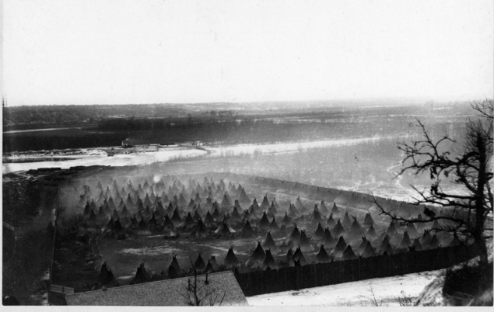
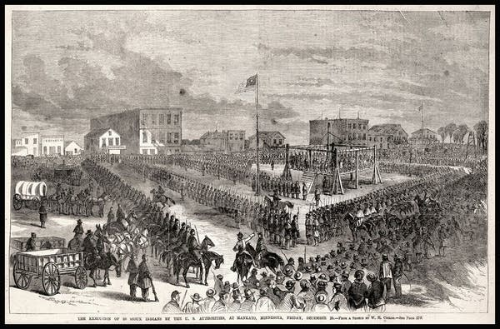
Aftermath
Concentration camp at Fort Snelling
  Dakota women, children, elders – “non-combatants”
  ~ 400 of the 1,600 held there would die
38 Dakota men hanged at Mankato, Minnesota
  December 26, 1862
  Largest mass execution in US history
Dakota Concentration Camp, Fort Snelling
Minnesota Historical Society Collections
Minnesota Historical Society Collections

Slide 11
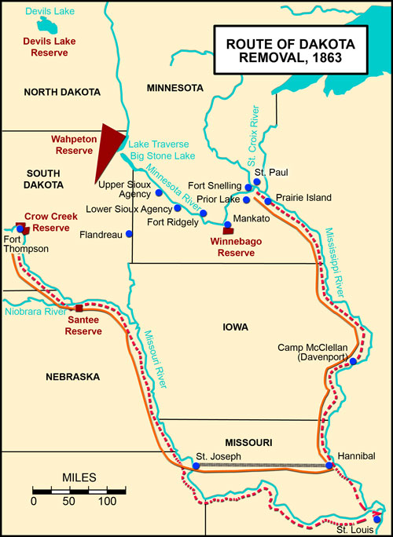
Exile
Spring 1863
  Acts of Congress abrogates treaties with Dakota
Dakota exiled from Minnesota
Ho-Chunk exiled from Minnesota
Exile remains on the books today
Map by Cassie Theurer, adapted from original by Alan Ominsky

Slide 12
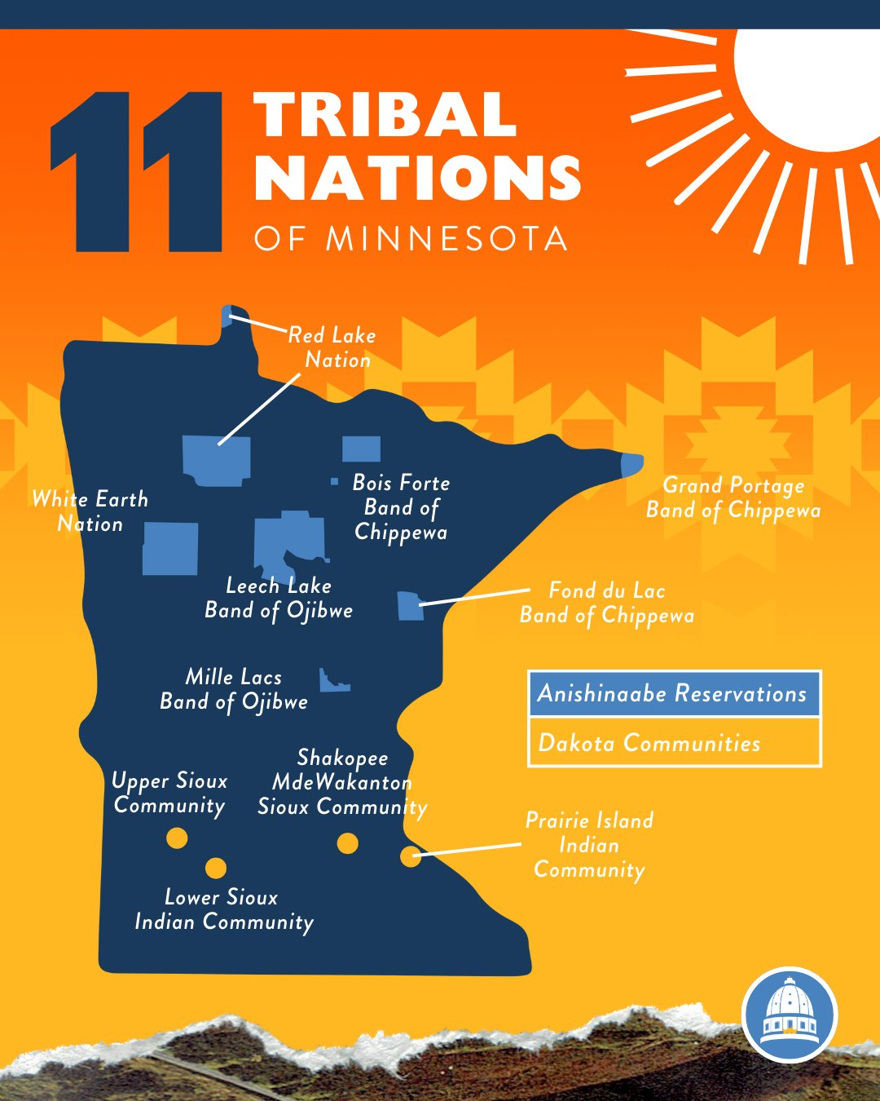
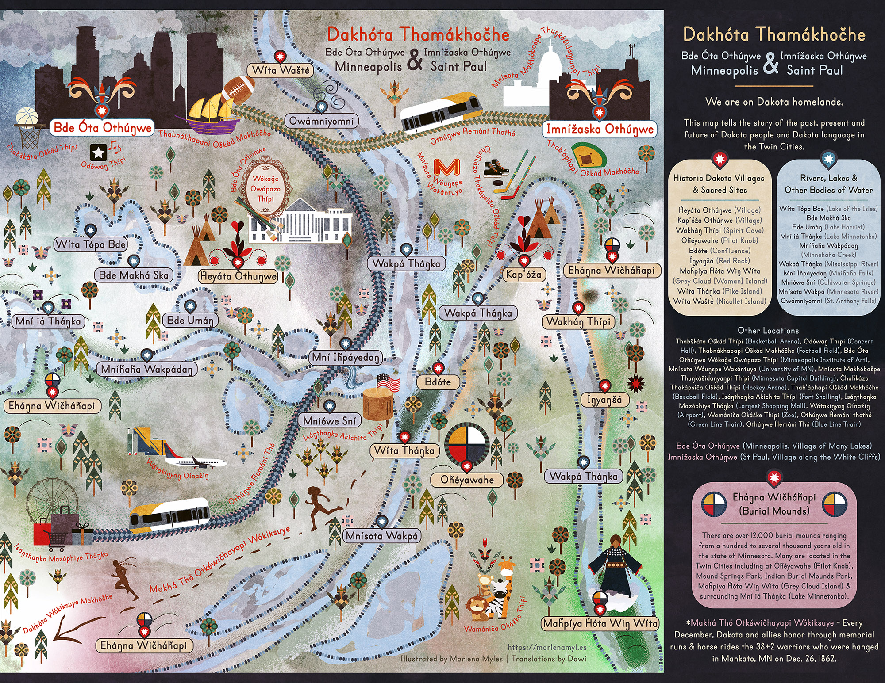
Dakota Return
Four federally recognized Dakota communities in Minnesota
4,000 Dakota people live in MN today
Ongoing work to reclaim land, revitalize language & culture

Slide 13
US-Dakota War Discussion
What did you know about the US-Dakota War prior to today’s lesson?
  Why do you think the US-Dakota War is not something that is widely taught or known outside of Minnesota?
What were the complex factors that led to the outbreak of violence in 1862 across southern Minnesota?
  What are the larger historical forces?
How should we think about the US-Dakota War in the context of the Morrill Act of 1862?
How can we, as benefactors of Native dispossession, work to reconcile histories of violence?

