Slide 1

Subsequent Land Grants: The Morrill Acts of 1890 and 1994
Whose Land Was “Granted” to the Land Grant?

Slide 2
Lesson Objectives
Explain what HBCUs and TCUs are and how they came to be
Compare and contrast the various Morrill Acts and the ensuing institutions
Recognize the inequities between the Morrill Act of 1862 with the subsequent land grant institutions
Describe the Morrill Act of 1890 and 1994

Slide 3
Key Terms
Historically Black Colleges and Universities (HBCUs)
Tribal College and Universities (TCUs)
Second Morrill Act/Morrill Act of 1890
Equity in Educational Land-Grant Status Act of 1994
1994 Land-Grant Institutions

Slide 4
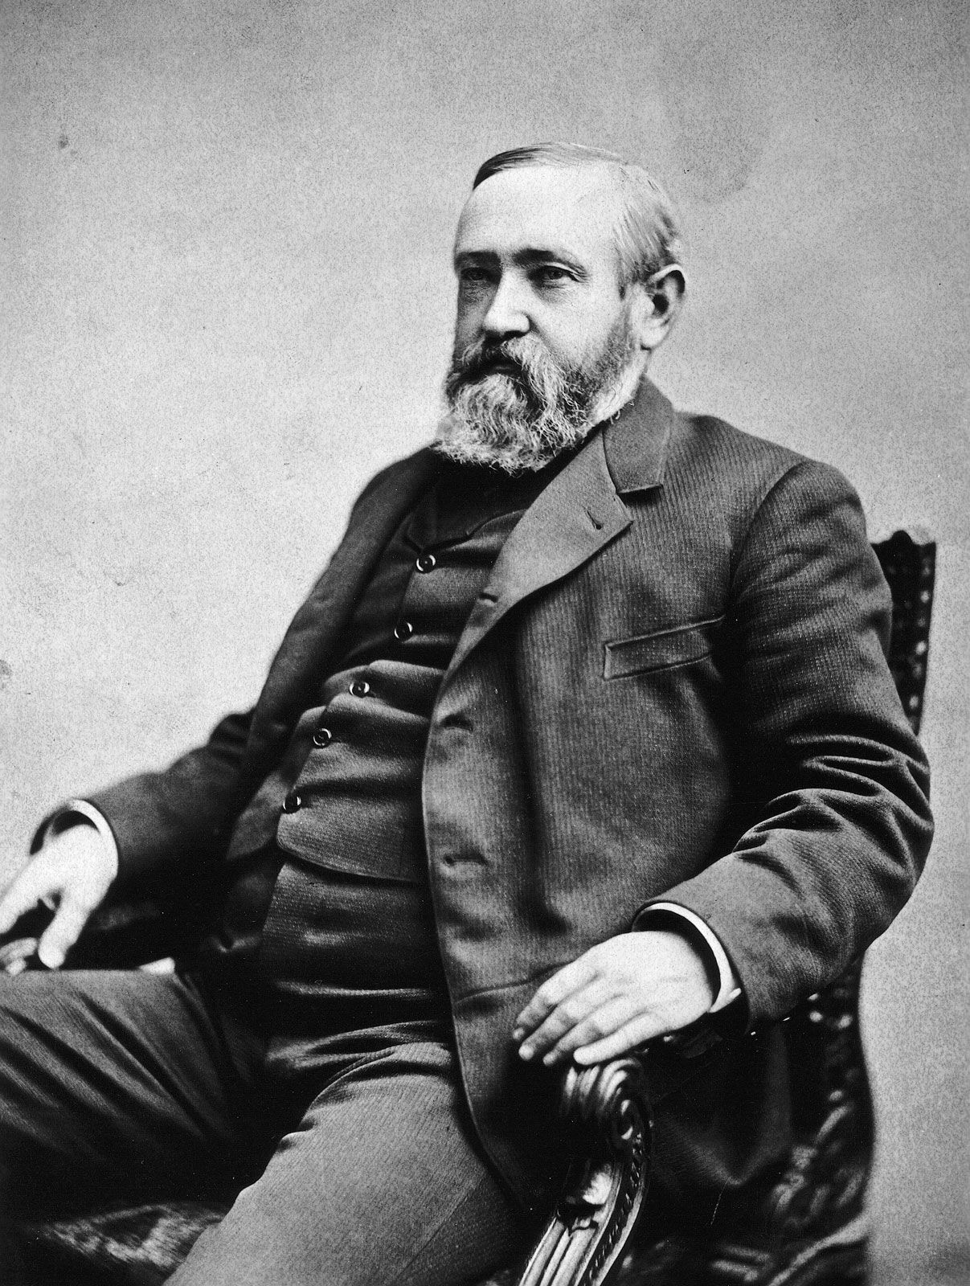
What is the Morrill Act of 1890?
Signed into law on August 30th, 1890, by President Benjamin Harrison
Required each state to show race was not an admissions criterion to the 1862 land-grant institution
If it was, the state was to designate a separate land-grant institution for Black people
In this way, the Morrill Act facilitated the segregation of higher education
President Benjamin Harrison

Slide 5
Discussion
What does it mean to have “separate but equal” institutions of higher education?
What does it mean for public land-grant institutions to refuse to admit Black people?
How do we see these legacies reflected today?

Slide 6
How did the Morrill Act of 1890 work?
Activity:
Read text of the Second Morrill Act (1890)
Small Group Discussion
How was the Morrill Act of 1890 funded?
How was the Morrill Act of 1890 “enforced”?
What is surprising about Second Morrill Act?

Slide 7
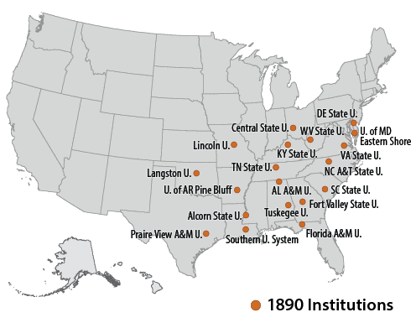
What is the legacy of the 1890 Morrill Act?

Slide 8
Land-Grant But Unequal Discussion
Questions
What other land-grant legislation do the authors describe? Why does this other legislation matter?
How do present-day disparities reflect the history of racism higher education in America?
What do you think about Lee & Keys's recommendations? Are these sufficient and/or desirable?

Slide 9
Equity in Educational Land-Grant Status Act of 1994
Signed into law on October 20th, 1994
Designed to provide more equity in funding institutions of higher education
Designated all tribal colleges and universities as land grant institutions

Slide 10
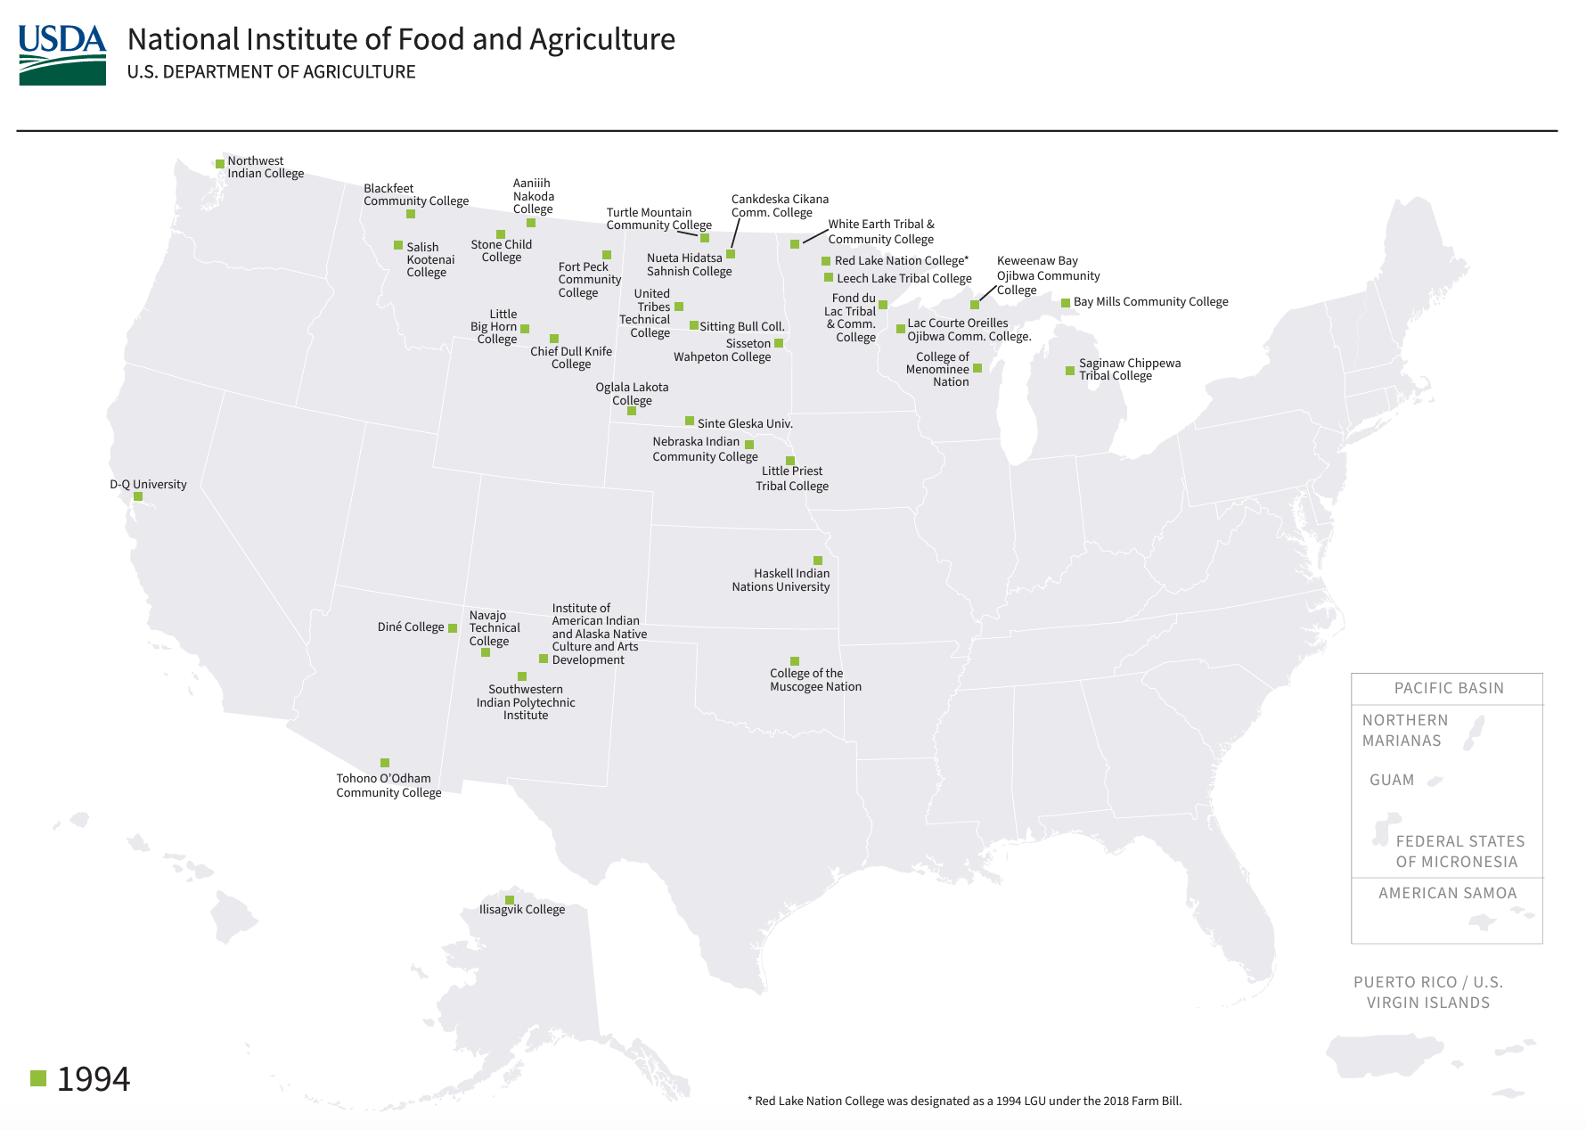
the 1994 Land grant Institutions

Slide 11
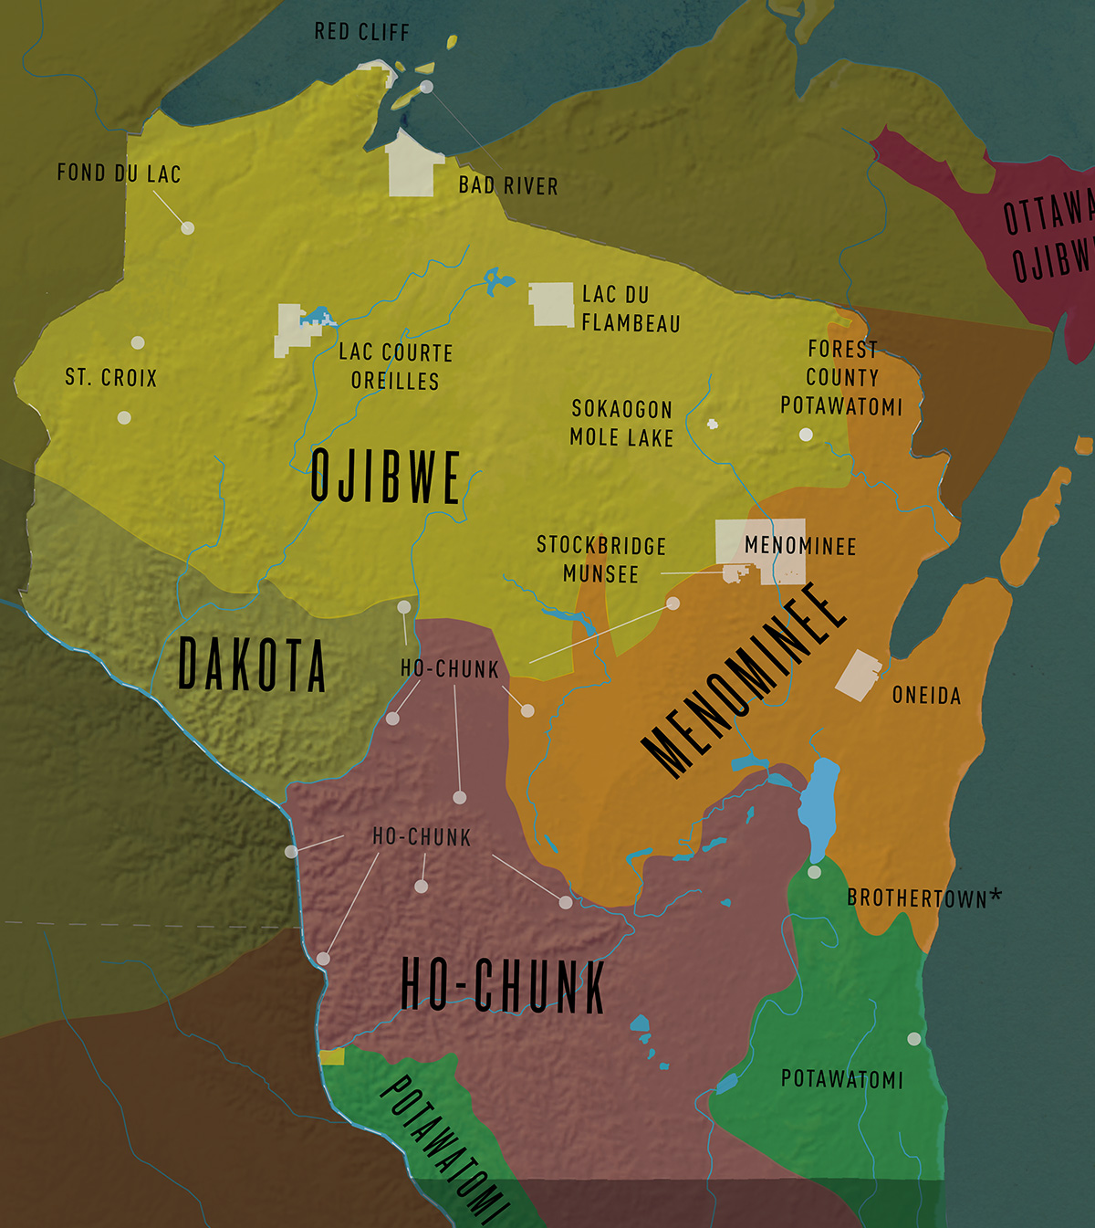


TCUs in Wisconsin
College of Menominee Nation
Lac Courte Oreilles Ojibwe Community College

Slide 12
Activity: Guided Exploration of Tcus
Explore:
The American Indian College Fund’s “Tribal Colleges and Universities”
American Indian Higher Education Consortium “TCU Roster and Profiles”
Guiding Questions:
Where are these TCUs located and why?
Who attends these schools?
What degrees are offered at these schools?
What types of resources do they offer students?
How do they differ from UW-Madison and other land grant institutions? Why?

Slide 13
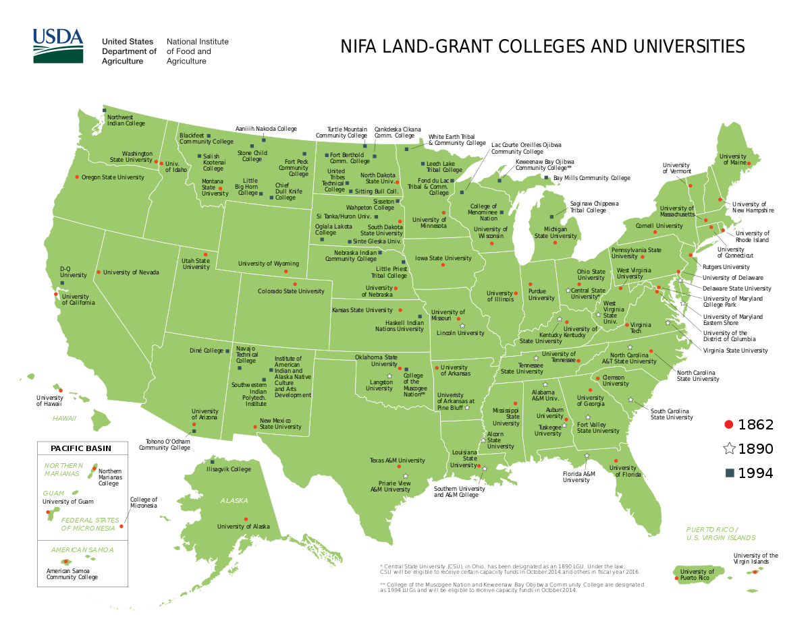
Discussion

