Slide 1
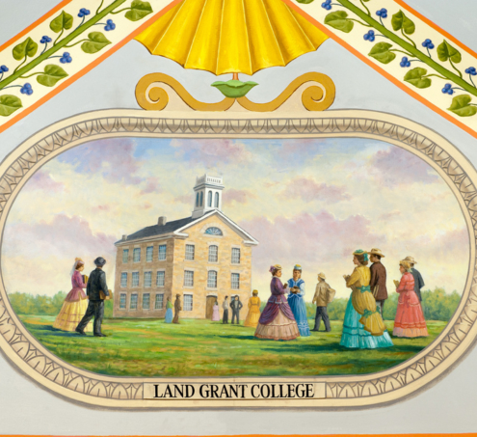
The Morrill Act
Module 1: The 1862 Moment
Whose Land was “Granted” to the Land Grant?
Notes:
This college building in Kansas was one of the first created under the 1862 Morrill Act, which was meant to ensure higher education for all classes of Americans. (Photo credit: Architect of the Capitol)

Slide 2
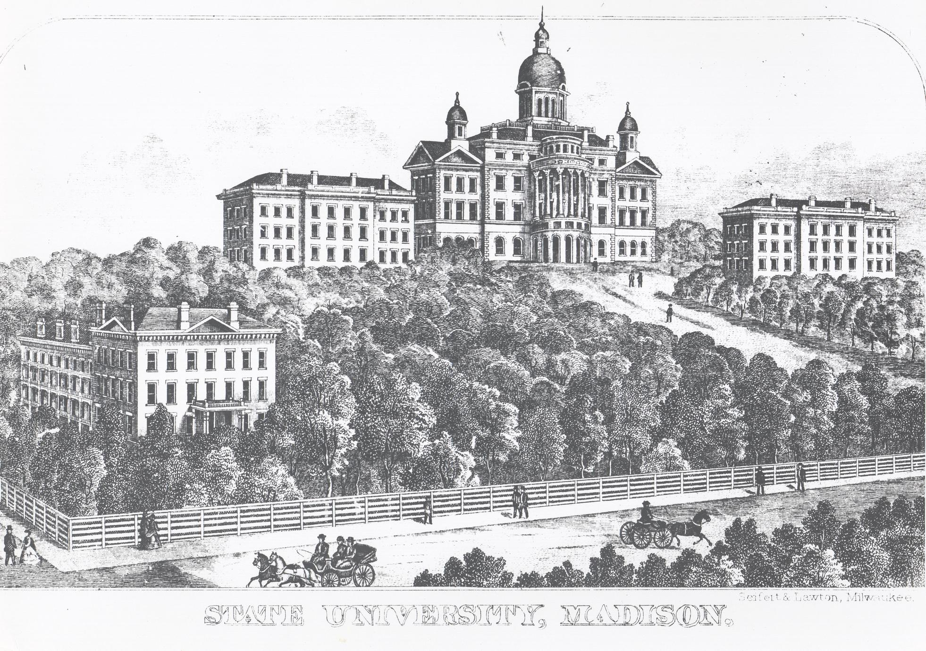
Lesson objectives
Define and describe the Morrill Act of 1862
Analyze how the Morrill Act functioned
Acknowledge the ways the history of Morrill Act dispossession connect to the present
Recognize the broader national political moment that the Morrill Act in 1862 was enacted during
Critically reflect on the ways UW–Madison and other land grant institutions have and continue to benefit from Indigenous dispossession
Bascom Hall; UW–Madison Archives; Milwaukee, Wisconsin: Seifert & Lawton

Slide 3
Key Terms, People, and Places
Morrill Act of 1862
Justin Morrill
Land grant
Land parcels; script
Agriculture and mechanical arts
Land grab universities
Endowment
Dispossession

Slide 4
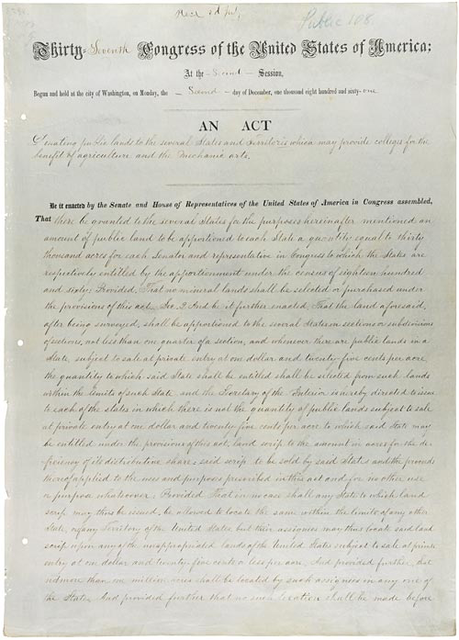
What is the Morrill Act?
Passed by the Senate on June 10th, 1862 and the House on June 17th, 1862
First federal intervention into the funding of higher education
Goal was to fund public institutions across the US and invest in practical and accessible higher education
Morrill Act (1862), National Archives

Slide 5
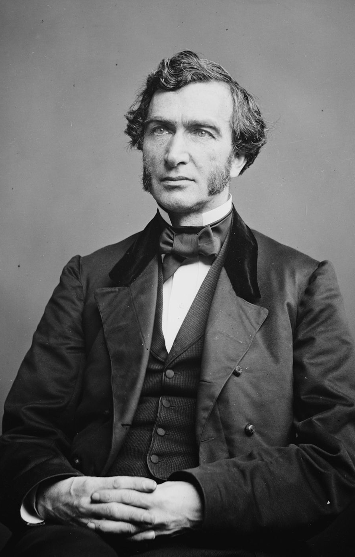
How did the Morrill Act Come to Be?
  Passage of the Morrill Act was led by Illinois College professor, Jonathan Baldwin Turner
  Illinois state legislature adopts resolution for land-grant institutions at state level
  Proponents support legislation to be introduced by a congressperson from the east (Senator Justin Morrill of Vermont)
  The Morrill Act was proposed in 1857, passed Congress in 1859, but was vetoed by President James Buchanan
  The Morrill Act was reintroduced in 1861 under President Abraham Lincoln, who signed it into law on July 2nd 1862
Justin Morrill, Library of Congress Prints and Photographs Division. Brady-Handy Photograph Collection.

Slide 6
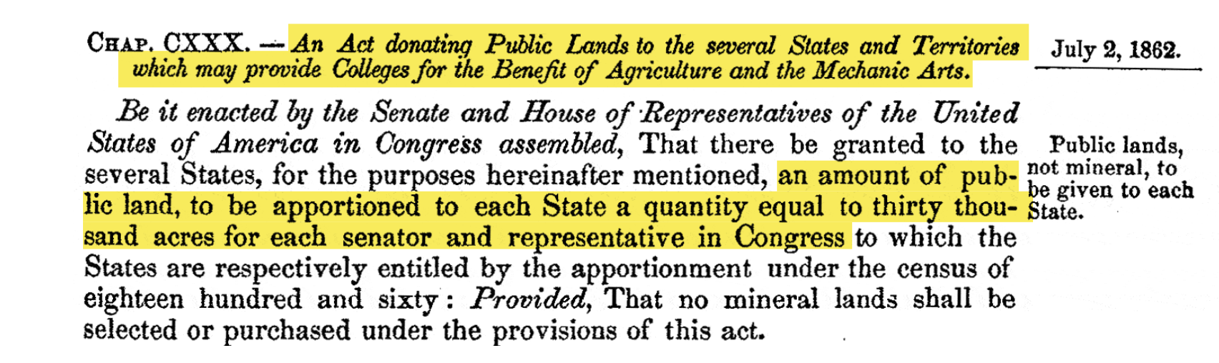
HOW did the Morrill Act Work?
Each state was to establish a college/university funded by the sale of federal lands
The Morrill Act provided each state with 30,000 acres of “public land” per each member of Congress
This land was then sold off by state governments and used to fund public universities with a focus on agriculture and the mechanical arts
  Some states with no remaining “public land” received “script,” or deeds to land in western states

Slide 7
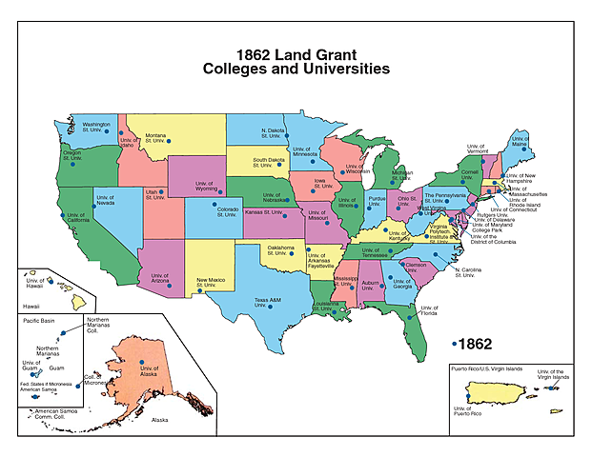
1862 Land Grant colleges and universities

Slide 8
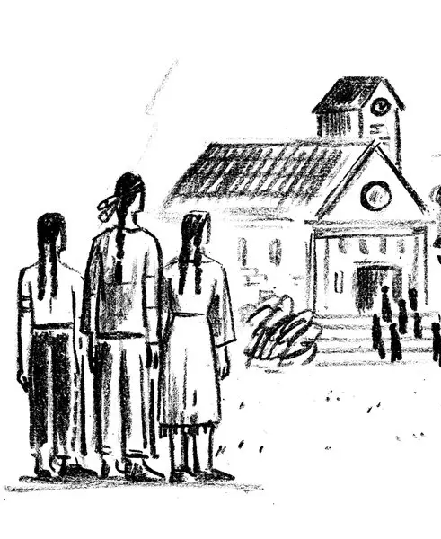
American Indians and the Morrill Act
The Morrill Act redistributed 10.7 million acres of land from more than 250 tribal nations across the United States
However, American Indians were denied access to education at most land grant universities
Agnes Lee, the New York Times

Slide 9
AMERICAN INDIANS AND THE MORRILL ACt Activity
Visit landgrabu.org
Explore the mapping features, Guided by the following questions:
  What tribal lands did the University of Wisconsin acquire from the Morrill Act?
  How much money did the University of Wisconsin generate from the sale of those lands?
  What other universities benefitted from Indigenous dispossession in Wisconsin through the Morrill Act?

Slide 10

What is the lasting impact of the Morrill Act?
Discuss the following questions:
  How does the University of Wisconsin talk about its history today and how does this relate to the history of Indigenous dispossession, if at all?
  What histories are centered at the University of Wisconsin? What histories are ignored or hidden and therefore not told?
  How does the Wisconsin Idea (below) relate to the Morrill Act, past and present?
  How have you benefited, if at all, from the University of Wisconsin as a land grant institution?
  In your opinion, how should UW acknowledge and address implications of the Morrill Act and being a land grant university?
The Wisconsin Idea: central to the core mission of the University of Wisconsin–Madison is our commitment to the Wisconsin Idea, which states that what we do here at the University should enhance the lives of every person in the State of Wisconsin, as well as around the nation and the world (Office of the Chancellor).
Jeff Miller/UW–Madison, 2015.

Slide 11
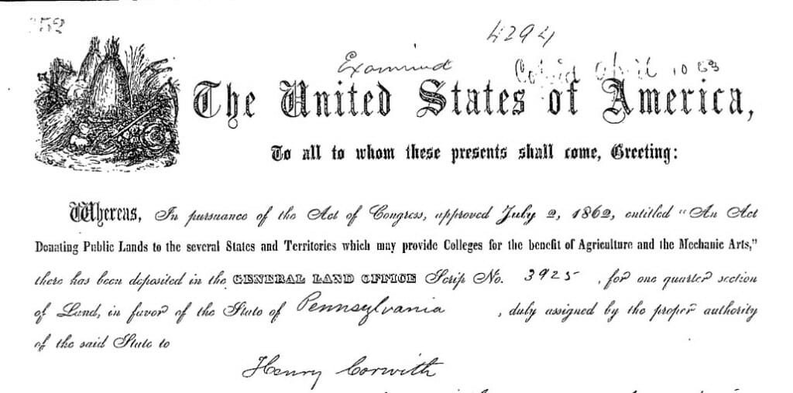
How does the Morrill Act Fit in The Broader 1862 Moment?
How is the Morrill Act a part of the 1862 Moment?
Passed in the midst of ongoing war and conflict
  US Civil War
  US Dakota War
Implemented in addition to two other major land redistribution programs
  The Pacific Railway Act
  The Homestead Act
A General Land Office patent for a parcel in Taylor County, Wisconsin. Henry Corwith bought the parcel using scrip purchased from Pennsylvania to benefit Penn State.

