Slide 1
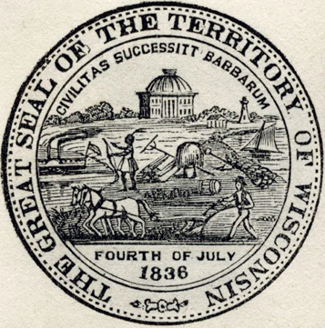
Key Concepts for Understanding Expropriation of Indigenous Land in Wisconsin and Beyond
“Whose Land Was Granted?”
An educational module funded by the National Endowment for the Humanities
The Seal of the Territory of Wisconsin. “Civilization Succeeds Barbarism” as justification for land expropriation. Wisconsin Historical Society, WHS-64629

Slide 2
Covered in this module:
What is a land grant institution and how does it relate to land expropriation?
Terra Nullius and settler colonialism
Doctrine of Discovery
Wisconsin First Nations, Indigenous Sovereignty, and the Indian Removal Act of 1830
The First Morrill Act of 1862
The Alaska Purchase of 1867
The University of Wisconsin
The Wisconsin Idea
(Slides prepared by Ruth Goldstein ruth.goldstein@wisc.edu with insight from Jen Rose Smith, Jessie Conaway, and Annie Menzel)

Slide 3
What is a Land Grant Institution and How Does it Relate to Land Expropriation?
A land grant institution enjoys the benefits of the Morrill Act of 1862 and 1890. It is a state institution of higher learning, either a university or college.
The history of land grants in the United States predate the Morrill Acts.
The United States wasn’t an empty territory, but European settlers treated it that way. The term “terra nullius” refers to “nobody’s land,” defining it as free for the taking.
In what are now the 50 states (and US territories), Indigenous People inhabited this land. It was their land that was granted.

Slide 4
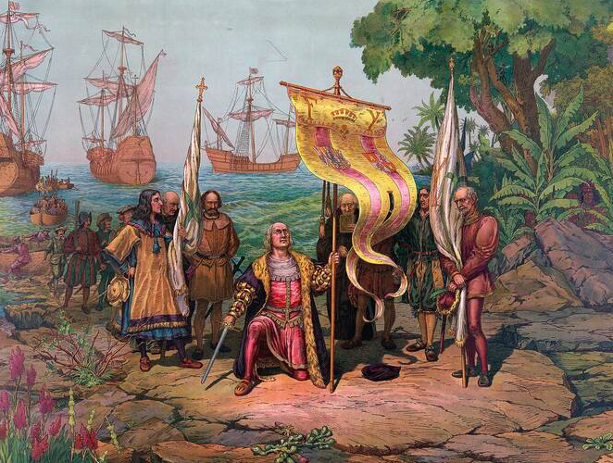
Papal Bulls and The Doctrine of Discovery
- As European powers began to “discover” lands and people new to Europeans, the Catholic Church developed justifications for brutal takeovers and seizures of land. The Papal Bulls authorized the seizure of land and enslavement of non-Christian peoples in the 15th century.
- The “Doctrine of Discovery” traces its history to these Papal Bulls, legitimizing European colonization, seizure, and dispossession of land not inhabited by Christians peoples.
- The “Doctrine of Discovery” has stood for hundreds of years. On March 30, 2023, the Catholic Church declared that the papal bulls did not reflect the teachings of the Catholic Church. Apologies for the harm done to Indigenous Peoples under the banner of Christ received some acknowledgement.

Slide 5

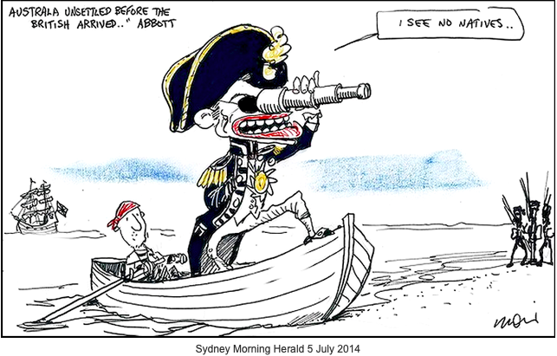
Terra Nullius and Settler Colonialism
In Latin, “terra nullius” means “land without a master.” But this is a European construct, as is the concept of “property”
Because European conceptions of property conceived of land that wasn’t developed into European style agriculture as “occupied,” European settlers didn’t recognize land in the Americas (and elsewhere around the globe) as occupied.
This definition of “land without a master” rests on assumptions that humans live apart from, rather than a part of, the environment.
“Settler colonialism” refers to people who take and inhabit land, displacing – often violently - the previous inhabitants.
https://bmuc.blogspot.com/2014/07/abbott-clings-to-colonial-myth-of-terra.html
Notes:
The original cartoon showed Australia’s Abbot making a comment about Australia as “unsettled land” before the British arrived.

Slide 6
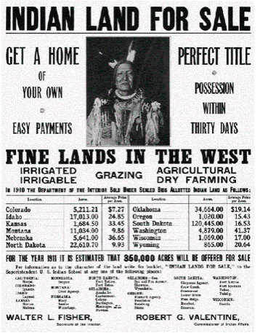
Wisconsin First Nations, Indigenous Sovereignty, and the Indian Removal Act of 1830
https://www.loc.gov/item/2015657622/
Notes:
But of course, what is now called Wisconsin wasn’t an empty territory.

Slide 7
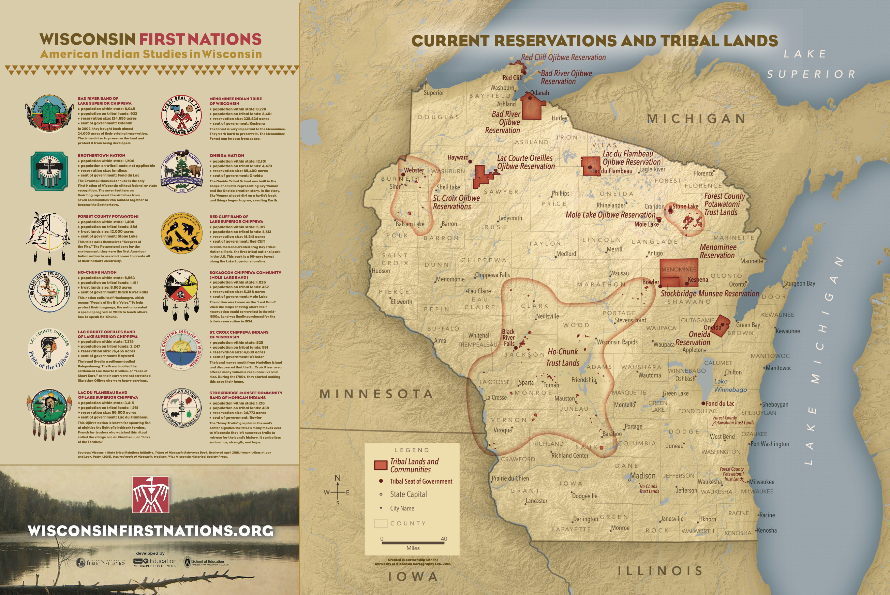
Wisconsin First Nations and Indigenous Sovereignty
Wisconsin First Nations have been in what is now called Wisconsin since time immemorial.
Not all Indigenous Peoples have federal recognition, but this doesn’t mean that their claims to land, history, or identity aren’t valid.
Notes:
See https://wisconsinfirstnations.org for teaching plans and resources

Slide 8

Effects of the the Indian Removal Act of 1830
On May 28, 1830, United States President Andrew Jackson signed the Indian Removal Act into law. The law provided for a so-called “exchange” of lands with Native Americans and to move them west of the Mississippi River. Under Jackson (1829-1837) and then Martin Van Buren (1837-1841), some 60,000 Indigenous Americans were forced off their land during the Trail of Tears. The number of deaths range from estimates of 10-16,000 people.
The Ojibwe in Wisconsin were forced to cede land between 1837 and 1843 and the Ho-Chunk were forced to Nebraska in 1874 but continued to return to Wisconsin. In 1881, the US government allotted the Ho-Chunk forty-acre homesteads, nothing compared to their original lands. The Ojibwe bands lost the majority of their land but retained a small portion of their ancestral lands – though they had to continue to fight to protect these rights.
See this UW resource for more information

Slide 9
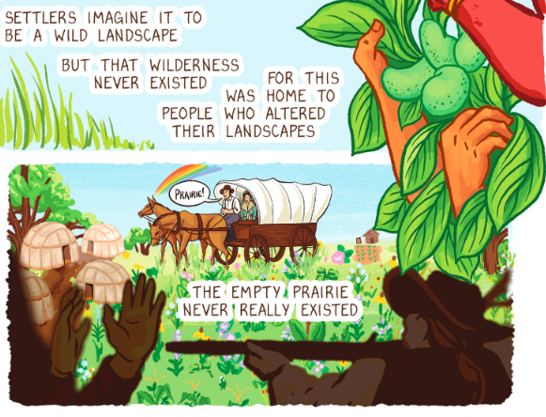
The First Morrill Act of 1862
On July 2, 1862, the United States government passed the Morrill Act, which gave “public lands to the several States and [Territories] which may provide colleges for the benefit of agriculture and the Mechanical arts.” The Act, sponsored by Senator Justin Morrill of Vermont, made a “donation” of land taken from Native American peoples, apportioning 30,000 acres per each senator and representative in each state (according to the 1860 census). There was an additional provision that: “no mineral lands shall be selected or purchased under the provisions of this Act.” The government would keep such precious lands for itself.
Drawing of cart in prairie. Artwork by Liz Kozik 2023

Slide 10
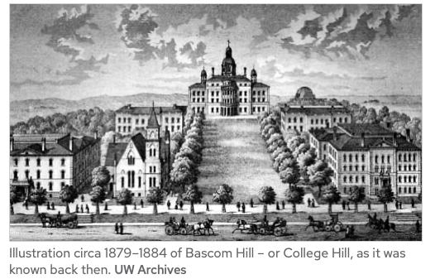
The First Morrill Act of 1862
The Morrill Act would ultimately “gift” over 100 million acres taken from stolen land to states for educational purposes, although the land would often not be the grounds for school construction, but rather sold off to private buyers. From the proceeds that did go towards public education, the Morrill Act did create the foundation in land and in monetary structure for public state colleges and universities of today. The University of Wisconsin campuses represent one of the educational systems that did benefit from the sale of land granted under the Morrill Act.

Slide 11
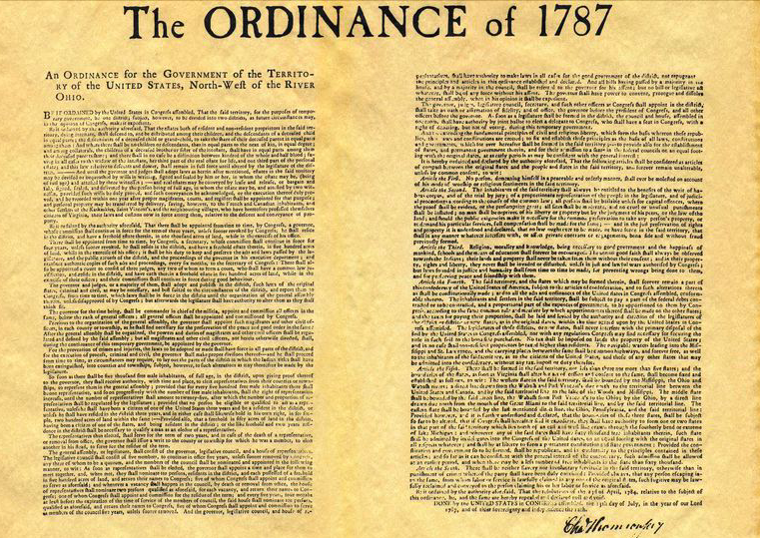
The First Morrill Act of 1862
While the Morrill Act stands as the groundwork for the land grab that continues to sustain public higher education in many states, it’s important to understand how support for public education – as well as appropriation of Indigenous land inscribed in law, began earlier. In 1787, the same year that tribal nations would enter – most often by force – into treaties “as equals” with the United States, the Continental Congress passed the Northwest Ordinance.
The ordinance declared that: "Knowledge, being necessary to good government and the happiness of mankind, schools and the means of education shall forever be encouraged." This supported Senator Morrill’s quest for educational support, built on expropriation of Indigenous lands. The treaties signed would not be upheld by the US government, providing the “land donations” of the Morrill Act.
“The Northwest Ordinance is one of the great American Founding documents. Often it is considered as the single most important accomplishment under the Articles of Confederation.”
The Northwest Ordinance, July 13, 1787 - UW-Madison History Department’s Center for the Study of the American Constitution

Slide 12
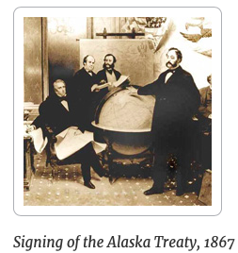
The Alaska Purchase of 1867
Often left out of discussions of Land Grab Universities, Alaskan Indigenous Peoples have also experienced settler colonialism and dispossession from their land. First, from the Spanish, British, and Russians (1741-1800s) and then the United States governments (1800s onward).
The United States purchased Alaska in 1867 from Russia, gaining a monopoly on the seal fur trade.
Founded in 1917 as the Alaska Agricultural College and School of Mines, UAF is Alaska's only Land Grant college. But Sea Grant and Space Grant institutions also occupy Indigenous land on Alaskan Native territories.

Slide 13
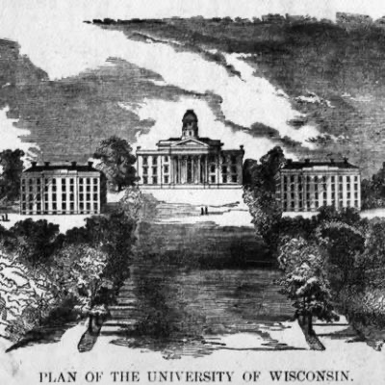
The University of Wisconsin
Wisconsin becomes a state and the University of Wisconsin is founded in the same year–1848.
Notes:
See: https://history.wisc.edu/department-information/the-history-of-the-history-department/timeline-1848-founding-of-the-uw/ for a brief summary of the first years and how many students as well as faculty

Slide 14
The Wisconsin Idea
The Wisconsin Territorial Seal of 1836 was created four years after the first treaty by which the US government attempted to displace the Ho-Chunk Nation from the lands and waters on which the University of Wisconsin sits. The UW is still occupying this land.
According to the UW’s website, “The fact that Van Hise was a prominent eugenicist, however, casts his notion of a “beneficent influence” on “every family” in a more sinister light. In the words of the UW’s Department of Genetics, Van Hise “vocally advocated for eugenic laws in the State of Wisconsin as a part of the ‘Wisconsin Idea’...This…helped drive the 1913 Wisconsin sterilization and marriage statutes, authorizing involuntary sterilization of inmates of mental and penal institutions.”

Slide 15
The Wisconsin Idea
The genesis of the Wisconsin Idea is often attributed to former UW President Charles Van Hise, who in a 1905 address declared, “I shall never be content until the beneficent influence of the University reaches every family of the state”
…the Wisconsin Idea has come to signify more broadly the university’s commitment to public service — a mission that substantially predates the progressive political era.

Slide 16
The Wisconsin Idea
While just one particularly prominent figure in the history of the Wisconsin Idea, Van Hise’s white supremacist and ableist imperatives were more rule than exception. As S. Ani Mukherji writes:
“the historical vision of the Wisconsin Idea, the state’s politics were founded on the liberal ideals of exiled German revolutionaries and a Scandinavian communitarian outlook. This progressive ethos inspired Wisconsin abolitionists in the antebellum period, and later led to the embrace of populism and the rise of Robert La Follette.”

Slide 17
The Wisconsin Idea
Wisconsin’s demographic whiteness and urban hyper-segregation are products not of innocent immigration patterns, but of violent and systematic anti-Black racism: Black disfranchisement, the predominance of sundown towns (municipalities that excluded African Americans by threat of death), redlining and racial covenants, and job discrimination.
As An S. Mukherji notes in “Racism and the Wisconsin Idea”:
These campaigns notably occurred in the same years that the Wisconsin Idea was first being implemented.

Slide 18
The Wisconsin Idea
Native Nations UW Initiative Leaders Aaron Bird Bear (Diné/Three Affiliated) and Omar Poler (Sokaogon Ojibwe) have highlighted Wisconsin’s 1836 Territorial Seal (see top of section) in their longstanding work to center Native histories and presence on campus. As Poler shows participants in his UW cultural landscape tour, and BirdBear discussed in his 2019 presentation, “Teaching 12,000-Year Human History of Campus,” the seal offers both a visual representation and written expression of the US’s genocidal displacement of the Native Nations of the lands that it was claiming under the name Wisconsin. As BirdBear notes, the seal is a kind of “graphic novel” telling the white colonial power’s self-justifying story about this place.

Slide 19
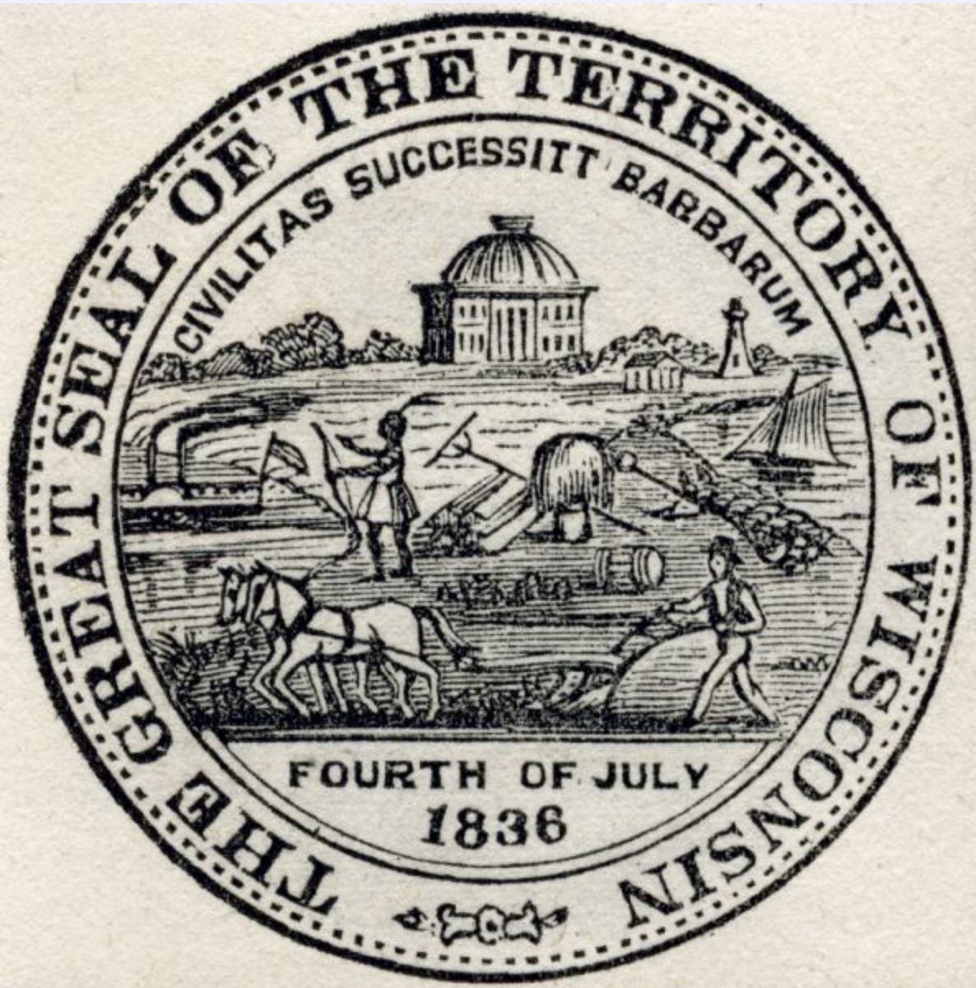
The Wisconsin Idea
Take some time to look closely at this territorial seal. What do you notice?

Slide 20
The Wisconsin Idea
The Latin phrase “Civilitas Successitt Barbarum” means “Civilization Succeeds Barbarism”--framing the displacement of the Native man by the hale and hearty white farmer in the center foreground, as a natural and inevitable outcome of history and human progress.
The representation of the Native man–pictured as a single lone hunter, a generic “Indian” with no ties to a specific place, community, family, or culture–is situated at the very edge of the land, arguably at the point of a pitchfork. The white farmer, driving his plow over the phrase “Fourth of July” personifies the spirit of pioneer hard work and independence. The ships in the harbor signify marine commerce and perhaps modern transport. The monumental architecture of the state’s capitol crowns the image of fertile plains.

Slide 21

The Wisconsin Idea
Ho-Chunk doctoral candidate in Art History Kendra Greendeer notes that monumental architecture–both state capitol and the University of Wisconsin itself entailed the destruction of countless earthen monuments.
By the time the territorial seal is replaced with the state seal in 1851 (see below) there is no representation of Indigenous presence at all. A miner and a mariner, both idealized white men, hold the tools of their trade. “Civilization Succeeds Barbarism” has been condensed to simply “Forward,” erasing any trace of Indigenous history or presence.

Slide 22
For further study:
Basics of Settler Colonialism
Dunbar-Ortiz, Roxanne. 2014. “Introduction” and “‘Indian Country’” in An Indigenous People’s History of the United States. New York: Beacon Press. (PDF)
Kauanui, J. Kēhaulani (Kanaka Maoli) and Patrick Wolfe (settler), “Settler Colonialism Then and Now.” Politica & Societa 2: 235-258. (PDF)
Snelgrove, Corey (white settler), Rita Dhamoon (South Asian arrivant), Jeff Corntassel (Cherokee). 2014. “Unsettling settler colonialism: The discourse and politics of settlers, and solidarity with Indigenous nations.” Decolonization: Indigeneity, Education & Society 3 (2): 1-32. (PDF)
Barker, Joanne (Lenape). 2005. “For Whom Sovereignty Matters” in Sovereignty Matters: Locations of Contestation and Possibility in Indigenous Struggles for Self-Determination. Lincoln: University of Nebraska Press. Pp: 1-31. (PDF)
Deloria Jr, Vine (Standing Rock Sioux). 1969. “Laws and Treaties.” in Custer Died for Your Sins; An Indian Manifesto. New York: Macmillan. (PDF)

Slide 23
For further study:
Ho-Chunk Nation website
Wisconsin First Nations website links to other Native Nations’ websites and has many intro-level resources
Land Grab U Sources--should I curate these to make the list more digestible?
Ho-Chunk Citizen and Indigenous Studies scholar Amy Lonetree’s essay, “A Heritage of Resilience,” about historical studio photographs of members of Ho-Chunk Nation (figure out how to upload). THE PUBLIC HISTORIAN, Vol. 41, No. 1, pp. 34–50 (February 2019).
Our Shared Future website: resources and primary sources relevant to Ho-Chunk history and presence and the state and university as colonial institutions

Slide 24
For further study:
https://www.jstor.org/stable/10.5749/natiindistudj.8.issue-1
https://storymaps.arcgis.com/stories/d402092609d44ab7bac2ead074e7f9c5
Act of July 2, 1862 (Morrill Act), Public Law 37-108, which established land grant colleges, 07/02/1862; Enrolled Acts and Resolutions of Congress, 1789-1996; Record Group 11; General Records of the United States Government; National Archives.
Guyaush, Jime Pete. YEAR? Treaties.
Ordinance for the Government of the Territory of the United States North-West of the River Ohio; 7/13/1787; Miscellaneous Papers of the Continental Congress, 1774 - 1789; Records of the Continental and Confederation Congresses and the Constitutional Convention, Record Group 360; National Archives Building, Washington, DC
Treaties: How we've come to be where we are
https://www.youtube.com/watch?v=kGiRfgXWNZY&t=26s
https://www.archives.gov/milestone-documents/morrill-act#transcript
https://cals.wisc.edu/about-cals/history/

