Slide 1
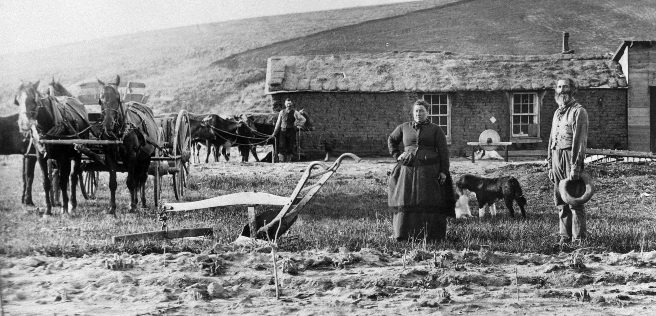
The Homestead Act
Module 1: The 1862 Moment
Whose Land was “Granted” to the Land Grant?

Slide 2
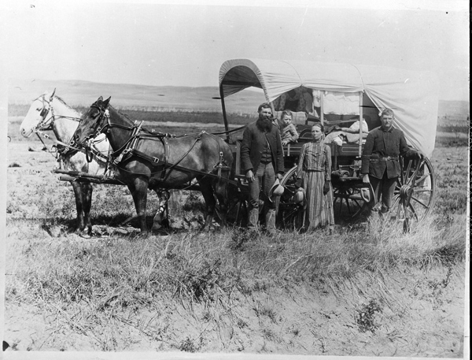
Lesson objectives
Define the Homestead Act
Analyze how the Homestead Act functioned
Connect the Homestead Act to other events of 1862, including the Morrill Act
Describe the ways the Homestead Act of 1862 fueled Indigenous dispossession
Image of family and covered wagon, National Archives

Slide 3
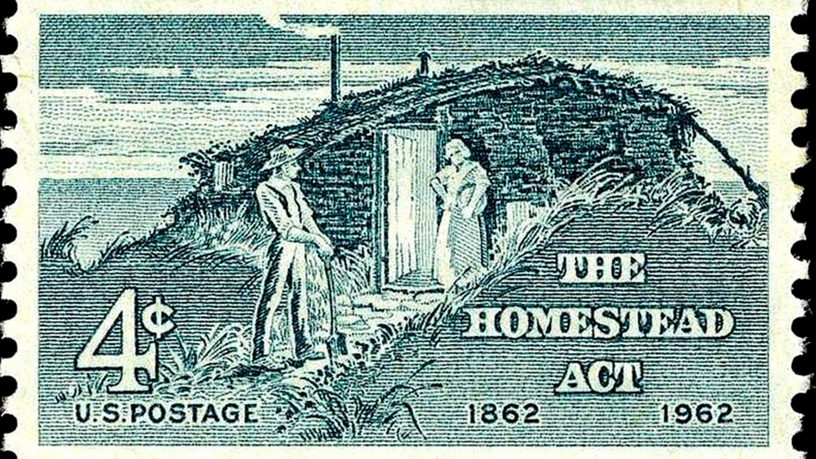
keywords
Homestead Act
Westward expansion
Abraham Lincoln
Land parcel
“proving up”
Settlement
Citizenship
4-cent Homestead Act Stamp, Smithsonian National Postal Museum

Slide 4
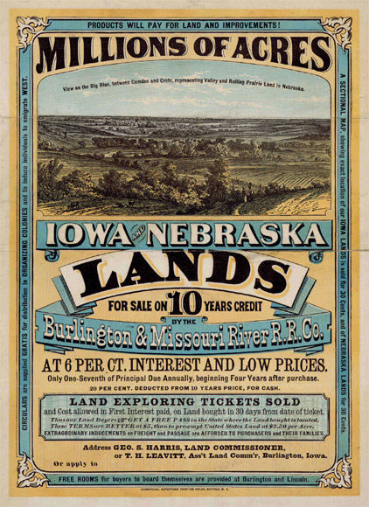
What is the homestead act?
May 20th, 1862
An act of land “redistribution”
Intended to settle lands across the US, including Alaska
270 million acres of land
In effect till 1976 (1986 in Alaska)
“The Building Blocks of the Homestead Act” (3 min runtime)
Poster advertising land for sale, Library of Congress

Slide 5
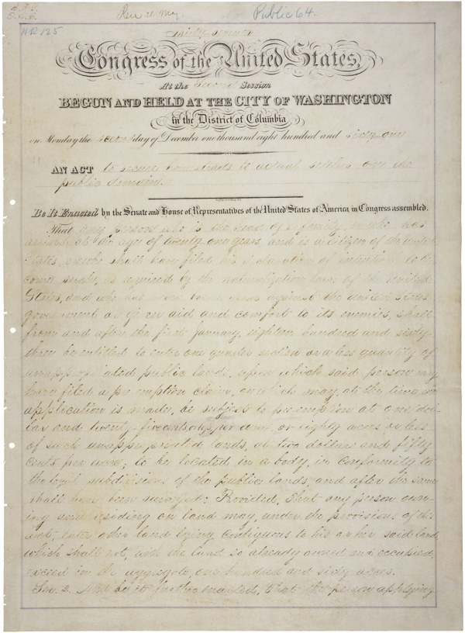
How did the Homestead Act work?
    Land redistribution
    Head of household or 21+ = 160-acres of land
    Had to be a US citizen or person planning to apply for citizenship
    Pay a $18 filing fee
    Had to live on the land, construct a home, and make improvements to the land (i.e. proving up) for 5 years
  Land shifted hands
  Indian land ==> treaties ==> public land (federal government) ==> homestead land ==> individual homesteaders
Text of Homestead Act of 1862, National Archives

Slide 6
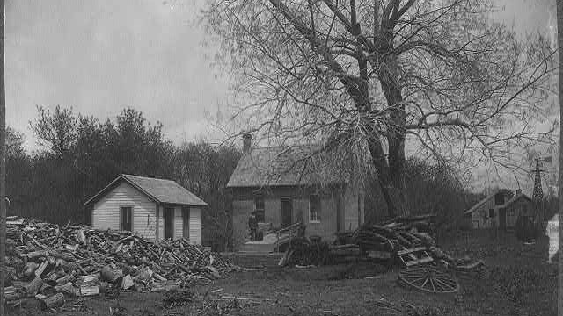
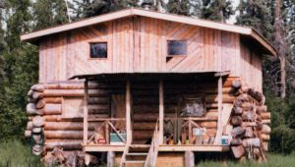
The First and the Last
“The first homestead in the Unites States, U.S.A.,” National Park Service
Kenneth W. Deardorff Homestead, Alaska Public Media
Daniel Freeman Homestead
Beatrice, Nebraska
January 1, 1863 (patent granted 1869)
Kenneth W. Deardorff Homestead
Stony River, Alaska
May 5, 1988

Slide 7

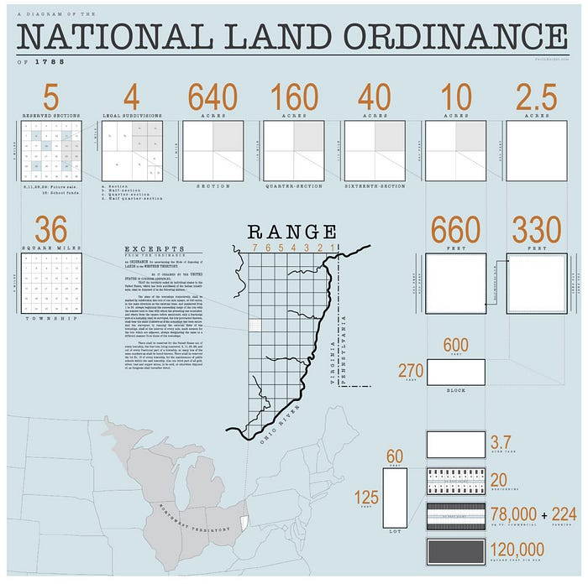
Historical context
The Land Ordinance of 1785 and the Public Land Survey System (PLSS)
National Land Survey, Wikipedia

Slide 8
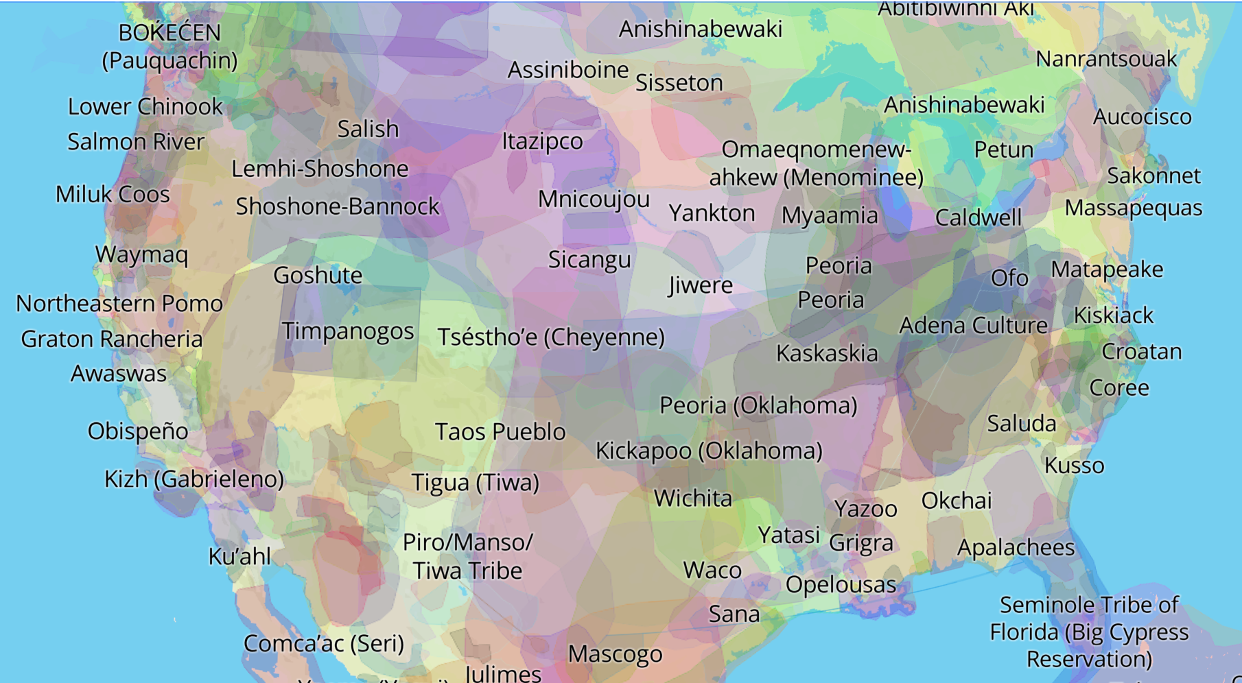
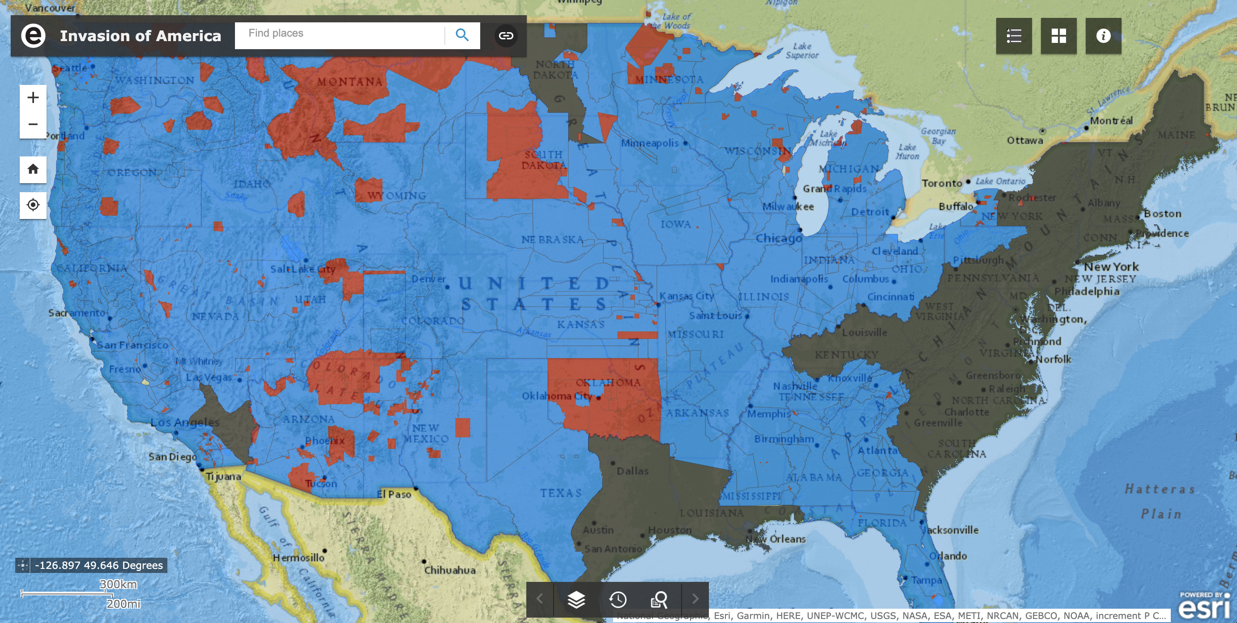
Historical Context
Interactive Native Land Map
The Invasion of America
Indigenous Dispossession via Treaties and Land Cessions

Slide 9
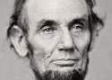
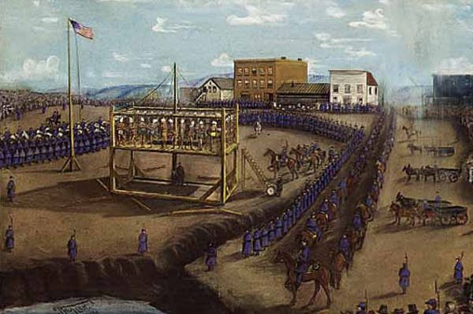
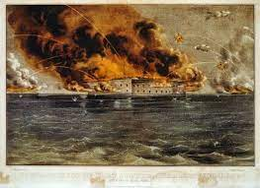
The 1862 Moment
Abraham Lincoln
Abraham Lincoln: elected 16th president of the US, November 1860; inaugurated as president March 1861
Civil War: Confederate forces fire upon Fort Sumter, April 1862
Homestead Act: May 20, 1862
Pacific Railway Act: July 1, 1862
Morrill Act: July 2, 1862
US-Dakota War: Tensions between Dakota and white settlers accelerate. Four Dakota men kill five white settlers, August 17, 1862 (Acton, Minnesota). Six-week war follows.
Dakota hanging at Mankato, Minnesota Historical Society
“Fort Sumter Ablaze,” American Battlefield Trust

Slide 10
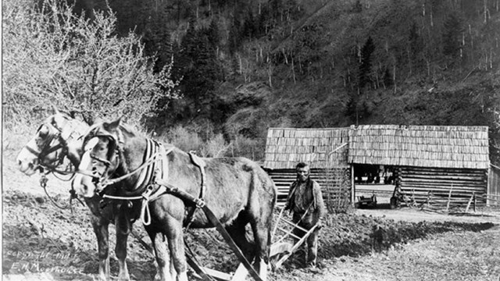
American Indians and the Homestead Act
Most American Indians not US citizens
Federal Indian policy is directly connected to the opening of land for non-Native settlement through the Homestead Act
    Treaty Making with the US (1770s-1871)
    Removal Policy (passed in 1830)
    Creation of Reservations (1770s-1890s)
1875: Homestead Act extended to American Indians who relinquished tribal life, culture, and identity
Image Credit: National Park Service
“Chief Skookum Wallihee plows a field with two horses near the Klickitat River, 1911”
The Oregon Historical Society/E.H. Moorhouse

Slide 11
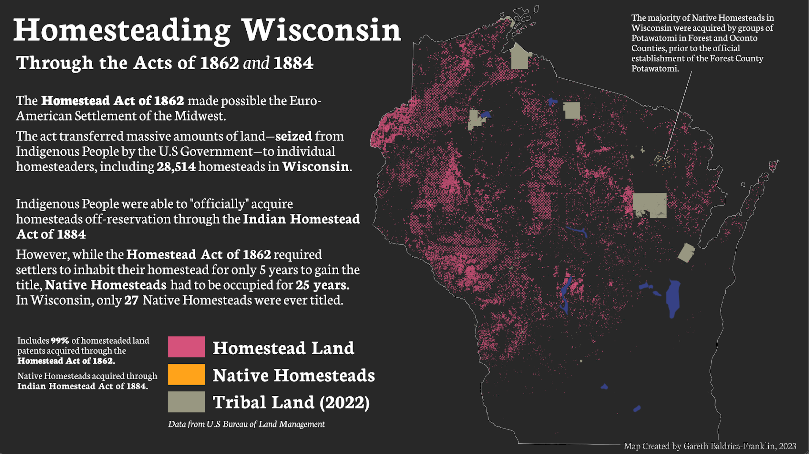
The Homestead act in Wisconsin

Slide 12
Examining Primary documents
Individually review text of the original homestead act
  Highlight key words, phrases, or passages – what jumps out at you?
Discussion questions
  Who was the Homestead Act intended for?
  Who was excluded from the Homestead Act?
  What was the perceived value/importance of land? Of a home? Of property ownership?
  How have our views of property ownership changed, if at all?
Notes:
- have them look at Steve’s book and how the Ho-Chunk used it
- have them look at the Forest County Potawatomi website about the Indian Homestead Act
- have students go to the BLM website to look at actual homestead act land patents (for example, have them look at Forest County, WI - look to see if this case recorded race or tribe on land patents)

Slide 13
Explore the Bureau of Land Management Database
Individually visit the Bureau of Land Management Database
  https://glorecords.blm.gov/default.aspx
  “Search Documents”
    State: Wisconsin (explore other states/counties)
    Authority: “Homestead Original Entry [May 20, 1862] (12. Stat. 392)” OR “Indian Homestead Fee Patent [May 20, 1862] (12. Stat. 392)” OR “Indian Homestead Trust [May 20, 1862] (12. Stat. 392)”
    “Search Patents”
Were there any homesteads taken in the county/state you are from?

Slide 14
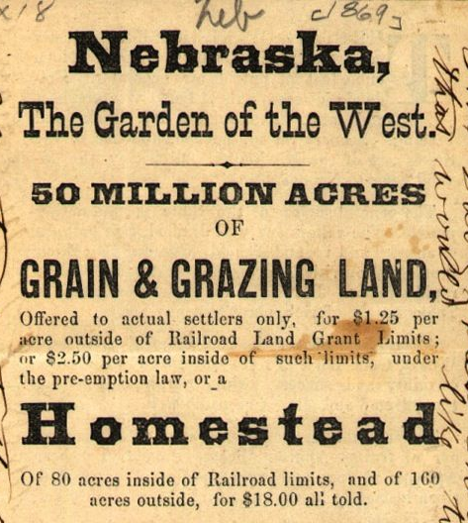
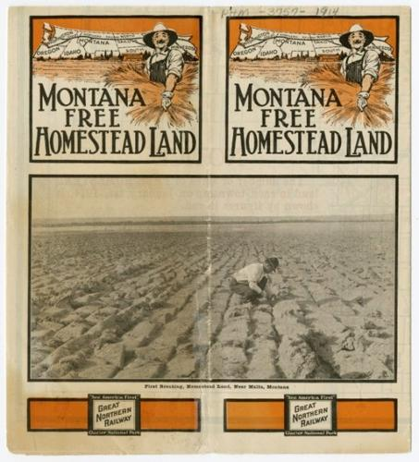
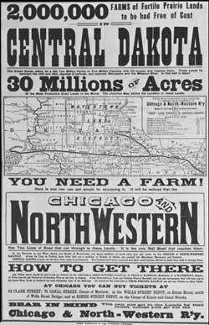
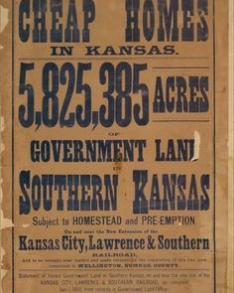
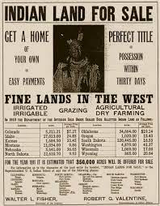
How should we think about the homestead act and Indigenous Dispossession today?
Promotional materials published in newspapers to encourage settlement via the Homestead Act

